Slide 1


2016 Procurement Framework
Overview: Procurement Framework, Complaints review mechanism, other types of complaints
Private Sector seminar
April 2018

Slide 2

Procurement Framework: Key Features
Modern procurement practice
Risk-based and proportionate
Fit-for-purpose/ Strategic planning
Emphasis on value-for-money (VfM)
Offers more options to meet the clients’ and private sector needs
Encourage the right companies to participate
Leads to enhanced development outcomes

Slide 3
Procurement Framework: Key Innovations
BETTER OUTCOMES
More upfront analysis and design
Shifts focus from the lowest evaluated compliant bid
Promotes strategic engagements with providers in highest risk operations
Enables hands-on expanded implementation support
Improved approach to resolving procurement-related complaints
Provides more options for tailored procurement approaches
Enables the use of sustainable procurement criteria
Value for Money as a core procurement principle
Slide 3

Slide 4
Complaints Mechanism: Fulfilling Different Objectives
    Articles of Agreement:
    Ensuring that the Bank’s fiduciary function is fulfilled, avoiding undue delays in and disruptions to the project implementation (Development effectiveness)
    Procurement Vision:
    “Procurement in IPF operations supports Borrowers to achieve value for money with integrity in delivering sustainable development”

Slide 5

Complaints Mechanism: Regulatory Framework
Articles of Agreement IBRD & IDA
Policy: Core Procurement Principles & Governance
Directive: Section III.G
Procedure: Section III & Annex II
Procurement Regulations
Guidance “How to Complain”

Slide 6
Overview: Handling complaints: Possible scenarios
  Complaints may be handled under three (3) possible scenarios:
  1. if acceptable by the Bank, national procurement procedures when approaching national market. Complaints to be handled in accordance with the Borrower’s national procurement complaints review procedures, as agreed by the Bank
  2. Alternative Procurement Arrangements (APA)
  Complaints to be handled in accordance with the applicable procedures, as agreed by the Bank
  3. Complaints arising under contracts where Bank SPDs are required to use
  Procurement Regulations (paragraphs 3.26-3.31 and Annex III) govern the handling of complaints related to contracts where Bank’s SPDs are required to be used, or where no SPDs exist, documents and conditions of contract acceptable to the Bank

Slide 7
Overview: Complaints when Bank’s SPDs are required to be used (group (3) of Complaints)
Seek to implement the overarching objectives noted above
List 4 requirements for a complaint to be eligible for the review process set out in Annex III of the Procurement Regulations
Describe the review process and set out timelines requirements
Set out roles and responsibilities for complainants, Borrowers and the Bank

Slide 8
Overview: Other Types of Complaints
  These are handled through the appropriate mechanisms existing within the Bank
  GRM in OPCS, is a complaint mechanisms through which project affected people and communities may raise their concerns directly with Bank management, when they believe a Bank-funded project has caused them harm
  The Inspection Panel is an independent complaints mechanism for people and communities who believe that they have been, or are likely to be, adversely affected by a World Bank-funded project

Slide 9
Overview: Fraud and Corruption
  Any complaint that includes allegations of Sanctionable Practices (Fraud and Corruption) requires special treatment
  Irrespective of whether the contract is subject to prior or post review, the Bank shall apply due care and discretion on the extent of sharing information with the Borrower
  Complaints alleging Fraud and Corruption are reported to INT
    References: Bank’s Anti-Corruption Guidelines and Sanctions Framework. See Annex IV to the Procurement Regulations

Slide 10


Complaints when the Bank’s SPDs are required to be used

Slide 11
Four (4) Essential Requirements
  Who can complain?
  Complainant must be an ‘interested party’
  2. What can be challenged?
  The circumstances giving rise to the complaint must be relevant to the procurement - there are 3 (three) relevant circumstances
  When to complain?
  Complaints must be filed in a ‘timely manner’ - Regulations set out the time limits that apply
  What information to include?
  Regulations prescribe the minimum information that must be included in the complaint for it to considered
Slide 11

Slide 12
The four
ESSENTIALS
  1. Who can complain?
‘interested party’ means either:
a potential participant in a procurement opportunity, or
an actual participant
‘potential’ or ‘actual’ depends on:
the stage that the procurement process has reached when the complaint arises
what action, if any, the interested party has taken in relation to the procurement process
Example: potential participant
RFB advertised, and party is interested in submitting a bid, but has not yet done so
Example: actual participant
A firm that submitted a bid under RFB
Slide 12

Slide 13
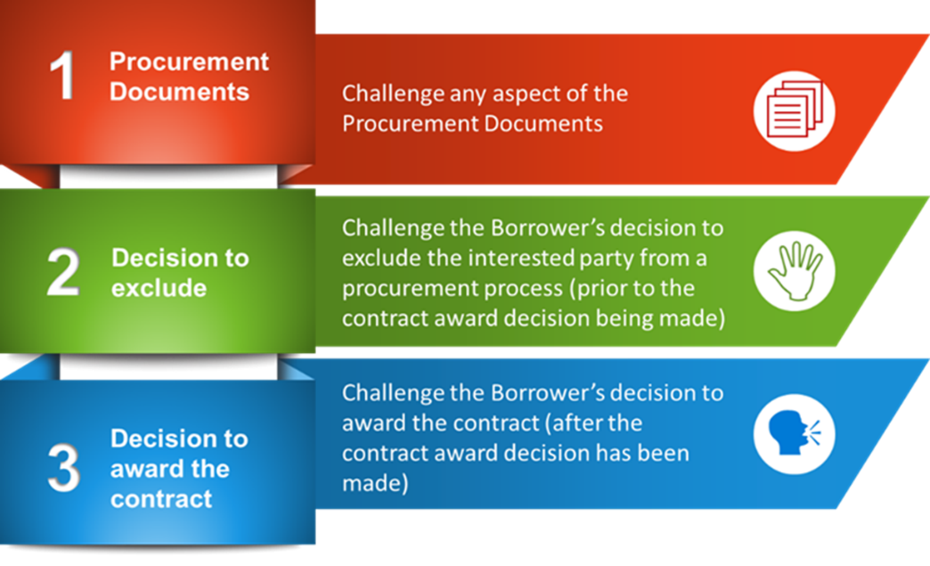
The four
ESSENTIALS
  2. What can be challenged?
Regulations identify 3 circumstances that complaints may challenge:
Slide 13

Slide 14
What can be challenged? Examples
1. Procurement Documents
      Prequalification document
      Initial Selection document
      Request for Bids or Request for Proposals
      Addenda to any of the above documents
2. Decision to Exclude
      not qualifying in a Prequalification
      not being selected in an Initial Selection
      being eliminated from a multi-stage procurement process
      not passing the minimum technical qualifying mark in consulting services
    3. Decision to award a contract
Slide 14

Slide 15
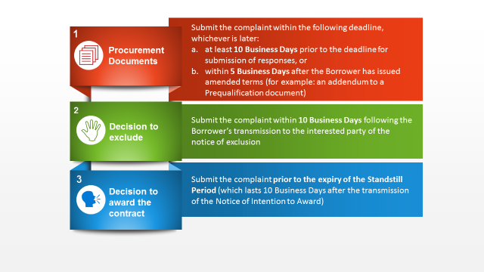
The four
ESSENTIALS
  3. When to complain?
In a timely manner: “Timely” depends on what is being challenged
Slide 15

Slide 16
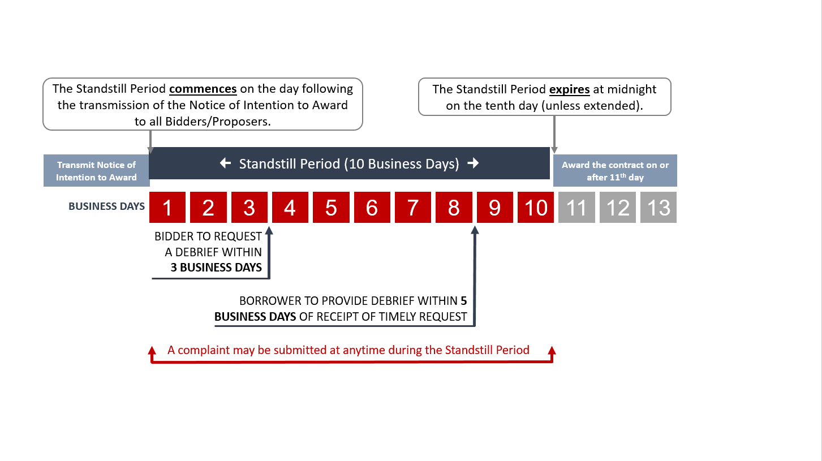
Standstill Period Timeline
Slide 16

Slide 17
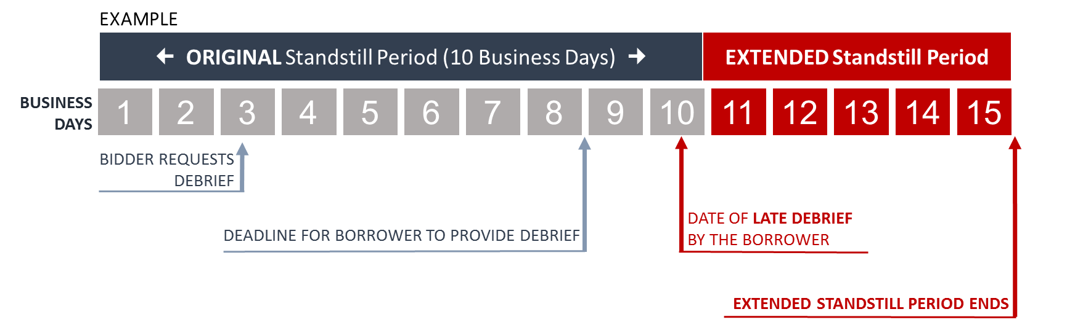
Extended Standstill Period
Bidder/Proposer submits request for a debriefing
Borrower decides for justifiable reasons to provide debriefing outside of 5 Business Day timeframe
Standstill Period extended to 5 Business Days after the debriefing takes place (or if multiple debriefings, 5 Business Days after the last debriefing)
Slide 17

Slide 18
The four
ESSENTIALS
  4. What information to include?
Regulations describe the minimum information to be included:
the identity of the complainant
contact details and address
interest in making the complaint
identify the procurement activity
details of any previous communications
nature of complaint and perceived adverse impact on the complaining party
state the alleged inconsistency with or violation of the applicable procurement rules
Slide 18

Slide 19
Submitting a Complaint
  SPDs provide instructions to bidders/proposers on how, where and when to file a complain
  Form of Notification of Intention to Award provides among others instructions on how to file a complaint challenging award
  Complaints must be submitted to the Borrower
  This is the entity and the official designated for that purpose in the respective Procurement Document
  If sent to the Bank, the complaint will be forwarded to the Borrower promptly
  Must be submitted in writing (preferably by the quickest means available to be able to meet the timelines). E.g.
  Email, fax, or
  Borrower’s e-procurement system, if applicable
Slide 19

Slide 20
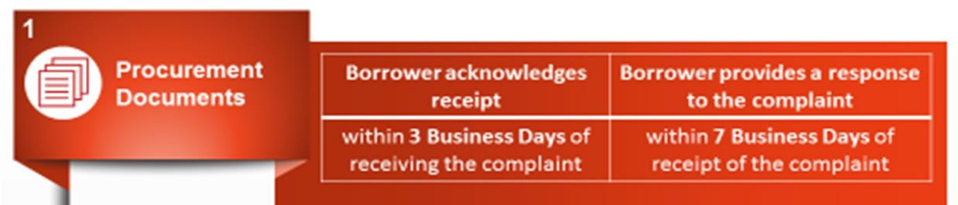

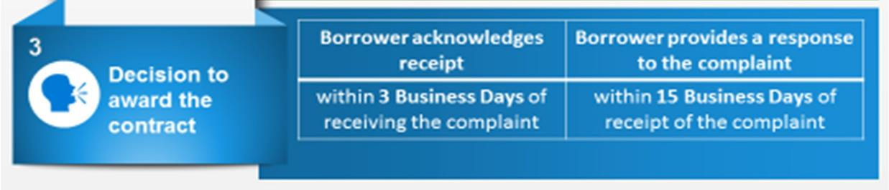
Borrower’s Response
  If complaint meets all 4 requirements the Borrower will manage it within these timelines:
Slide 20

Slide 21
Borrower’s Response (cont.)
  Borrower must provide sufficient information in its response. As a minimum, the response shall include:
  statement of issue/s
  statement of facts and evidence
  the decision and the basis for the decision
  an explanation of the basis for the decision
  conclusion: statement of the resolution of the complaint and a statement of the next steps, if any
Slide 21

Slide 22
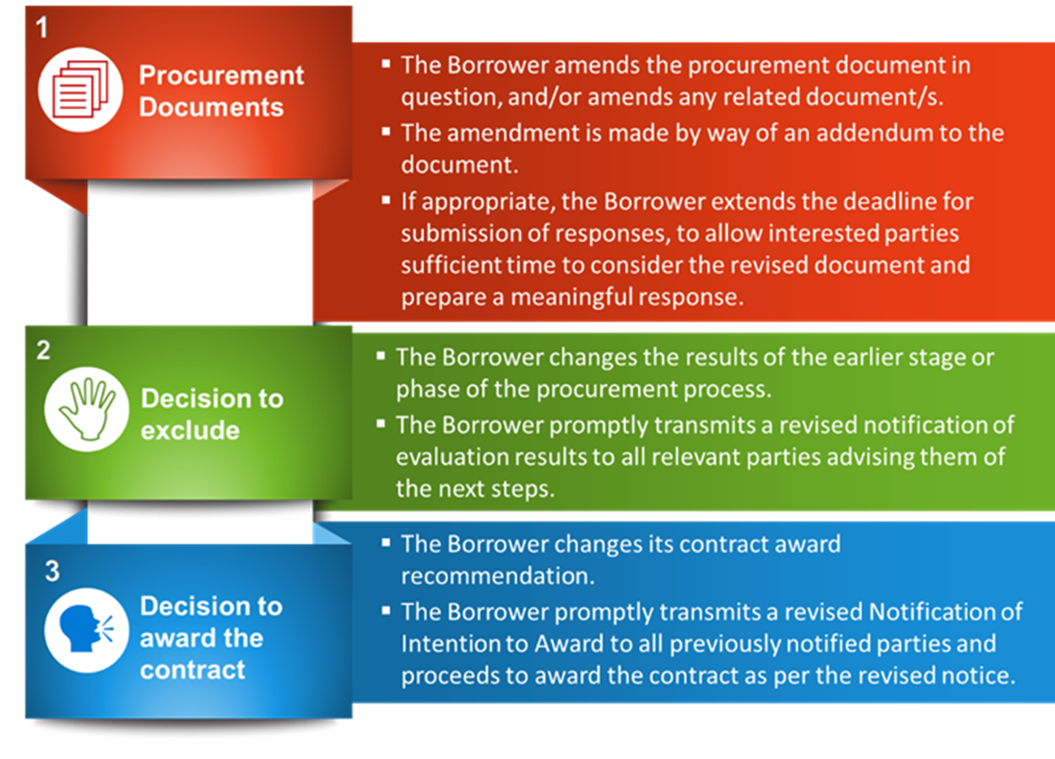
Actions by Borrower if Complaint is upheld
  Borrower’s actions if complaint is upheld include:
Slide 22

Slide 23
Complaints Where the Contract is subject to the Bank’s Prior Review
  The Borrower shall
    Promptly inform the Bank of a received complaint
    Provide all information and documentation pertaining to the complaint, including a draft response once it is available
  If the complaint results in…
    Modification of the procurement documents,
    Borrower’s changing its decision to exclude a bidder/proposer prior to award
    Borrower’s changing its contract award recommendation
  the Borrower shall take any of the above actions upon receiving the Bank’s confirmation of satisfactory resolution of complaint
  The Borrower shall not proceed with the next phase of the procurement process or with the award of contract, without having received the Bank’s confirmation of satisfactory resolution of complaint
Slide 23

Slide 24
Debriefing by the Borrower
An unsuccessful Bidder/Proposer/Consultant has three (3) Business Days to make a written request to the Borrower for a debriefing
Borrower shall provide a debriefing to all unsuccessful Bidders/Proposers/ Consultants within five (5) Business Days, if the request is received within the above deadline:
  unless the Borrower decides, for justifiable reasons, to provide the debriefing outside this timeframe;
  in that case, the Standstill Period shall automatically be extended until five (5) Business Days after such debriefing is provided
    If more than one debriefing is so delayed, the Standstill Period shall not end earlier than five (5) Business Days after the last debriefing takes place
Slide 24

Slide 25
Debriefing by the Borrower (cont’d)
  By the quickest means available, Borrower shall promptly inform all Bidders/Proposers/Consultants of the extended Standstill Period
For contracts subject to prior review, the Borrower shall simultaneously send the information on the extended Standstill Period to the Bank
Slide 25

Slide 26
Debriefing by the Borrower (cont’d)
In case of requests for debriefing received by the Borrower later than the three (3) Business Day deadline, the Borrower should provide the debriefing as soon as practicable, and normally no later than fifteen (15) Business Days from the date of publication of Contract Award Notice
  Debriefing shall repeat the information contained in the Notification of Intention to Award, and respond to any related question(s) from the unsuccessful Bidder/Proposer/Consultant
Slide 26

Slide 27
Debriefing by the Borrower (cont’d)
Debriefing shall not include:
  point-by-point comparisons with another Bidder’s/Proposer’s/Consultant’s bid/proposal
  information that is confidential or commercially sensitive to other bidders.
  A written summary of each debriefing shall be included in the official procurement records, and copied to the Bank for contracts subject to prior review
Slide 27

Slide 28
Debriefing by the Bank
After publication of the Contract Award Notice, a Bidder/Proposer/Consultant who has not received satisfactory explanation from the Borrower may request a meeting with the Bank
Such request is to be addressed to Accredited Practice Manager (Procurement) for the Borrower’s country, who will arrange a meeting at the appropriate level and with relevant staff
The purpose of such meeting is not to discuss the Bids/Proposals of competitors or the Bank’s position that has been conveyed to the Borrower
Slide 28

Slide 29
Complainant’s Roles and Responsibilities
  Comply with the complaints submission process described in the Regulations
  Be familiar with the Procurement Document (e.g. RFB or RFP) and Regulations and understand the rules governing the procurement process
  Make a timely request for a debriefing, if one is desired
  Submit the complaint within the permitted timeframe and to the Borrower
  Ensure the complaint is specific i.e.:
  explains the issues or concerns
  identifies the alleged violation (e.g. of the Procurement Regulations, or Procurement Document process)
The Bank has prepared a Guidance How to Complain posted in the World Bank’s website.
Slide 29

Slide 30
Borrower’s Roles and Responsibilities
  Provide timely and sufficient information to the complainant
  Promptly acknowledge complaints received
  Resolve complaints promptly and fairly
  Preserve other parties’ confidential information
  Maintain records of the complaint
  Where contract is subject to prior review:
  promptly inform the Bank of the complaint and provide copies of all relevant documents and information, including a draft response to the complaint
  consult with the Bank promptly and forthrightly throughout the complaint review and resolution process
Slide 30

Slide 31
Bank’s Roles and Responsibilities
  Ensure that a complaint addressed to the Bank is forwarded promptly to the Borrower for review and resolution
  Prior review: timely consideration of any action proposed by the Borrower including:
  conduct and content of debriefing
  denial of a complaint
  taking action to correct the impropriety
Slide 31

Slide 32

Questions?

Slide 33

  Contact for World Bank Procurement Framework:
  Enzo de Laurentiis Diomedes Berroa
  Chief Procurement Officer Lead Procurement Specialist
  Elaurentiis@worldbank.org dberroa@worldbank.org
  Tel: +1-202-473-0538 Tel: +1-202 458-9432
  World Bank Group
  1818 H Street NW
  Mail Stop MC 10-1018
  Washington DC 20433
  USA
  Procurement Website

