Slide 1
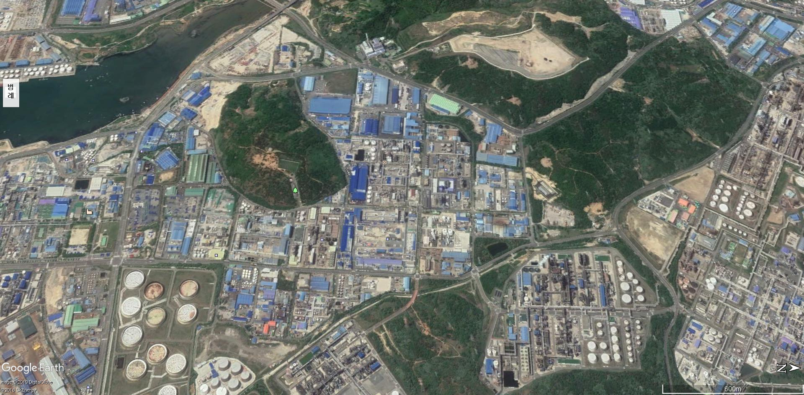
Korean representative EIP business model
Ulsan-Mipo National Industrial Park
(Yongyeon Area, Ulsan City)
 | Benefit
Investment cost | 96.3 million USD
Revenue | 49.7 million USD/yr
Energy saving | 104,262 toe/yr
CO2 reduction | 272,137tCO2/yr
Sungam # 1
Sungam # 2
HP Steam
30 ton/hr
MP Steam
20 ton/hr
HP Steam
15 ton/hr
MP Steam
20 ton/hr
LP Steam
25 ton/hr
Hyosung #1
HP Steam
20 ton/hr
SK energy
HP Steam
70 ton/hr
LP Steam
20 ton/hr
MP Steam
10 ton/hr
Hyosung #2
SK chemical
Eastman fiber
KP chemical
Waker chemical
Duckyang
HP Steam
60 ton/hr
Hanhwa chemical
Hyosung #3
HP Steam
25 ton/hr
SK advance
Total
HP Steam
30 ton/hr
HP Steam
50 ton/hr
Korea PTG
SK energy #2 FCC
MP Steam
10 ton/hr
SKC

Slide 2
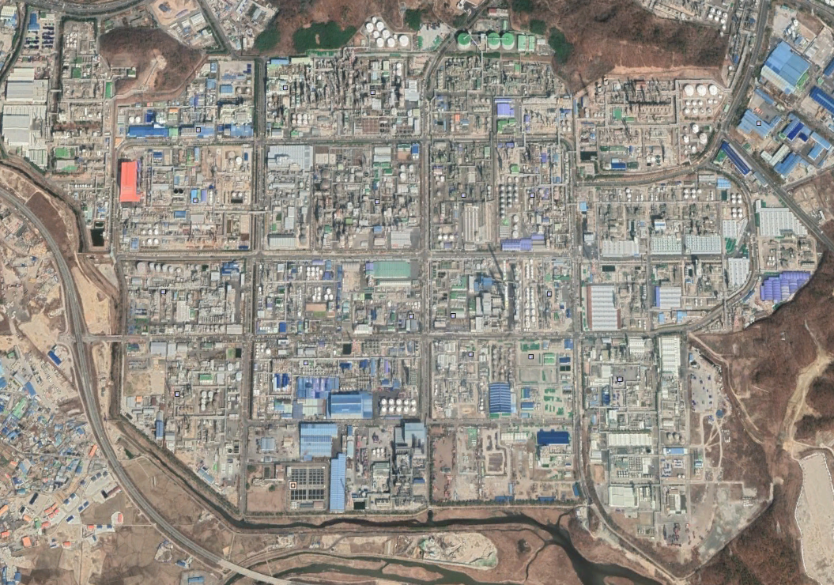
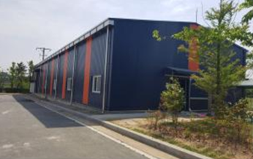
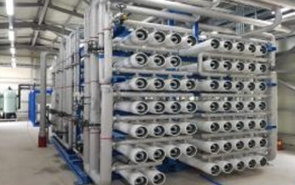
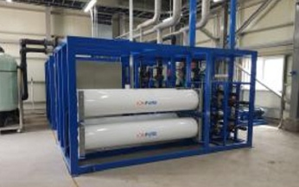
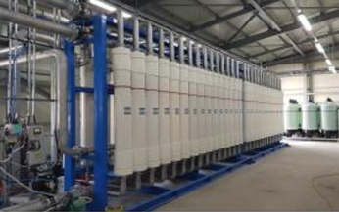
Korean representative EIP business model
(Water Optimization in Yongyeon Area)
 | Business Cost | Capacity | Supply Target
1st Business | 4 million USD | 2,400 ton/day | Lotte BP Chemical, Ulsan Sungam Incineration facility
2nd Business | 19 million USD | 14,400 ton/day | 5 companies in Ulsan Petrochemical industrial park
Korea Ineos Styrolution
Lotte Chemical
Hanhwa Solution
Hanhwa Chemical
Lotte BP Chemical
Nexlene
Sungam # 1

Slide 3
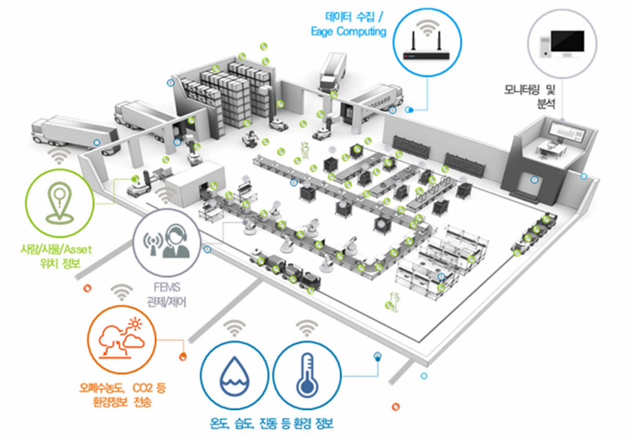
Smart Factory Concept
Data Collecting/
Monitoring/ Analysis
Worker/ Things/ Asset
location information
/ Control
Waste water Concentration, CO2 Information
Temp., humidity, information

Slide 4
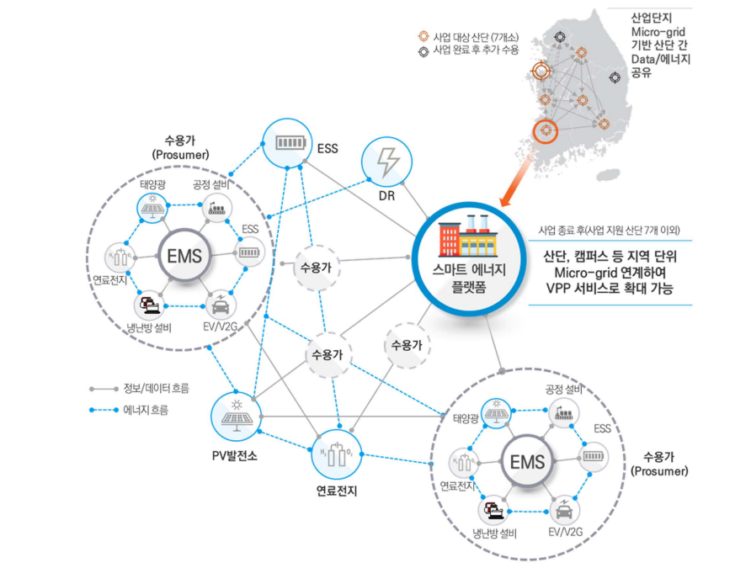
Smart Green Industrial Park
PV
Infra
FC
Smart Energy
Platform
AC
Info./Data flow
Energy flow
PV
Infra
Photovoltaic generation
Fuel Cell
FC
AC

