Slide 1
KIGALI, MAY 19, 2019
COUNTRY WORKSHOP ON READINESS FOR THE 4th INDUSTRIAL REVOLUTION

Slide 2
Theme 2
(Discussion Leader: Marito Garcia, PhD)
Higher Education and TVET Courses
WHAT TYPES OF NEW COURSES SHOULD BE INTRODUCED?

Slide 3
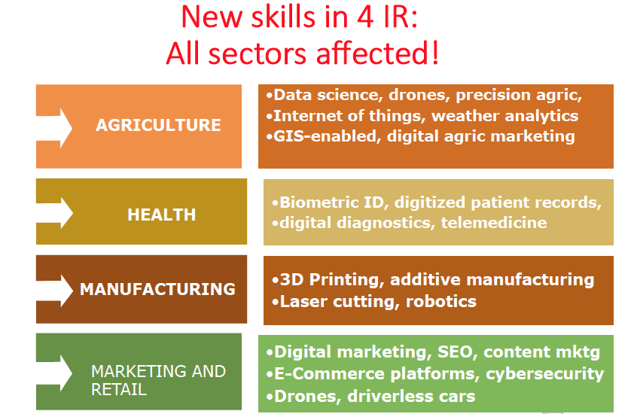
Theme 1-Sajitha

Slide 4
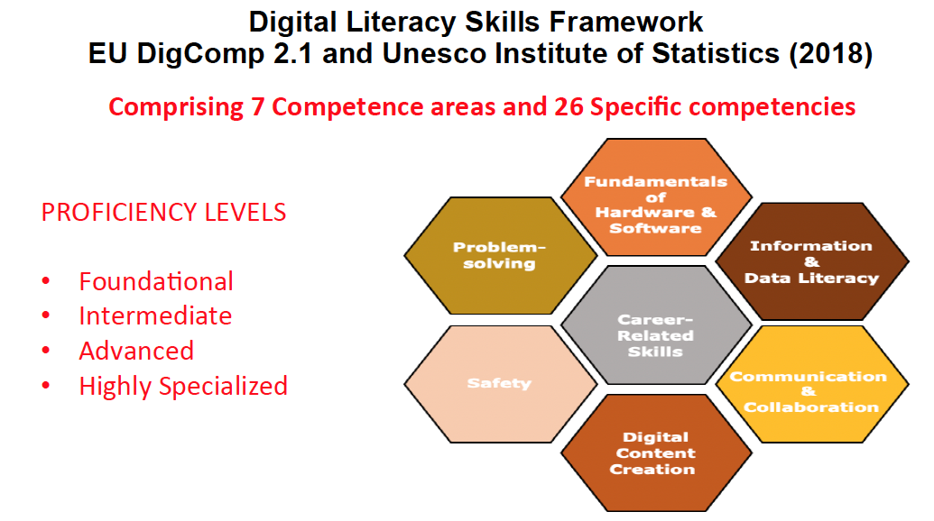
KIGALI, MAY 19, 2019

Slide 5
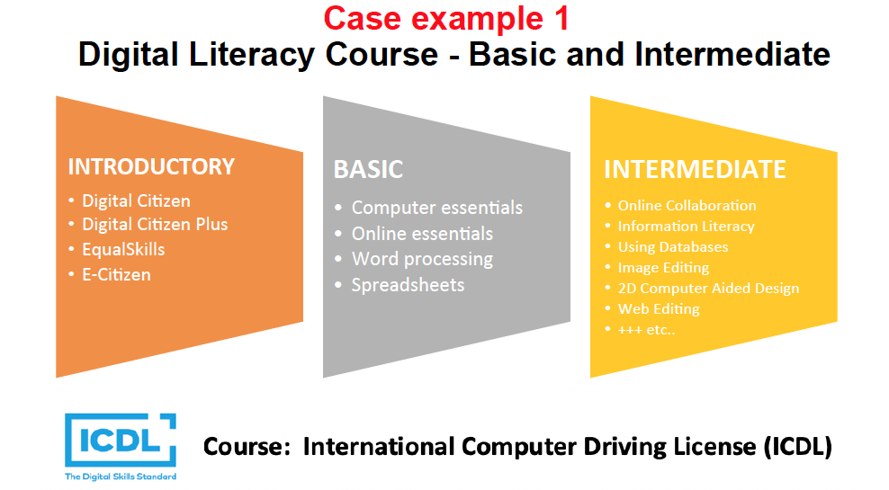
KIGALI, MAY 19, 2019

Slide 6
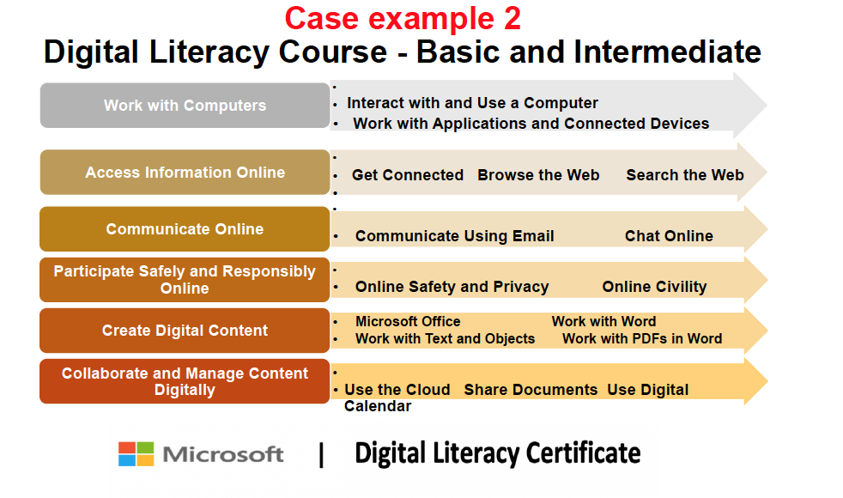
KIGALI, MAY 19, 2019

Slide 7
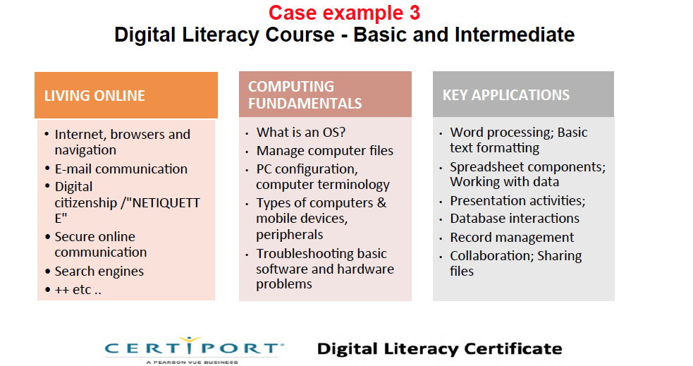
KIGALI, MAY 19, 2019

Slide 8
Case example
TVET - MECHATRONICS
LEVEL 2
Siemens Certified Mechatronic Systems Associate
Introduction to Totally Integrated Automation
LEVEL 1
Siemens Certified Mechatronic Systems Assistant
Electrical Components
Automation systems
Motor control
Mechanics and machine elements
Manufacturing processes
Mechanical Components and Electric Drives
(Electro) Pneumatic and Hydraulic Circuits
Digital Fundamentals and PLCs

Slide 9
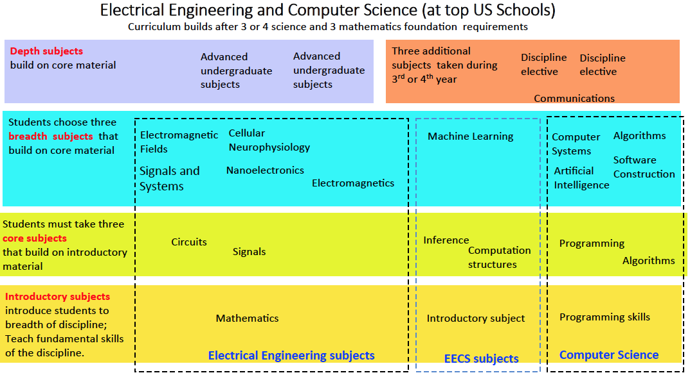
Case example 4: Advanced and highly specialized

Slide 10
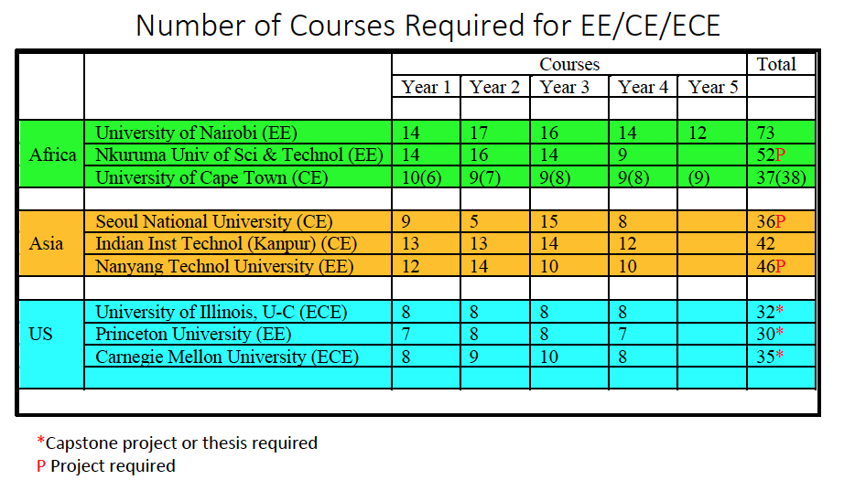
US vs. African engineering: Most African universities do not require capstone (thesis or project)

Slide 11
Advanced & highly specialized courses in the 4 IR
Information and communications technologies
Data science and artificial intelligence,
Quantum computing, and mobile computing,
Adaptive learning technologies,
Machine learning, cloud storage technology,
5G mobile technology,
Blockchain,
Virtual and augmented reality,
Internet of things, internet of living things
Cybersecurity.
Physical and biological technologies
Biotechnology and genome editing,
Advanced robotics,
3-D printing and additive manufacturing,
Nanotechnology and new materials
Renewable energy capture, storage and transmission,

Slide 12
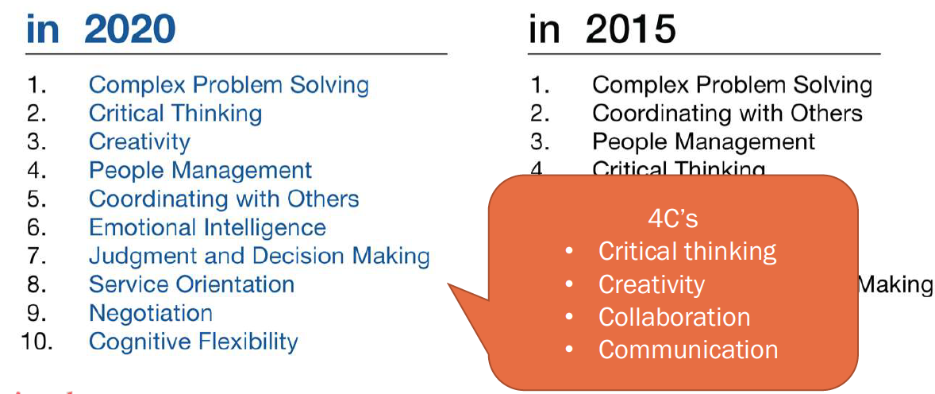
Top 10 soft skills in 4 IR
SOURCES: World Economic Forum (2015), World Bank (2019)

Slide 13
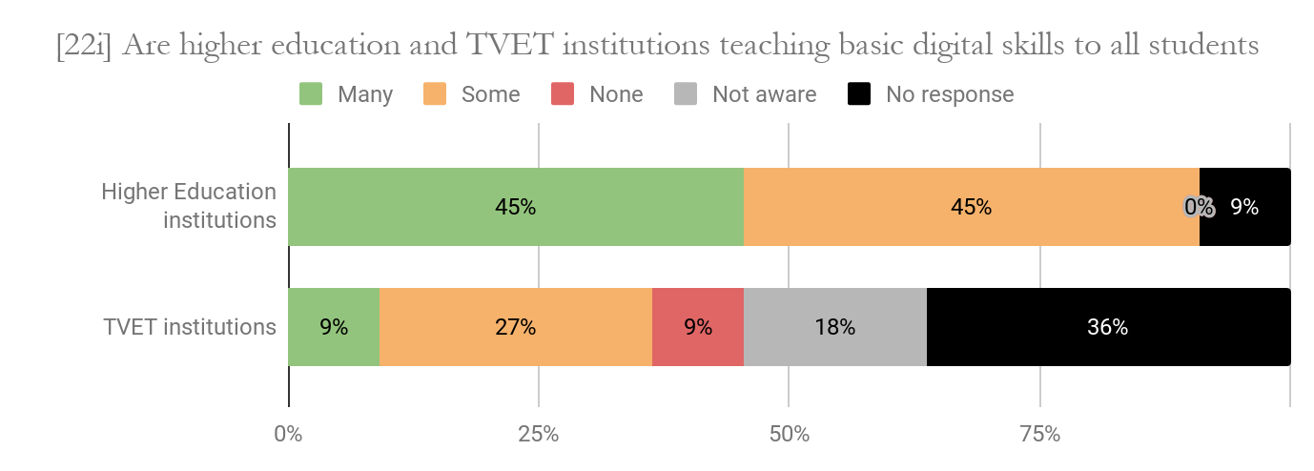
Are universities and TVET teaching basic digital skills? Survey of 22 African countries.

Slide 14
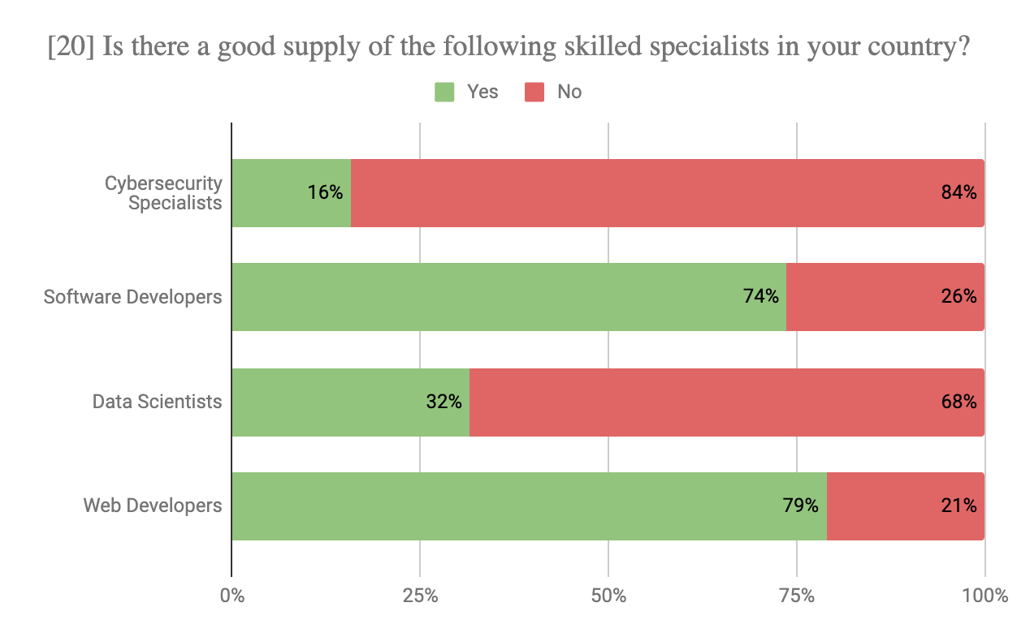
Skills and competencies in Africa today: Survey of 22 countries

Slide 15
Survey of 22 African countries:
What courses currently offered?
A.I.-Data science -- Ethiopia, Cameroon, DRC, Tanzania,
Kenya, Togo, Rwanda
Cybersecurity -- 14 out of 22 countries
Robotics -- Burkina Faso, Senegal, Kenya, Somalia, Ethiopia
Web design -- Nigeria, Cameroon, Cote D’Ivoire, Kenya,
Rwanda
3-D Printing -- Senegal, Kenya, Cameroon, Nigeria, Rwanda
Mauritius, Ghana
Internet of things -- Tanzania, Rwanda, Nigeria, Kenya, Ghana
E-Commerce -- Cote D’Ivoire, Kenya, Nigeria, Ghana
IOT --Mauritius, Kenya

Slide 16
Survey of 22 African countries:
Soft- skills courses currently offered?
(Critical thinking, creativity, collaboration, communication)
ONLY 6 of 22 COUNTRIES WITH POSITIVE RESPONSES
Senegal -- Ethics, communications, ethics, personal
development
Somalia -- Human-centered approaches to problem solving
Benin -- Psychology of work and organizations, course in
negotiations, theory of organizations
Nigeria -- Science of organizations, entrepreneurship
Kenya -- Communications skills, critical and creative thinking,
Diversity, ethics and citizenship
Mauritius --Critical thinking, problem solving, communications skills

Slide 17
Key questions for discussion
Highlights from experience of countries that offered new courses?
Key constraints in scaling up?
What assistance in technical and financial areas?
Any capacity building issues?

Slide 18
Theme 4
(Discussion Leader: Marito Garcia, PhD)
USING EDUCATION TECHNOLOGIES IN
HIGHER EDUCATION AND TVET

Slide 19
Education technologies: A Taxonomy in formal schooling

Slide 20
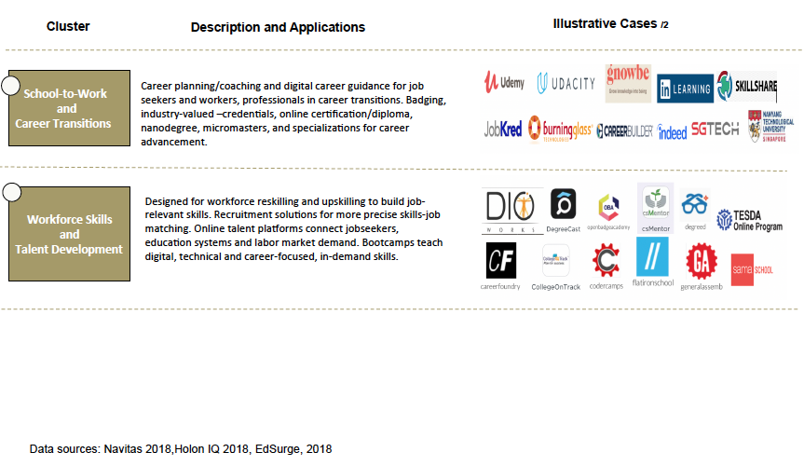
Education technologies: A taxonomy for workforce skills development

Slide 21
Examples of online course platforms
As of 2018 over 101-million learners worldwide used MOOCs online courses

Slide 22

EXAMPLES OF ONLINE COURSE PROVIDER UNIVERSITIES
in the U.S. – on Coursera Platform

Slide 23
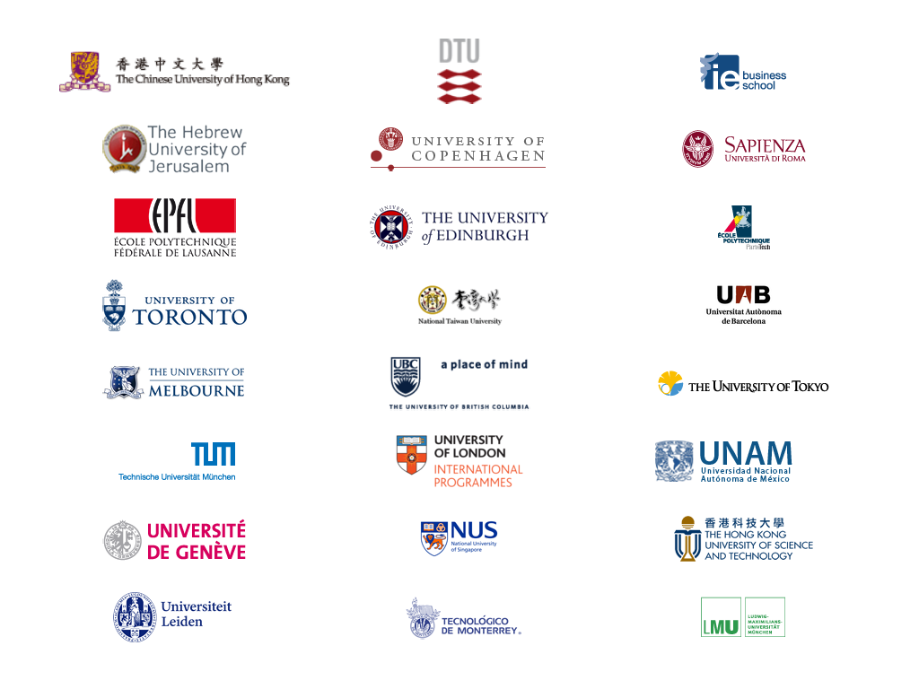
EXAMPLES OF ONLINE COURSE PROVIDERS
FROM ASIA, EUROPE, LATIN AMERICA on Coursera Platform

Slide 24
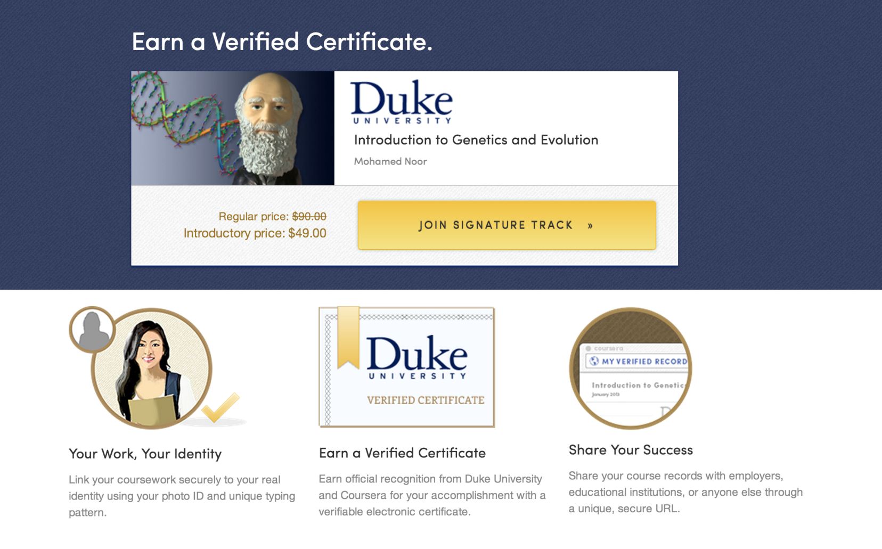
Certification Online:
Coursera with Partner Universities
Signature Track Courses

Slide 25
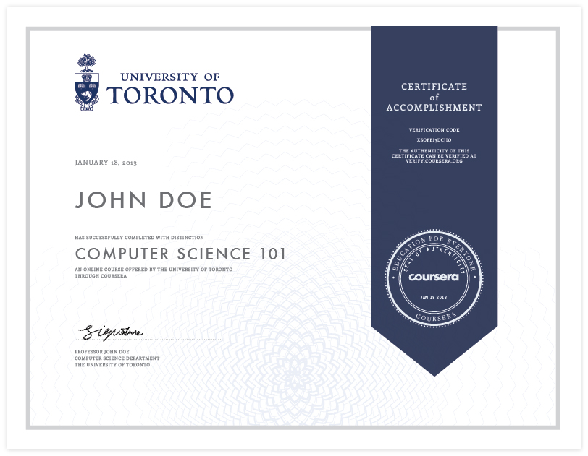
Certification Online: Coursera with Partner Universities

Slide 26
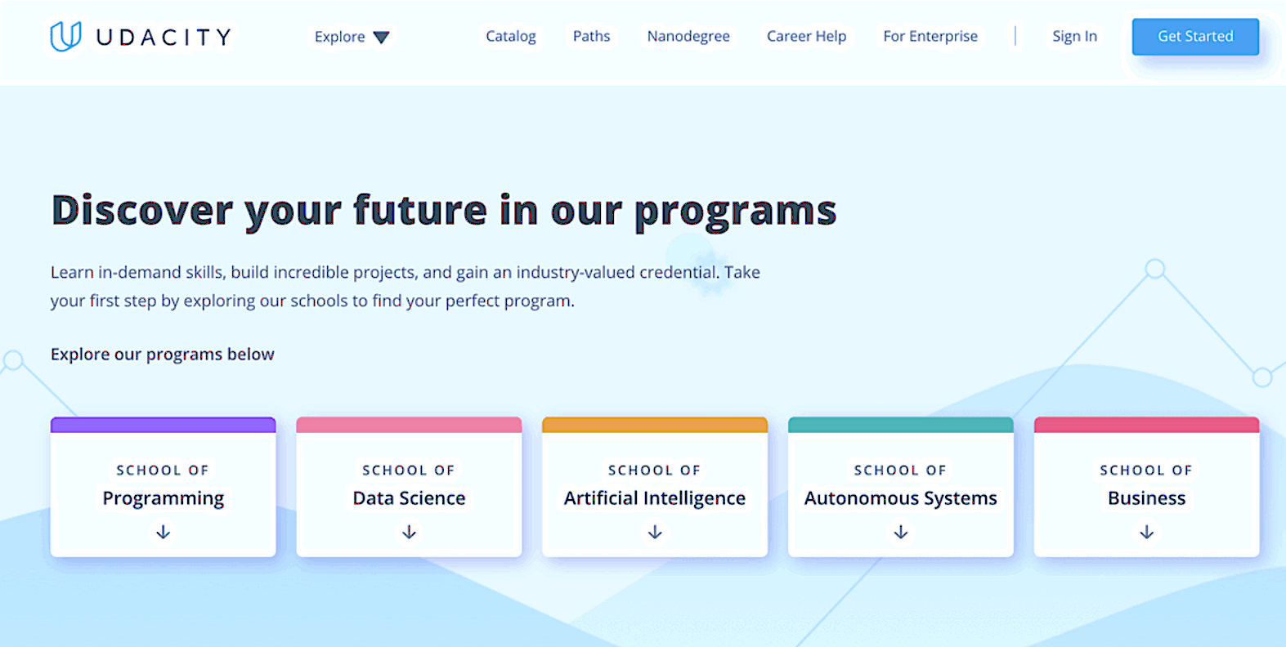
Udacity courses co-created with private companies

Slide 27

Diverse Marketplace of over 100,000Courses: Udemy
Broad content library spans huge variety of topics

Slide 28
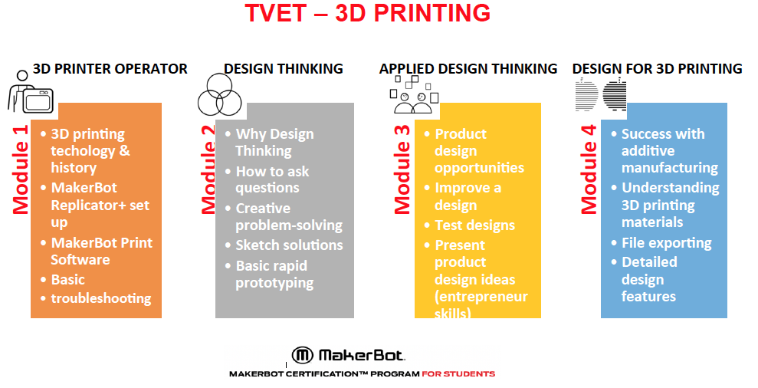
Case example TVET
COUNTRY WORKSHOP ON READINESS FOR THE 4th INDUSTRIAL REVOLUTION

Slide 29
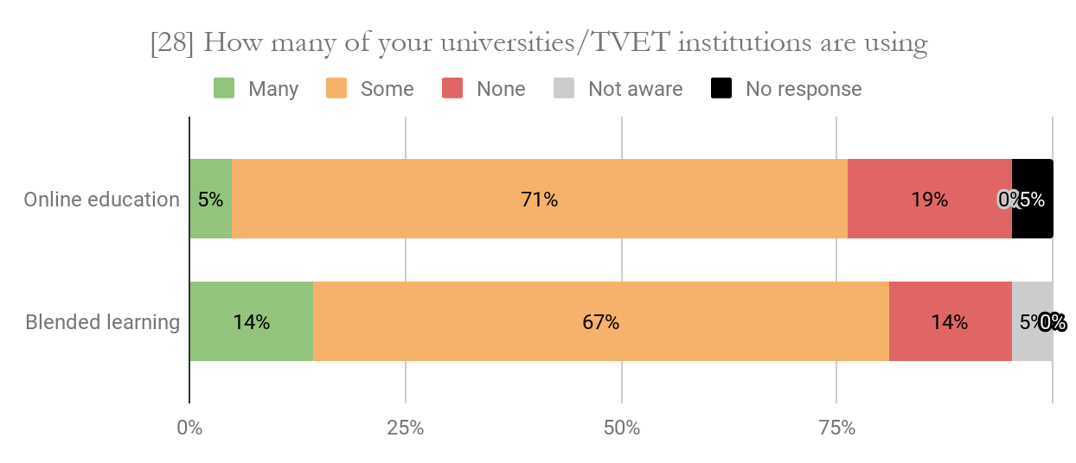
Survey of 22 African Countries
Are universities/TVET using online courses?

Slide 30
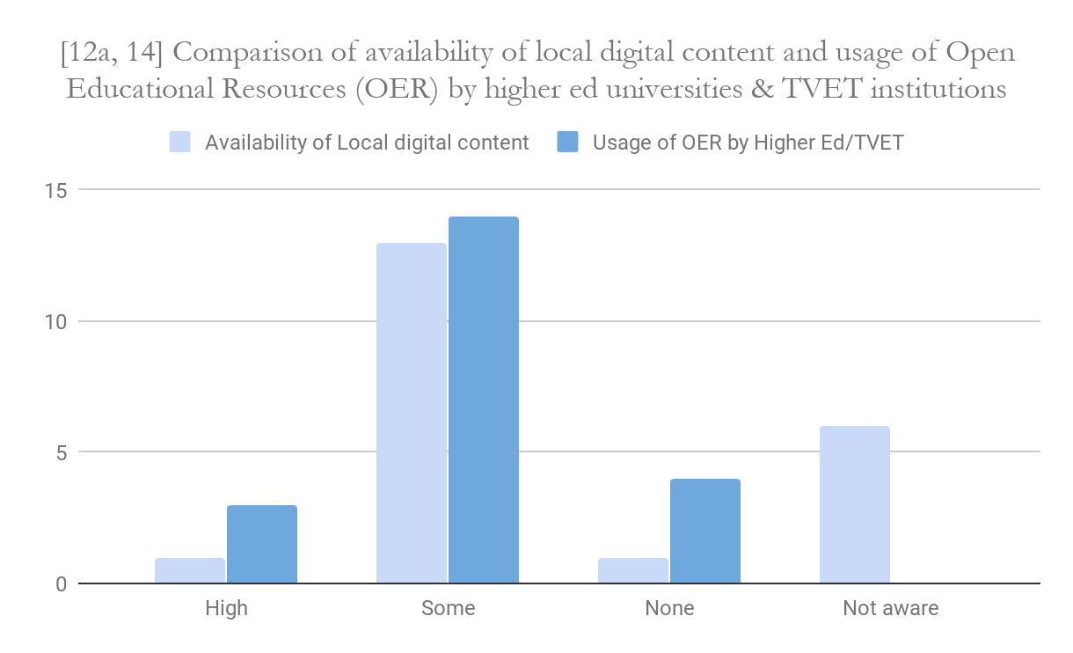
Survey of 22 African Countries
Are universities/TVET digital content and OER?

Slide 31
Survey of 22 African countries:
Education technology currently used?
Digital content platforms --Used in 17 of 22 countries
Online learning platforms -- Tanzania, Kenya, Mozambique,
Nigeria, Rwanda, Somalia,
Senegal, Mauritius, Ghana
Learning mgt systems (LMS) -- Somalia, Cote D’Ivoire, Congo Brazza,
Transition school to work --No country reported use of
digital counseling, guidance
MOOCs used -- Benin, Kenya, Somalia, Nigeria

Slide 32
Survey of 22 African countries:
Education technology for school management and administration
Student ID and Info --Used in 16 of 22 countries
Admission system --Ethiopia, Tanzania, Kenya, Sierra Leone,
Benin, Cameroon, Cote D’Ivoire, Mali,
Senegal, Mauritius
Scholarship admin -- Togo, Senegal, Sierra Leone, Tanzania,
Certification, assessment—Tanzania, Mozambique, Nigeria, Guinea
Mauritius, Ghana
Student loan admin ---Tanzania, Kenya, Ethiopia
University campus mgt --- Sierra Leone, Mozambique, Kenya, Ghana,
Mauritius

Slide 33
Survey of 22 African countries:
Main barriers to scale up of education technology?
Insufficient connectivity
and bandwidth 18 of 22 countries
Need strategic national plan 10 of 22 countries
Financial constraints 10 of 22 countries
Lack of teachers training 10 of 22 countries
Lack of power/electricity 7 of 22 countries

Slide 34
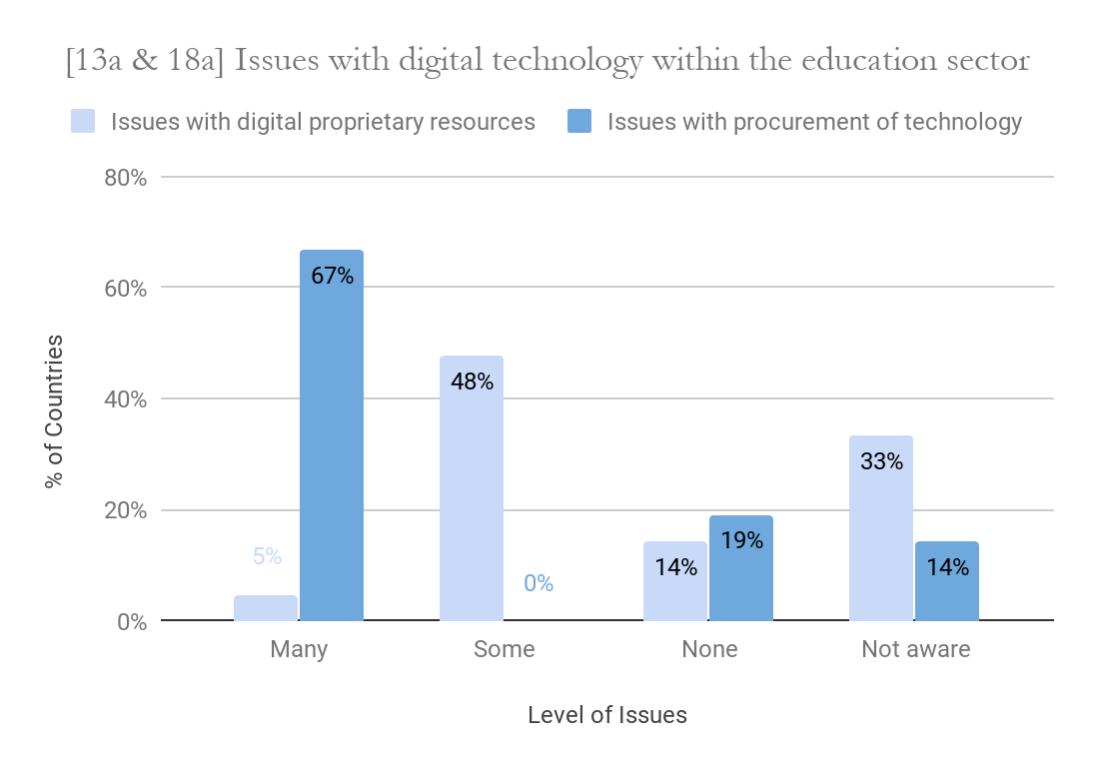
Survey of 22 African Countries
Issues with digital proprietary resources? And Procurement?

Slide 35
Issues to consider in scaling-up
What is the technology for?
Buy-in from faculty
Investing in technical support especially training on blended learning
Local content creation
Data privacy and data security

Slide 36
Key questions for discussion
Highlights from countries that applied education technologies?
Key constraints in scaling up?
What assistance in technical and financial areas?
Procurement issues, capacity building issues?

