Slide 1





SESSION 2
Eco-Industrial Parks
7th October 2020 (Wednesday)
9:00am-10:30am (EDT)
Learning Series supported by

Slide 2
Agenda
Expected Takeaways
Link between circular economy and eco-industrial parks
Overview on the eco-industrial park framework
Enabling eco-industrial parks at national and park level

Slide 3
Circular economy is an “industrial economy”
Returns products, parts and materials into use several times
Based on principles that
Products are designed to last
Value is maintained for as long as possible
Generation of waste and pollution is minimized
Renewable energy is used along value chains, as much as possible
Enablers: Innovation, Stewardship, Partnership and Collaboration between businesses, governments, and consumers along value chains

Slide 4
Circular economy practices are “business practices”
Along global and domestic value chains
Eliminate/replace the product (-> single-use plastics)
Design phase
  Reduce amount of materials used
  Eliminate/replace hazardous chemicals
  Improve Durability / Reusability / Upgradability / Reparability / Recyclability
  Increase recycled content in products
  Products to use energy, other resources efficiently
Maximize resource efficiency in manufacturing
Optimize/intensify use of products
Enable remanufacturing
Regenerate biomass, recycle materials
After maximizing circularity everywhere else, recover energy from remaining waste
Circular economy practices strengthen resilience

Slide 5
An EIP is a breeding ground for circular economy practices
EIPs facilitate urban-industrial symbiosis on energy recovery from waste (e.g. heat and cooling districts)
Management entity of an EIP provides circular economy services to its tenant firms (e.g. R&D, maintenance, centralised waste collection, reuse and recycling)
Recycling facilities operating within EIPs create synergies with other firms
Organics-based firms in EIPs benefit from utility, by-product, supply chain, service synergies with other firms in the park for regeneration of biomass
EIPs provide testing ground for new circular economy enabling technologies and businesses for reuse, remanufacturing, intensifying product use
Resource efficient and cleaner production (RECP) and industrial synergies reduce resource use and waste from design to manufacturing

Slide 6
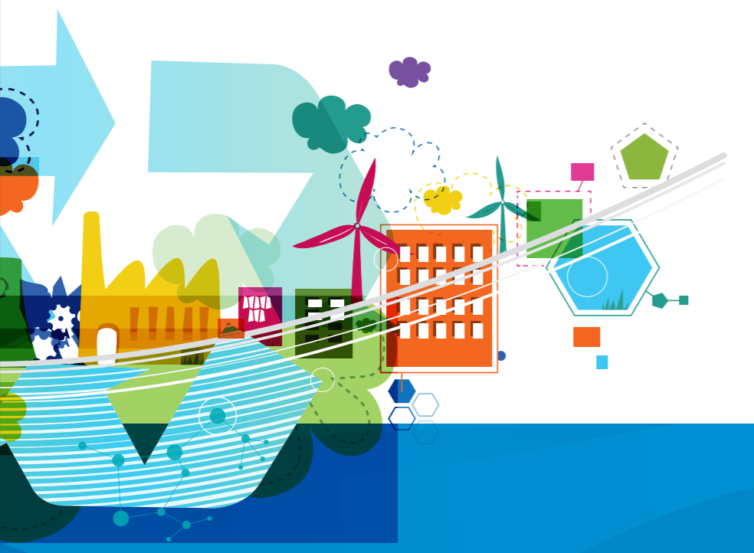
Key benefits of eco-industrial parks
When comparing an EIP to a traditional industrial park the main differences are in the following key benefits:
Reduced use of raw materials, water, energy and chemicals
Reduced waste through resource circularity
Minimized greenhouse gas emissions and release of pollutants
Reduced environmental, economic and social risks
Improved competitiveness and profitability
Creation of good-quality jobs
Improved workers health and safety
Increased quality of life for communities
Better access to new technologies and finances

Slide 7

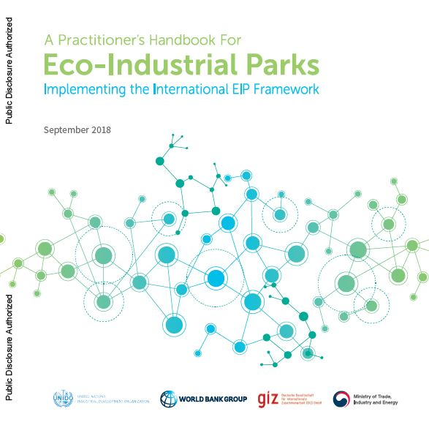
Towards an International Framework for EIPs
Over 16,000 downloads
1. An International framework for EIPs (2017 v.1; 2020 v.2*)
Attempt to create a standardized framework that can be implemented globally (applicable to both developed & developing countries).
Collaborative initiative of the World Bank Group (WBG), United Nations Industrial Development Organization (UNIDO) and the Deutsche Gesellschaft für Internationale Zusammenarbeit (GIZ) GmbH.
*The new release of the International Framework for EIPs is expected by December 2020
https://openknowledge.worldbank.org/handle/10986/29110
2. Implementing the Framework: A Practitioner’s Handbook (2018)
Provide a step-by-step guide on how to operationalize the framework, including on (1) how to develop a national approach for EIPs and (2) how to implement the approach (3) creating and managing industrial symbiosis networks.
Collaborative work from WBG, UNIDO, GIZ, and Ministry of Trade, Industry and Energy of the Republic of Korea (MOTIE).
https://openknowledge.worldbank.org/handle/10986/30458

Slide 8





Overall framework for eco-industrial parks
Economic
Baseline: Compliance with local and national regulations
Park Management
Social
Environmental
Prerequisites (basic requirements)
Performance indicators (expected performance levels)

Slide 9
Examples of EIP requirements
Park management
Park management entity | A distinct park management entity (or agency, where applicable) exits to handle park planning, operations and management, and monitoring. [yes/no]
Park management empowerment | Proportion of firms in the industrial park to have signed a residency contract/park charter/code of conduct that empower the park management entity to perform its responsibilities and tasks, and charge fees for common services. Percentage of firms [100%]
Environment
Waste: Resource conservation | Obeying the principles of circular economy is part of the Park’s Code of Conduct, and any legally binding agreement between tenant firms and the park authority. [yes/no]
Resource conservation | Proportion of manufacturing firms adopting circular economy practices, including engagement in Industrial Symbiosis Networks in the park; or actively exchanging secondary raw materials, or waste, or other circular economy practices. Percentage of tenant firms participating in CE practices [20%]
Social
Social management system | Dedicated personnel exist (as part of the park management entity) to plan, manage and enforce social quality standards. [yes/no]
OH&S management system | Proportion of all firms in the industrial park with more than 250 employees that have a well-functioning OH&S management system in place. Percentage of firms [75%]
Economic
SME development | Park management entity allows and promotes the establishment of SMEs that provide services and add value to park residents. [yes/no]
Local value added | Proportion of resident firms using local SME suppliers or service providers for at least 25 percent of their total procurement value. Percentage of firms [25%]

Slide 10
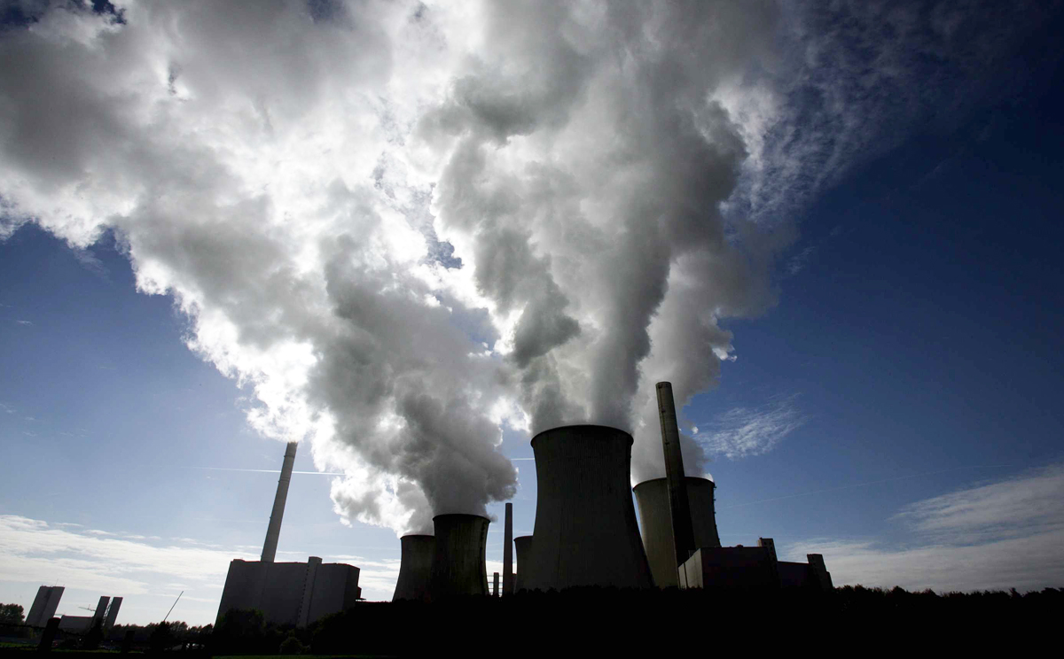

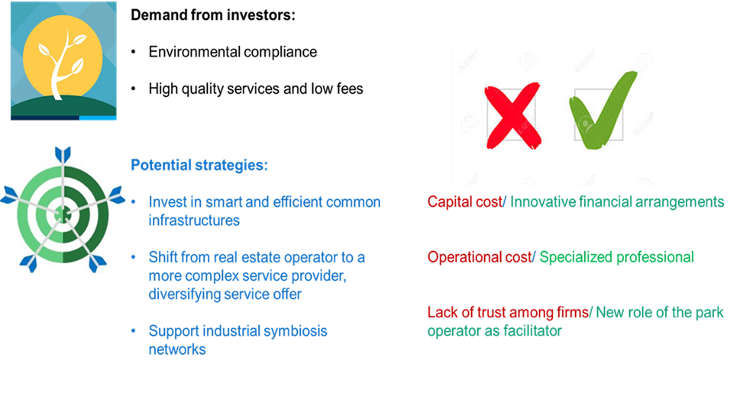
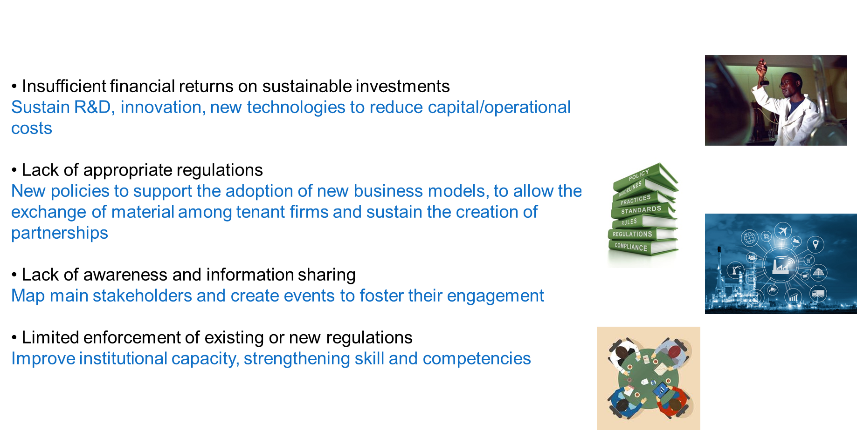
Barriers and enablers to the implementation of a national EIP framework
AT NATIONAL LEVEL
AT PARK LEVEL
National Framework
Stakeholders’
engagement
Financing mechanisms
Institutional capability for monitoring
Rules & Regulations
Eco-Industrial Parks
Notes:
Bangladesh: Grant mechanism to support investments in more efficient equipment and machineries
Vietnam: the exchange of by-products/waste was forbidden, hindering the development of IS
General on limited enforcement: the law exists (wastewater treatment) but the environmental agency is not able to enforce the regulation because of lack of (human and financial) resources
Pakistan: Use of a new platform for identification of sites for the establishment of new Industrial parks based on availability of infrastructures, connection to logistic hubs, environmental and social aspects and so forth. The platform has not been used systemically. It is a valid tool that can embed EIP criteria, but requires competences and skills.
Turkey: there will be the creation of a new department to launch, develop and monitor the EIP program

Slide 11
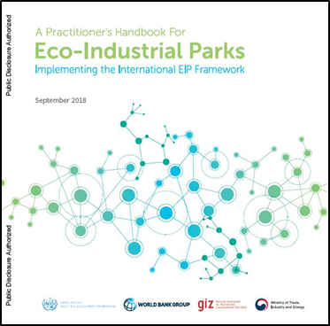
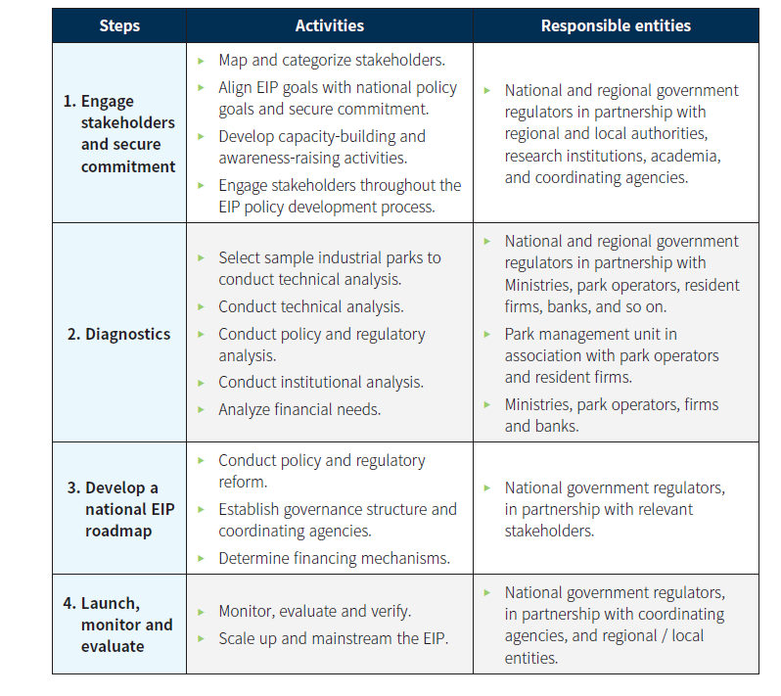
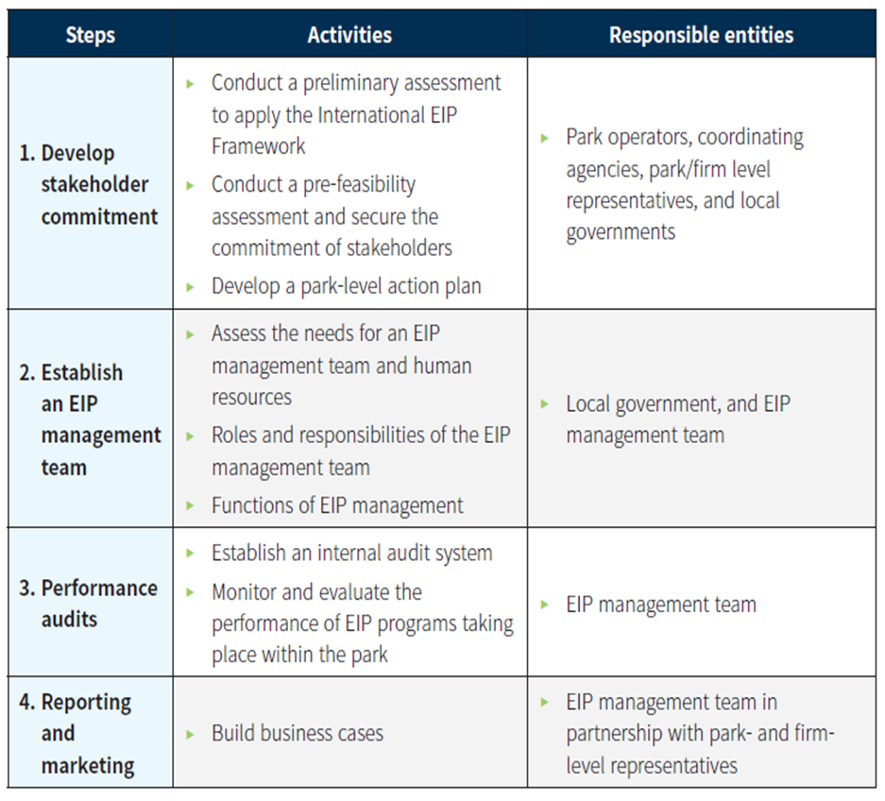
How to Develop a National EIP Framework
AT NATIONAL LEVEL
AT PARK LEVEL
1. Upgrade
Service and infrastructure

Slide 12
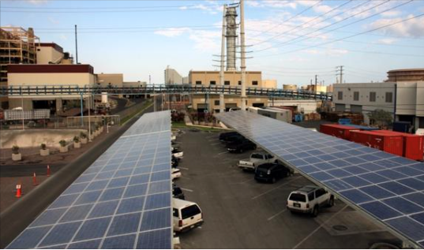
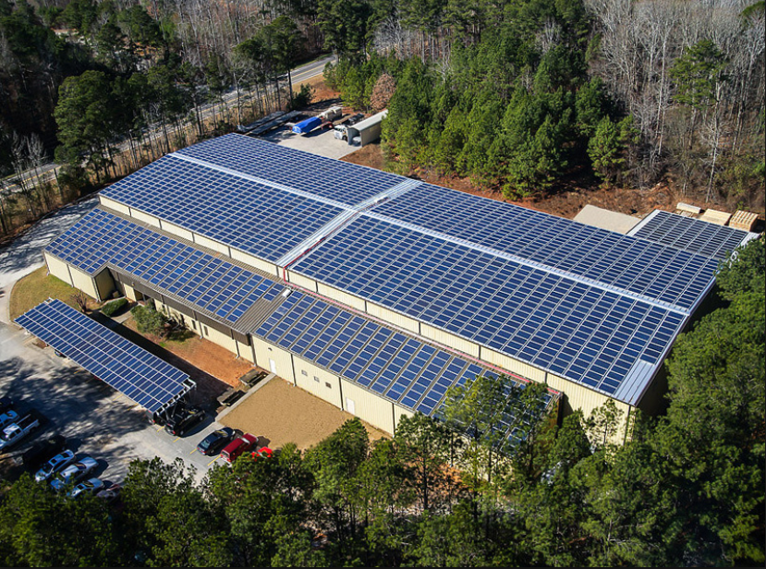
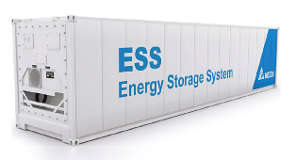
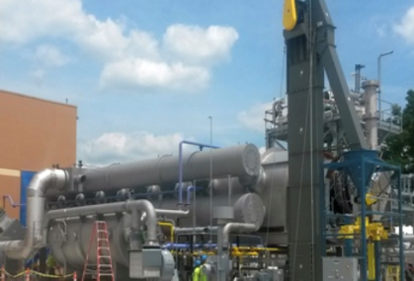
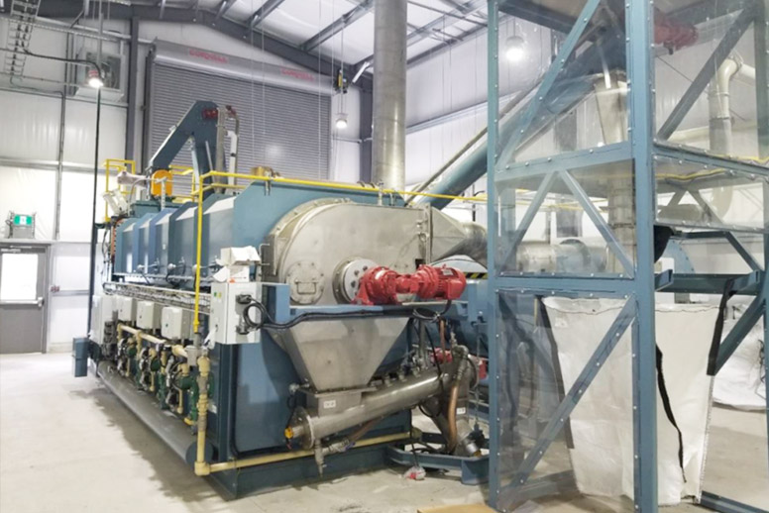
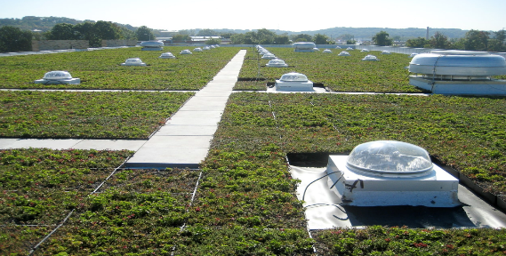
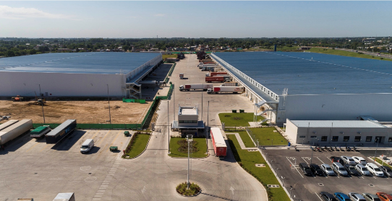
Innovative technologies and digitalization to enable resource efficiency, circularity and competitiveness
Green energy technology
  Ground-mounted / floating solar panels in industrial parks
  micro-grid, battery storage/ energy storage system and factory EMS
  Solar water heating/ centralized heating/ cooling technologies
  Biomass / biogas plants
  Energy efficient / smart factory/ green buildings, industry zone facilities, warehouses
  Energy, Water and material recovery
  Waste-heat recovery and steam generation
  Reuse of sludge to produce energy/biomaterial, recovery of biogas and reuse of treated wastewater generated from CETP
  Industrial symbiosis
  CO2 recovery and reuse for industrial processes
Sharing platforms: material exchange, energy exchange, knowledge and technologies, offer of underused assets, production sharing, by product offer to third parties outside the park
Solar panels in parking lots, factory rooftops, green space, etc.
Pyrolysis plant

Slide 13
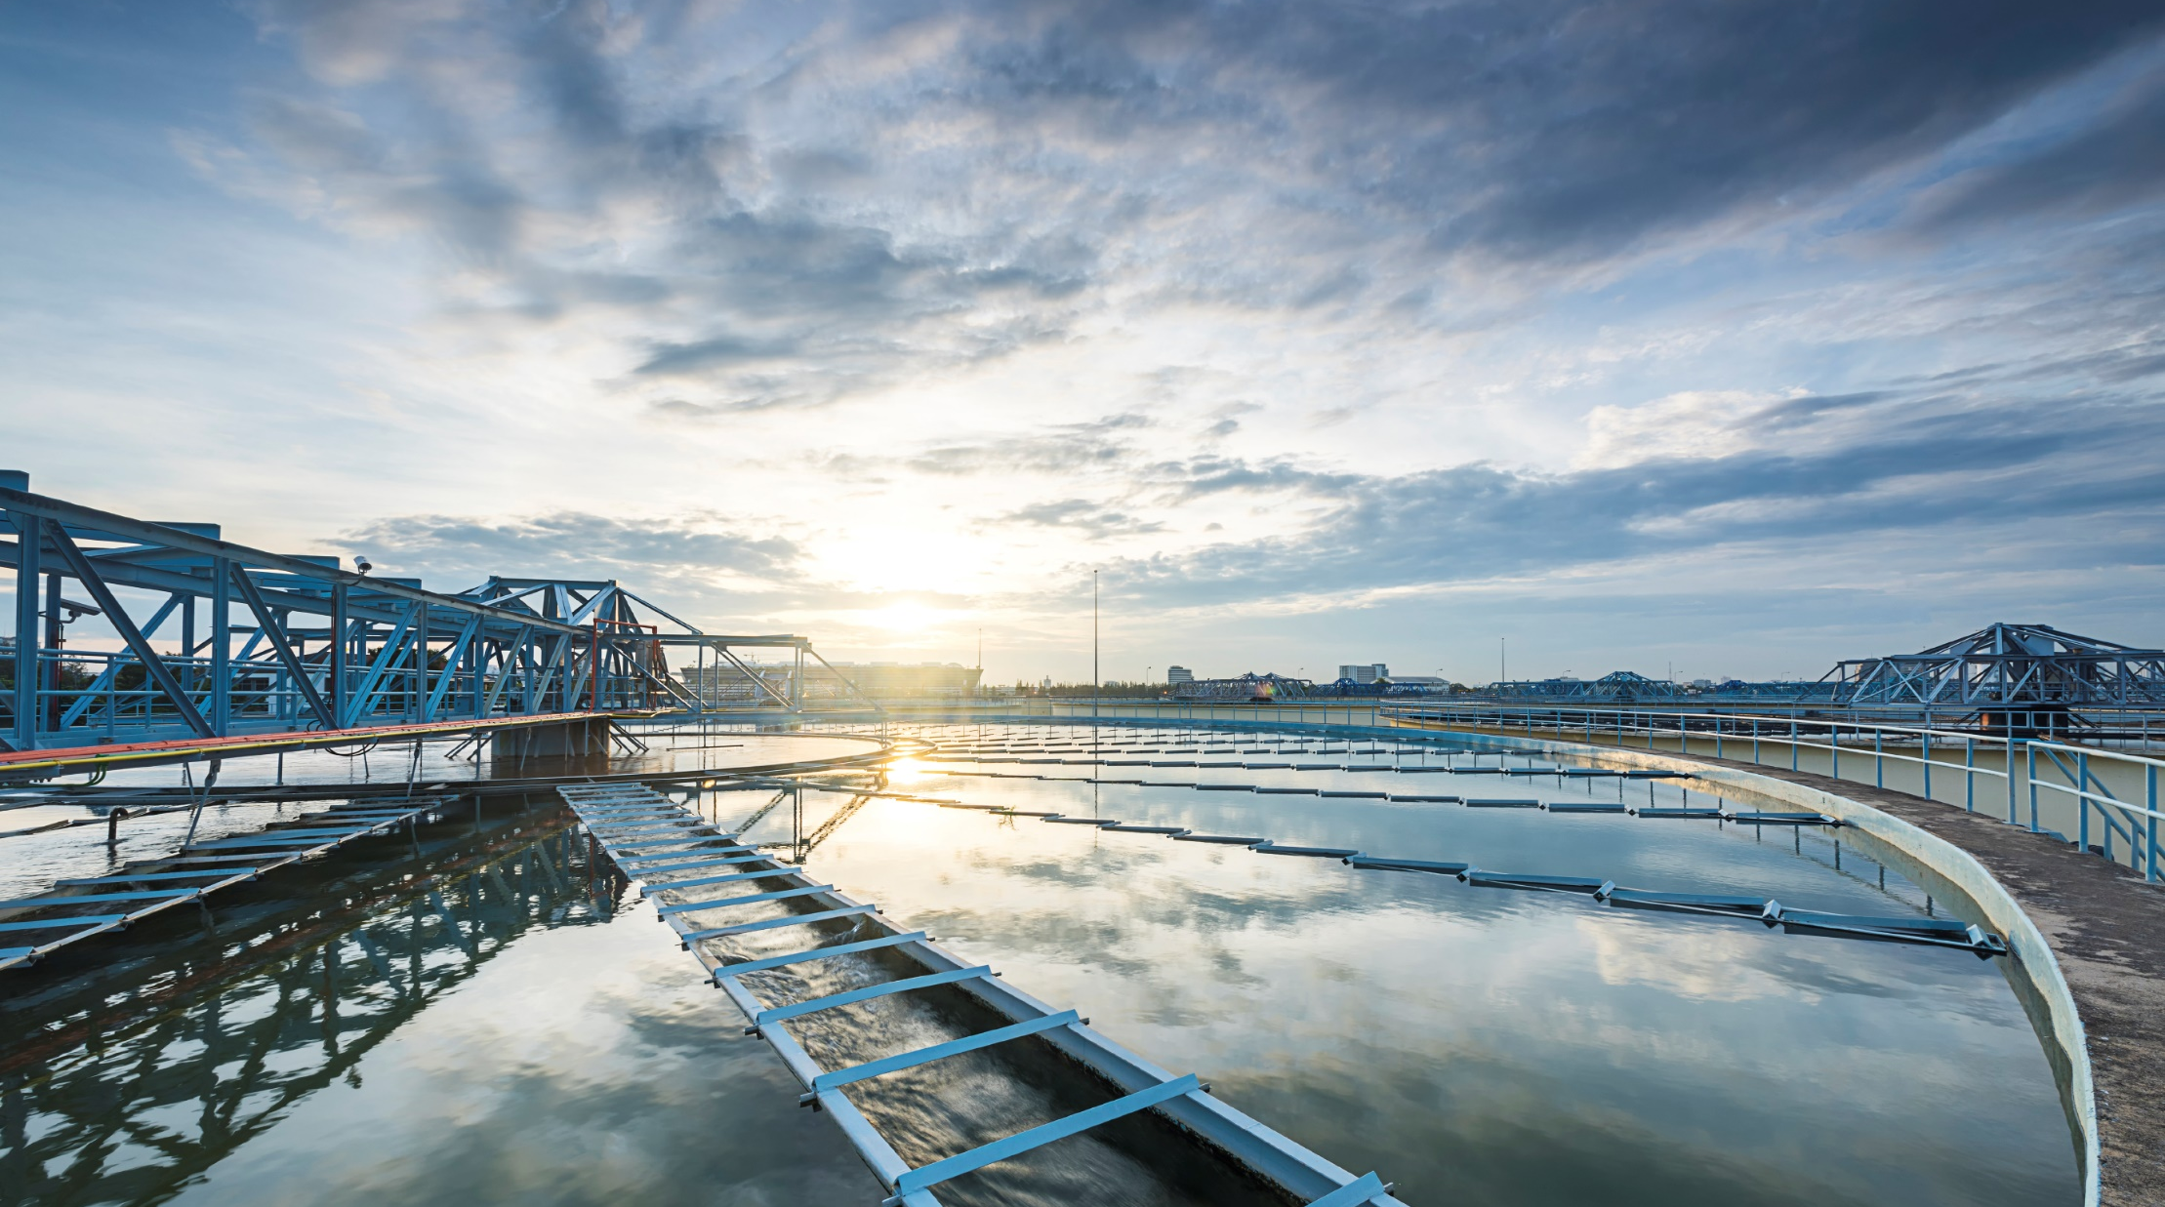
THANK YOU!
Dario Quaranta
dquaranta@ifc.org
Nilguen Tas
N.TAS@unido.org
Mareike Boll
mareike.boll@giz.de

