Slide 1
Survey data collection during and after COVID: lessons and recommendations
Gero Carletto
Inter-Secretariat Working Group on Household Surveys
Joint ISWGHS-ECLAC webinar on COVID-19: assessment of the mode effect on official statistics, 7 December 2020

Slide 2
As a result of Covid-19, virtually all countries halted F2F data collection …
Source: UNSD-WB survey of National statistical Offices

Slide 3
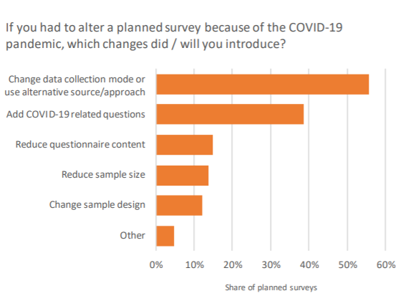
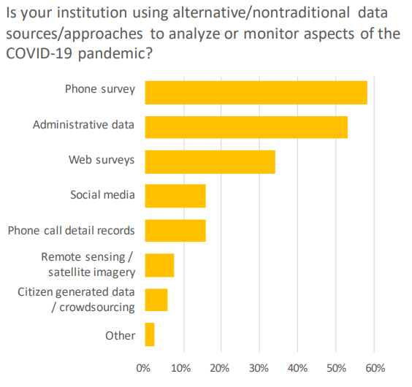
… but most quickly adapted!
Source: UNSD-WB survey of National statistical Offices, May 2020

Slide 4
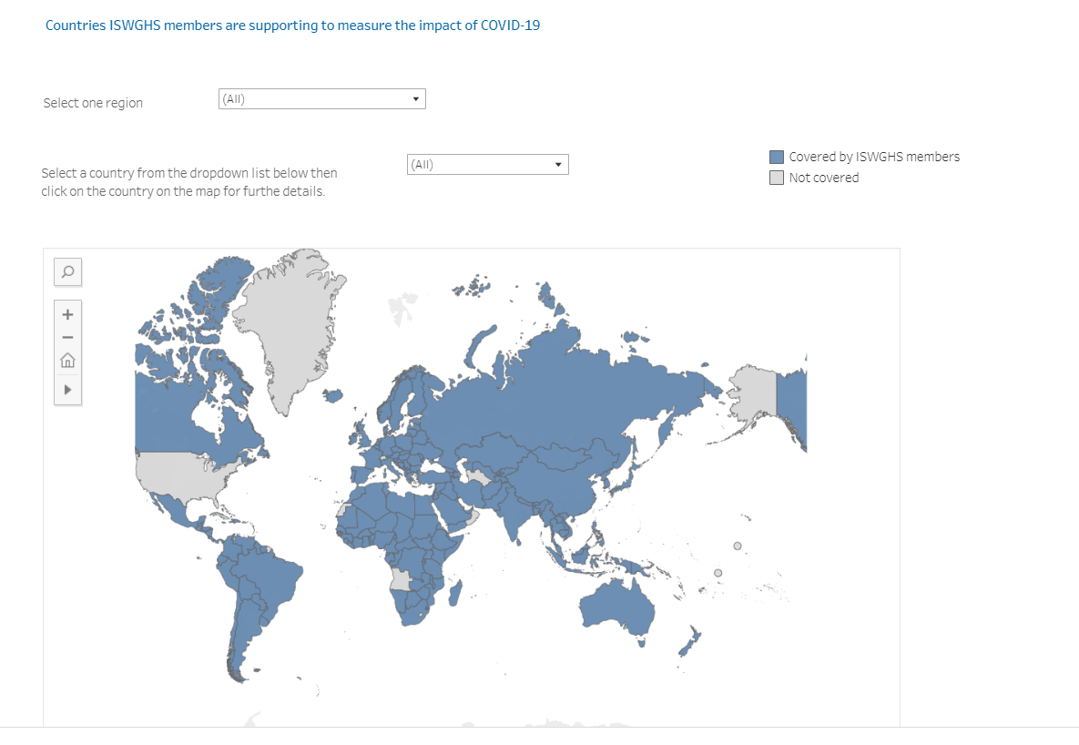
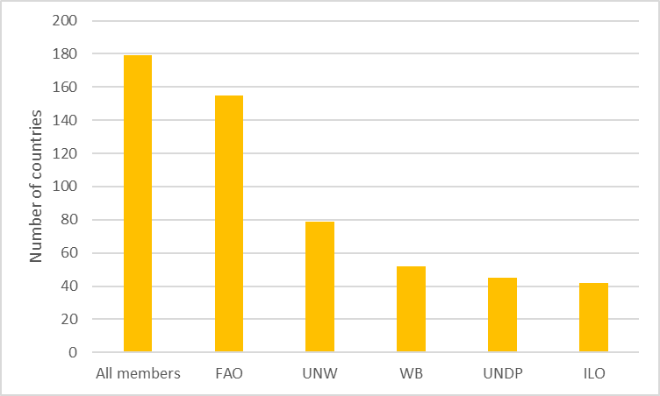
ISWGH members’ support on COVID-19 phone surveys
180 countries
530 surveys
https://unstats.un.org/iswghs/task-forces/covid-19-and-household-surveys/COVID-19-impact-surveys/

Slide 5
Alternative modes are not a perfect replacement
Phone/web surveys suffer from several limitations relative to F2F
Practical
Content – difficult to capture complex indicators/questions over the phone/web
Length – respondent attention span is much reduced over the phone/web limiting length of interview
Typically, maximum of 15-20 minutes for phone surveys
Addressing these limitations requires careful design of questionnaires and interview protocols
Reducing and prioritizing the scope of information that can be collected from phone surveys vis a vis F2F

Slide 6
Alternative modes are not a perfect replacement (cont’d)
Methodological
Sampling frame – a representative and quality frame can be difficult to come by
For phone surveys, pre-existing list of numbers (from prior F2F survey, network provider, etc.) or random digit dialing
Coverage bias – some segments of the population cannot be reached by telephone/web (individuals w/o phone or access to internet)
Nonresponse bias – some segments of the population are less likely to respond and agree to be interviewed
Present in F2F surveys, but magnified in phone/web surveys – easier to refuse over the phone/on the web than in-person
Mode effect – the answers respondents provide over the phone/on the web may be different than those provide in F2F surveys

Slide 7
Coverage and non-response bias: an example
Coverage and non-response bias are common in phone survey samples
Particularly in settings with limited mobile phone penetration (coverage) and high Y/urbanization (non-response)
Lessons from recently implemented phone surveys in SSA drawn from existing F2F samples
Comparing characteristics from F2F survey for
Full F2F sample
Sample with phone numbers (frame)
Sample successfully interviewed over phone
1 – 2 = Coverage bias
2 – 3 = Nonresponse bias

Slide 8
Coverage and non-response bias: an examples (cont’d)
Poor households are underrepresented in phone survey frame (coverage bias)
Even more so in interviewed sample (non-response bias).
The opposite is true for richer households
Non-respondents also more likely to live in rural areas, are less well educated, asset poor, etc.
The phone survey sample will not fully reflect the situation of the poorest households.
Provide biased estimates of key indicators

Slide 9
Coverage and non-response bias: Preventative measures (ex-ante)
There are many methods available to help improve coverage and limit non-response
Coverage
Frame selection – comprehensive as possible, multi-frame
For panel surveys, consider initial F2F visit providing mobile phone to respondents without a phone
Non-response
Mixed-mode – e.g. phone interview with follow-up F2F for non-respondents
Send SMS/Letter/personal contact informing respondent that they will be contacted for survey
Phone numbers from neighbors, family and friends

Slide 10
Coverage and non-response bias – Adjustment methods (ex-post)
There are also well-established methods available to help reduce the coverage and non-response bias in survey estimates
Weighting adjustments
Through modeled or estimated probability of inclusion in the sample/response
Weights are adjusted by inverse probability of response
E.g weighting class adjustments, response propensity model (Little 1986)
Or through weight calibration to a profile of general population characteristics
Derived from population census or existing representative surveys
Extent of weighting adjustments depends on amount of auxiliary information available to model non-response or to calibrate weights
For samples drawn from existing F2F samples, information collected in F2F survey for both respondents and non-respondents can be used to model probability of response
For fresh samples, should attempt to capture information in the phone survey that can be matched to census or other representative surveys to implement weighting adjustments
e.g. demographic information (sex, age, education), employment, basic wealth measures (asset ownership), location, etc.
draw on any information available on non-respondents (e.g. from frame, screening interview, etc.) to model non-response – usually quite limited
Collect information from neighbors, acquaintances, etc.

Slide 11
Coverage and non-response bias – Adjustment methods
Returning to Malawi example …
Unadjusted (red) shows substantial bias relative to F2F sample (blue)
After apply weighting adjustment (green) the bias is substantially reduced – though not eliminated
Relative success of adjustments depends on amount of auxiliary info available to model non-response

Slide 12
Interview mode effect
Respondents provide different responses depending on the mode of data collection
For the same respondent, asking a question over the phone might elicit a different response than if asked in a F2F interview
Particularly an issue for sensitive questions
However, many studies find limited mode effect between F2F and telephone interview (de Leeuw 1992, Laaksonen & Heiskanen 2014, Midanik & Greenfield 2003)
Difficult to detect and correct for mode measurement effect
Gain a better understanding of mode effects through survey experiments

Slide 13
Some final thoughts …
Phone/web/CS surveys are not the panacea but important tool in NSO’s shed
To be most useful, need to address limitations of phone surveys to min bias and MAX coverage
Use in combination with F2F in mixed-mode
Systematically collect phone numbers (of ≠ individuals), keep it updated and get consent
Identify possible sampling frames (ideally, w/ some auxiliary data)
Collect (meta-)data on non-respondents (directly or through proxies)
Ensure linkage with external representative sources
Carry out systematic experiments to assess extent of bias
Focus on ICT investments/infrastructures
CATI/CAPI, remote training, hard-to-reach populations
Strengthen capacity in use of new modes/methods/data sources, with focus on:
ex-ante and ex-post techniques
data integration and interoperability

Slide 14
How can ISWGHS help?
Promote and consolidate methodological standards and best practices for both ex-ante and ex-post adjustments and seek UNSC endorsement and countries’ buy-in
Importance of partnering with UN Regional Commissions
Leveling the playing field
Help agencies/countries’ coordination and knowledge diffusion to ensure scale-up and equitable adoption of new data modes and sources
Put forth a shared vision on a “new normal” for household surveys
Upcoming paper to be submitted to next UNSC

