Slide 1
Drought Response The California Experience
Beirut
Clémentine Stip
July 10, 2017

Slide 2
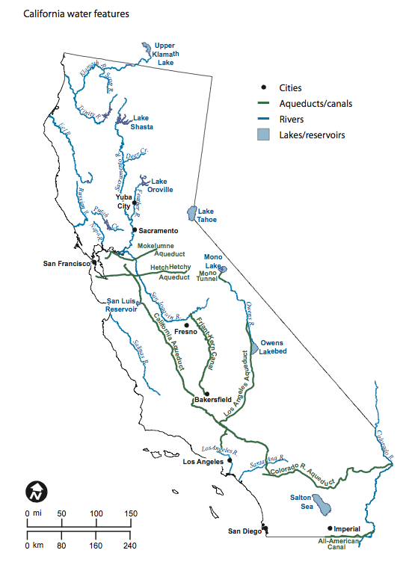
California water – where does it come from?
Notes:
Source: http://users.humboldt.edu/ogayle/hist383/Water.html

Slide 3
This leads to complex institutions
Notes:
Source: MWD

Slide 4
A Record-Breaking Drought hits California
Increasing disputes over existing sources of water in California.
The cost (price per m³) of imported water has doubled in the last 15 years and continues to rise.
Notes:
41% of the state faced “exceptional drought”
Compounded by drought on the Colorado River since 2000
Multi-year drought
Note that this is not the first such drought California faces but it has been the worst. Early 1990s and 2009

Slide 5
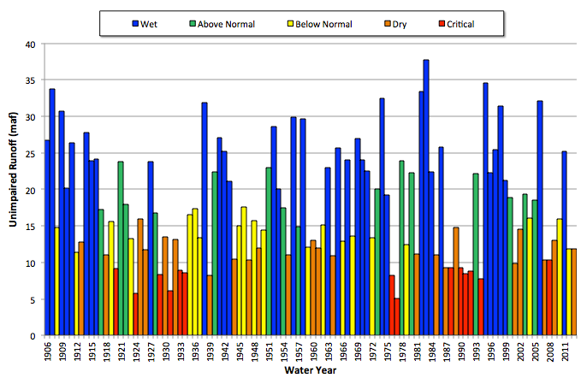
But it was not the first

Slide 6
A few examples of drought response in California
Conservation in Irvine Ranch Water District
Water Banking in Kern County
Agriculture to Urban transfer in San Diego County

Slide 7
Conservation:
Irvine Ranch Water District

Slide 8
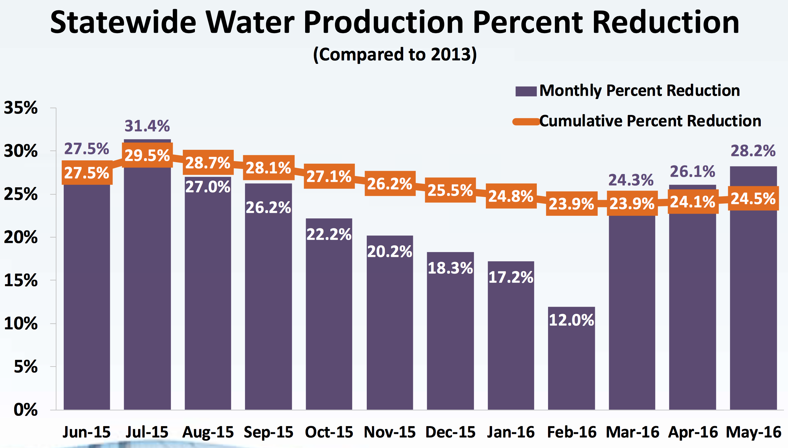
Governor Brown’s conservation mandate
April 1, 2015
Executive Order to reduce urban water use by 25%
May 2015
State Water Board emergency regulation to reduce all potable urban water supply by 25%
June 2015
Application of regulation begins (through Feb 2016)
Notes:
Goals are not met by each water district

Slide 9
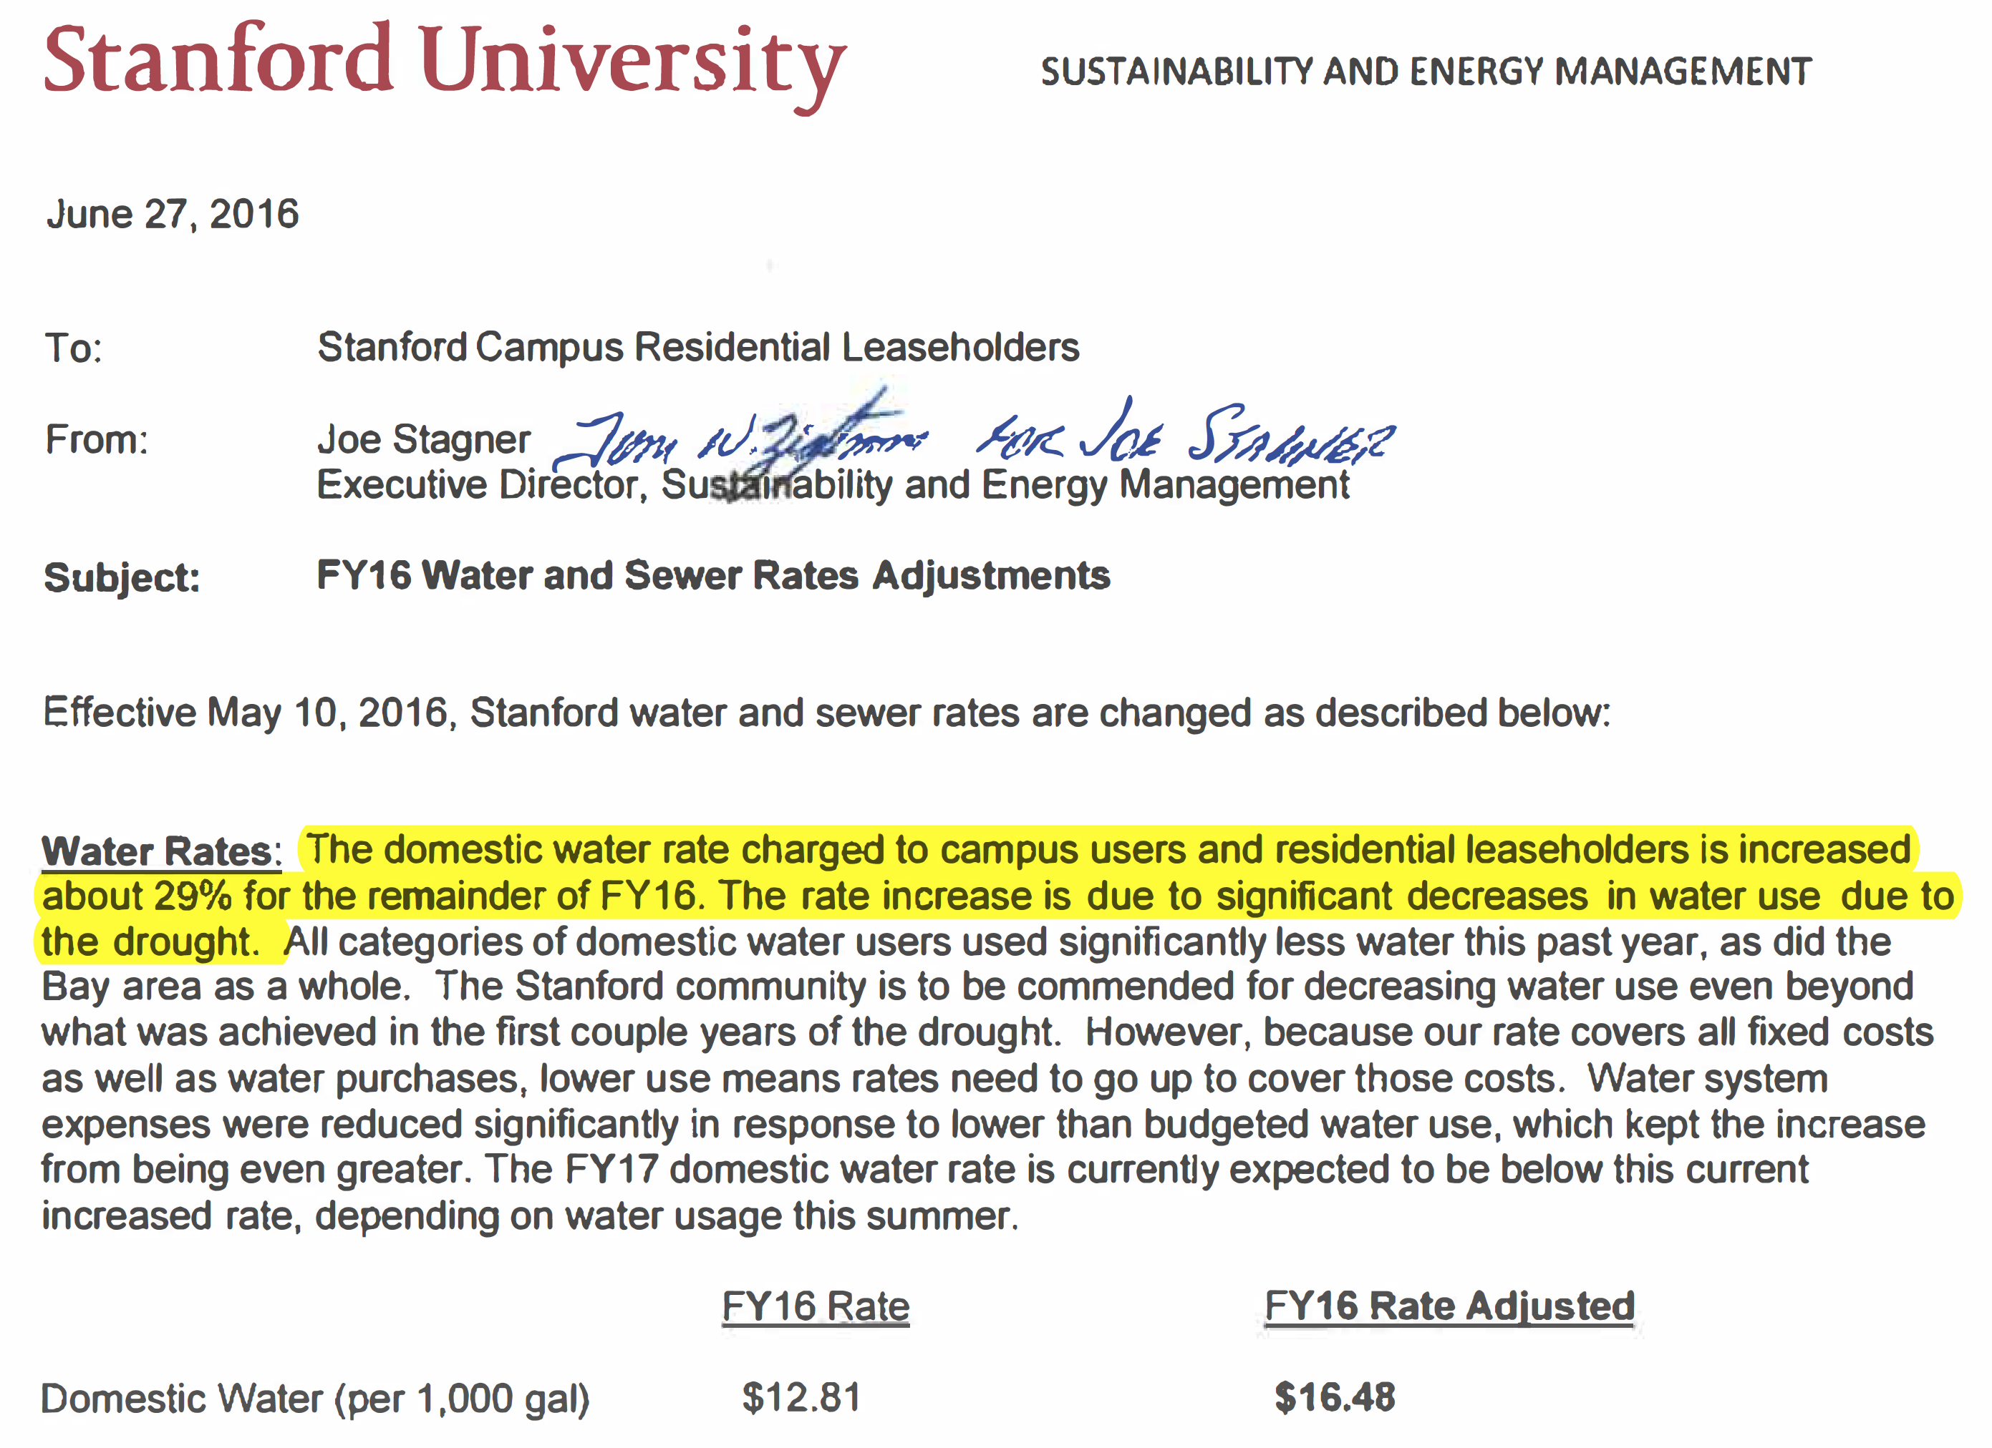
And the limitations of conservation

Slide 10
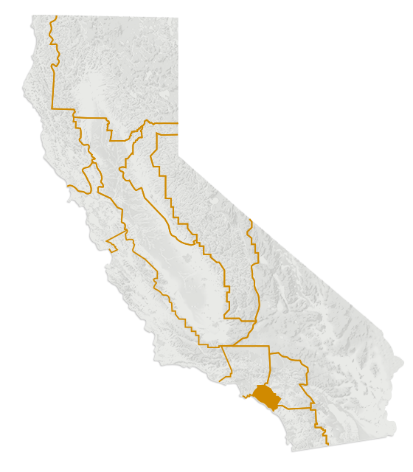
Irvine Ranch Water District
IRVINE RANCH
WATER DISTRICT
ORANGE COUNTY
CALIFORNIA
Notes:
Founded in 1961
Serves a population of over 380,000 people

Slide 11
IWRD – A few facts
Current demand 321 liters per capita per day
In 2008, Orange County consumption was at 719 lpcd compared to 341 lpcd in IRWD.
Non-revenue water at 7% (2015)
In the early 1990s, IRWD faced several challenges
Population grew by more than 75% in the 1980s
Then-worst drought on record in California (1991-2)
Increasing wholesale water prices
IRWD chooses water conservation as their main approach to meet growing demand.
Pioneer of the ‘purple pipe’ in California

Slide 12
IWRD’s conservation strategy – water pricing
Objective:
Reduce water consumption
Ensure revenue stability
The budget-based rate structure
Separated fixed (60%) and commodity (40%) charges
Even when demand decreases, IWRD recovers costs
Customized monthly water budget based on several factors:
Landscape square footage of the property
Number of residents
Daily weather or evapotranspiration
Data source: city assessor records and satellite imaging technology
Notes:
Fixed charges are the base charges to cover fixed costs such as infrastructures maintenance and fixed operation costs whereas commodity service charges are the price per volume of water used and cover all variable costs.

Slide 13
Rate structure
Tier | Rates per m³ | Use (of allocated budget) | Description of the calculation
Low Volume | $0.48 | 0-40% | Lowest cost of source water for the Irvine Ranch Rate Area ($0.47/m³)+ District wide conservation and urban runoffs costs ($0.01/m³)
Base Rate | $0.60 | 41-100% | All sources melded cost of budgeted water ($0.59/m³)+ District wide conservation and urban runoffs costs ($0.01/m³)
Inefficient | $1.44 | 101-130% | Blended cost of Baker & potable imported water ($1.04/m³) + District wide conservation ($0.01/m³) + Conservation Targeted to Over Budget Customers and Natural Treatment System Costs ($0.39/m³)
Wasteful | $4.26 | 131% + | Loaded cost of imported water ($1.20/m³) + District wide conservation ($0.01/m³) + Conservation targeted to over budget customers and N Natural Treatment System Costs ($3.05/m³)
Notes:
Water is sold to customers under a four-tiered structure adapted to their monthly water budget. Customers using an amount of water within their budget purchase water in the lower two tiers and are rewarded with very low water bills. Customers using in excess of their budget purchase water in one to two steeply ascending upper tiers, resulting in relatively high water bills and a strong pricing signal for excessive use.

Slide 14
Implementing the rate structure
Revenue generated from these higher billing tiers funds expenses associated with higher levels of demand
Purchase of additional expensive imported water
Urban runoff treatment
Targeted water conservation programs
Strong public outreach campaign
Intensive communication with various customer groups
Meetings with local community groups
Advice on conservation strategies and water allocation
Financial incentives on water efficient fixtures
Notes:
The water budgets have been adjusted downward over time, to reflect rising water use efficiency among Irvine’s customers and partially in response to drought conditions, first in 2009 and then again in 2014. The downward adjustment made to water budgets in 2009 was not rescinded once drought conditions ended.
Proposition 218 in CA mandates that water rates not exceed cost-of-service

Slide 15
Sample bills

Slide 16
IRWD: Results
IRWD residents have decreased their water usage by approximately 15%, while benefiting from the lowest rates in Orange County.
From 1992 to 2000, landscape area doubled in size, while water use level rose only by 3%.
Significant money savings
$33.2 million avoided in water purchases (1991-1997)
$5 million invested in conservation programs
Fewer than 3% of residential customers currently pay the highest tiers’ charges in any given month.
Customer service rating of “excellent” from 87.1% of surveyed customers.

Slide 17
IWRD: Drought-proofing
Notes:
Moreover, this structure has increased IRWD drought-proofing: they got through the dry periods of 2009 and 2014 without having to declare a shortage or undertake overt mandatory restrictions
It’s important to note that IWRD did not meet the mandatory conservation target set by the State: they reached 15.53% conservation against a goal of 16%! However, all the savings were realized through an increase in their water rate.

Slide 18
Water Banking:
Kern County

Slide 19
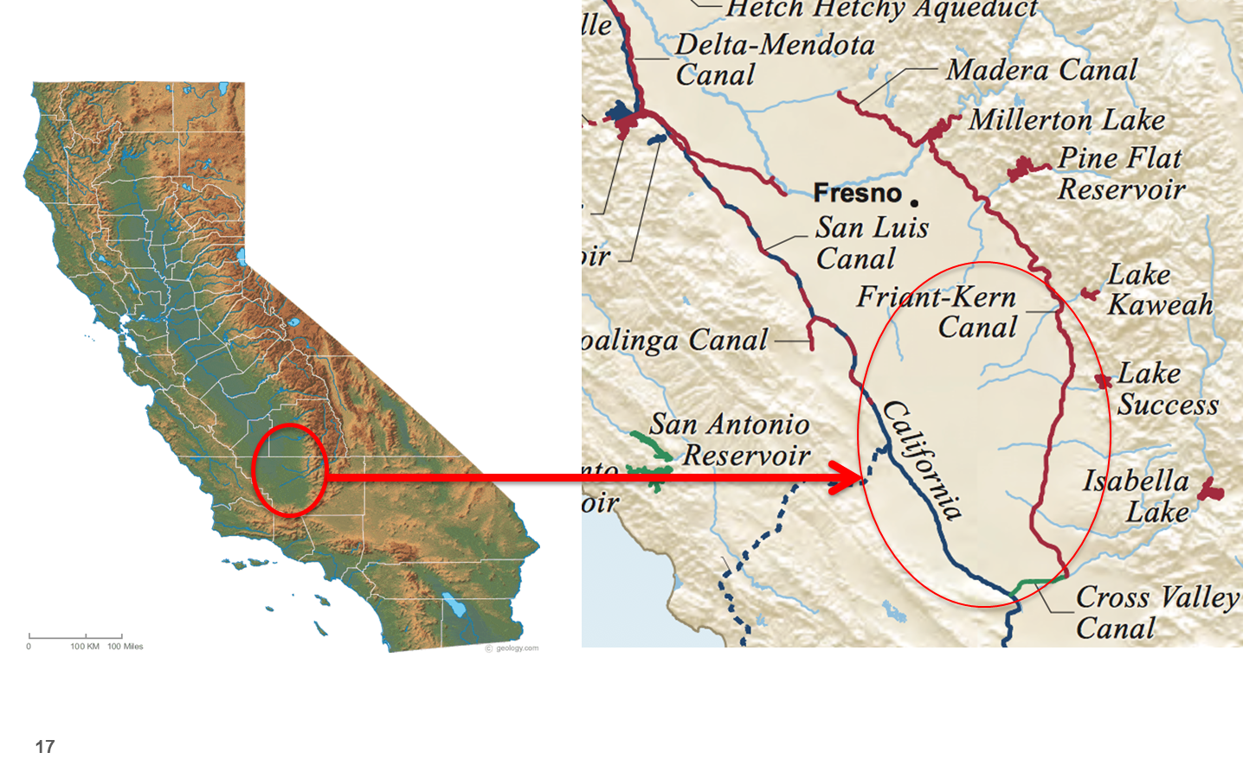
Kern County
9 water banking operations
The three largest water banks—Arvin-Edison, Kern and Semitropic—have a combined storage capacity of about 3,300 Mm³
Kern County is located close to the California Aqueduct, the Kern River and the federal Friant-Kern Canal
Aquifer is closed and unconfined, with very high transmissivity
50-70% sand and percolation rates of several inches a day
Notes:
9 water banking operations
Due to its location near the California Aqueduct, the Kern River and the federal Friant-Kern Canal, Kern County is ideally suited for groundwater banking.
The area has various underground water storage and recovery facilities, including two of the largest in the world — the Semitropic Water Storage Bank and the Kern Water Bank.

Slide 20
Water Banking basics
In wet years, participating banking partners deliver their surplus water to Semitropic or other bank.
Direct recharge
In-lieu recharge
Stored water is returned to the California Aqueduct for use
By exchanging its entitlement
By reversing the intake facility, which is called “pumpback.”
The state then delivers the water to the banking partners.
Notes:
Currently, there are six banking partners who have delivered approximately 700,000 acre-feet of water to Semitropic, which is enough to supply about 1.4 million households with water for a year.
in-lieu recharge wherein surface supplies are provided to groundwater users in lieu of pumping groundwater and that amount of groundwater that otherwise would have been pumped becomes banked water
Through pumpback, Semitropic can deliver a maximum of 90,000 acre-feet of water per year into the California Aqueduct.
Changes in the agricultural economy over the last 15 years, including the rising popularity of pomegranates and pistachios, prompted many farmers to switch to permanent crops, taking away the option of letting fields lie fallow in dry years. So water banking expanded.

Slide 21
Water banking arrangements
Financial arrangement compensate the district
Full compensation to store and return water
Energy costs for delivery
Operation and maintenance costs
Districts have contracts with landowners to use their wells with compensation
Fees also cover development of new infrastructure for banking
Challenges have included the perception of privatizing public assets, impacts on nearby properties and water quality (delivered vs stored)
Notes:
In 2010 the cost to recharge water was $13/acre-ft and the cost to recover water was about $70/acre-ft.
The price to third-party water users outside of Kern County can be quite high depending on the hydrologic cycle.

Slide 22
Agriculture to Urban Transfer:
San Diego County Water Authority

Slide 23
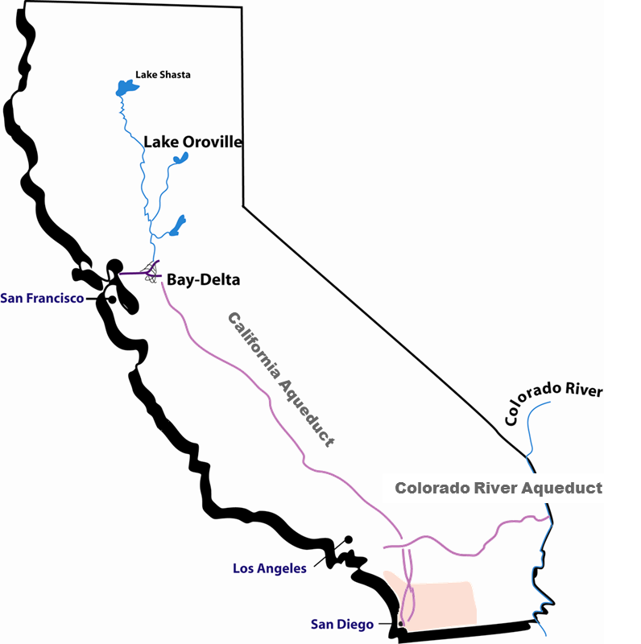
San Diego County Water Authority
Water wholesaler to SD County
24 member agencies
Strategy of source diversification
Quantification Settlement Agreement is signed in 2003.
Largest ag-to-urban transfer in the US

Slide 24
The Quantification Settlement Agreement
SDCWA purchases 247 Mm³/year of water from Imperial Irrigation District (IID) for up to 75 years
Increases every year from signing up to 247 Mm³
IID’s rights to the Colorado River are older and have one of the highest priorities
And represent the largest annual consumptive use entitlement among the Lower Basin states (70% of the state allocation!)
SDCWA paid for canal repairs to secure ~100 Mm³/year in reduced infiltration

Slide 25
How did it work?
IID was found to be “wasting water,” which is illegal by CA water rights law
IID has to implement water saving measures to reduce its use as of 2003
Negotiations were underway to reduce California’s excessive use of Colorado River water
Plan identified agriculture to urban transfers as key component of the strategy
SDCWA was ready to pay a higher price for the water than agricultural counterparts
Debate around environmental impacts to the Salton Sea, a saline lake mainly fed by IID irrigation runoff
Notes:
Excess water deliveries to farmers
Overfilling canals which led to spills
Poor regulation of flows within the system

Slide 26
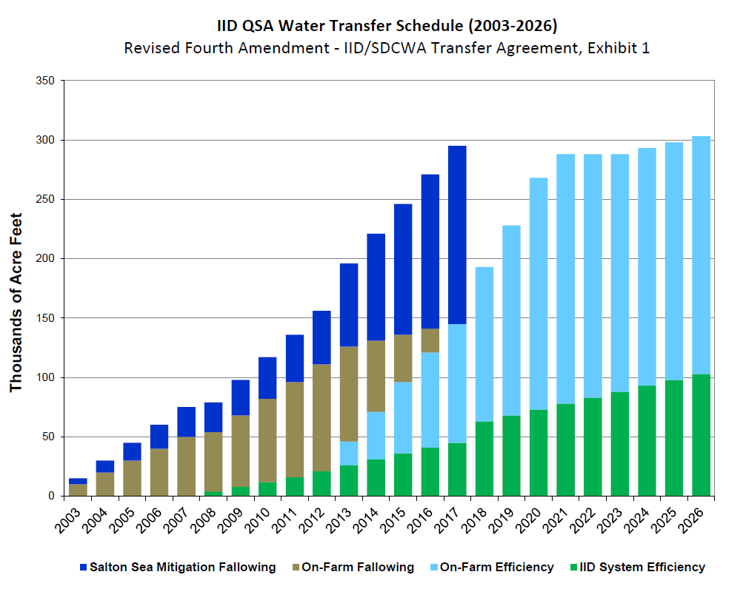
The plan for IID
Notes:
There are still concerns as to whether IID can conserve enough water to meet agreement terms.
This marked an important moment for California in prioritizing urban uses over agricultural interests through one of the largest ag to urban transfers in the US.

Slide 27
Thank you

