Slide 1
5th PASET FORUM
Bakary Diallo – Rector AVU

Slide 2
Brief History
Initial pilot Benchmarking exercise with 8 SSA universities - 2014
PASET Benchmarking launched – November 2015
Comprehensive Benchmarking methodology finalized and first major pilot conducted with 48 SSA universities – 2016
1st capacity building workshop held in Abuja – June 2016
African Virtual University competitively selected as implementing partner and a Data Hub – October 2018
Benchmarking exercise conducted with 74 participating universities – 2018/2019
2nd capacity building workshop held in Kigali – May 2019

Slide 3
Objectives of the Benchmarking Initiative
Enable SSA universities and national higher education regulatory agencies to measure and improve their performance based on comparative standardized data and metrics
Provide information to country-level policy makers to assess progress of universities and their overall national higher education systems
Build capacity in an African institution to manage and analyze higher education data and provide technical assistance to SSA universities and governments
Needed Areas of Support As Indicated By Participating Universities

Slide 4
Proportion of females among full professors
Why Benchmarking?
To improve diagnosis of areas for improvement and orient the design of specific interventions to help universities in Sub-Saharan Africa (SSA) reach their performance potential.
Access
Relevance
Governance
Financing
Quality of Teaching & Learning
Etc.

Slide 5
How countries can benefit
Access to a standardized national system-level benchmarking methodology, developed by global experts.
Opportunity to compare performance with other countries through an online tool.
Access to results of benchmarking exercise of universities under their purview.
Participate in capacity building opportunities, focusing on improving the higher education ecosystem in the country, developing and strengthening MIS and the use of data for decisions and policy making.
Pilot Graduate Tracer- Time to Find Job
Notes:
Pilot Graduate tracer study carried out among ACE 1 and 2masters degree graduates.
UGB - Gaston Berger University
KNUST - Kwame Nkrumah University of Science and Technology
UG - University of Ghana
2iE - Institute for Water and Environmental Engineering
CoM - University of Malawi College of Medicine
UMU - Uganda Martyrs University

Slide 6
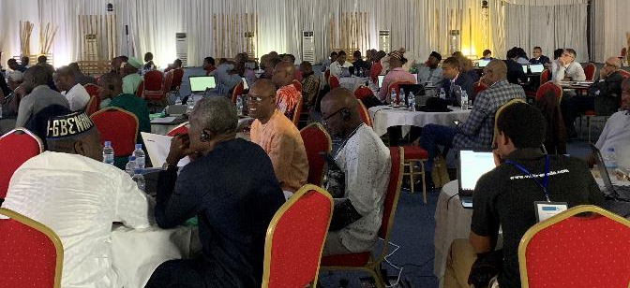
2nd Benchmarking Capacity Building Workshop; May 2019 in Kigali, Rwanda
Conclusion
AVU’s 3-year strategic plan for the data hub and PASET regional benchmarking initiative is being reviewed by the PASET governing bodies
The support from policy makers, donors and the private sector is important, especially in supporting the capacity of institutions to collect, manage and use Benchmarking data

Slide 7
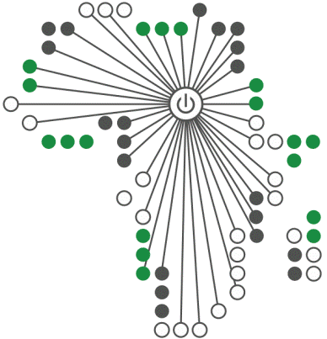
The
African
Virtual
University
www.avu.org
oer.avu.org
www.moocs.avu.org
www.youtube.com/avuorg
www.facebook.com/AfricanVirtualUniversity
https://twitter.com/avu_org

