Slide 1
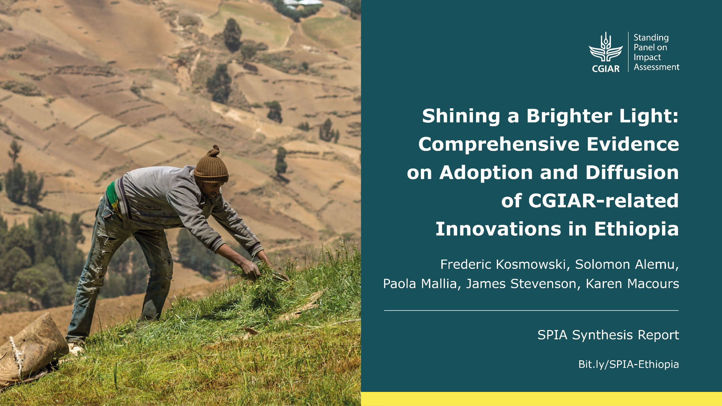

Shining a brighter light:
Data-driven evidence on adoption and diffusion of agricultural innovations in Ethiopia
Professor Karen Macours
PSE, INRAE,
CGIAR Standing Panel on Impact Assessment
with Frederic Kosmowski, Solomon Alemu,
Paola Mallia, James Stevenson
World Bank Webinar - Jan 21st 2021

Slide 2
Motivation: Can we measure the impact of agricultural research and innovations?
History tells us yield-enhancing innovations played in important role in reducing poverty (and more)
  Evenson & Gollin (2003)
  New quasi-experimental evidence on economic growth and health: Gollin, Hansen & Wingender (2020); Fishman et al., (2020)
  Tradition of Rates of Return calculations (Alston and Pardey, various)
  Often based on expert opinions on adoption rates and models
Are those answers still relevant today?
  Most of the rural poor are where yield gains have been modest
  Rapidly changing world, including climate change challenges, asking for different types of innovations?
  Long-standing concerns about data quality and representativeness

Slide 3
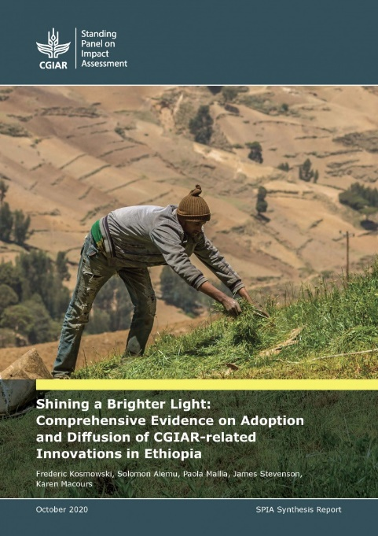
Shining a brighter light at the country level
Systematically and factually document CGIAR reach across crop, livestock and natural research management research
=> necessary, if not sufficient, for impact
Ethiopia: Almost all CGIAR centers/CRPs active
  => other countries to follow
Stocktaking of last 2 decades of research by CGIAR and national partners
=> 52 innovations and 26 policy influences
Novel data protocols and methods incorporated in Ethiopia Socioeconomic Survey (ESS)
  => representative and at scale
  => objective & independent measures
Partnership with Ethiopian Central Statistics Agency and World Bank LSMS team
Bit.ly/SPIA-Ethiopia

Slide 4
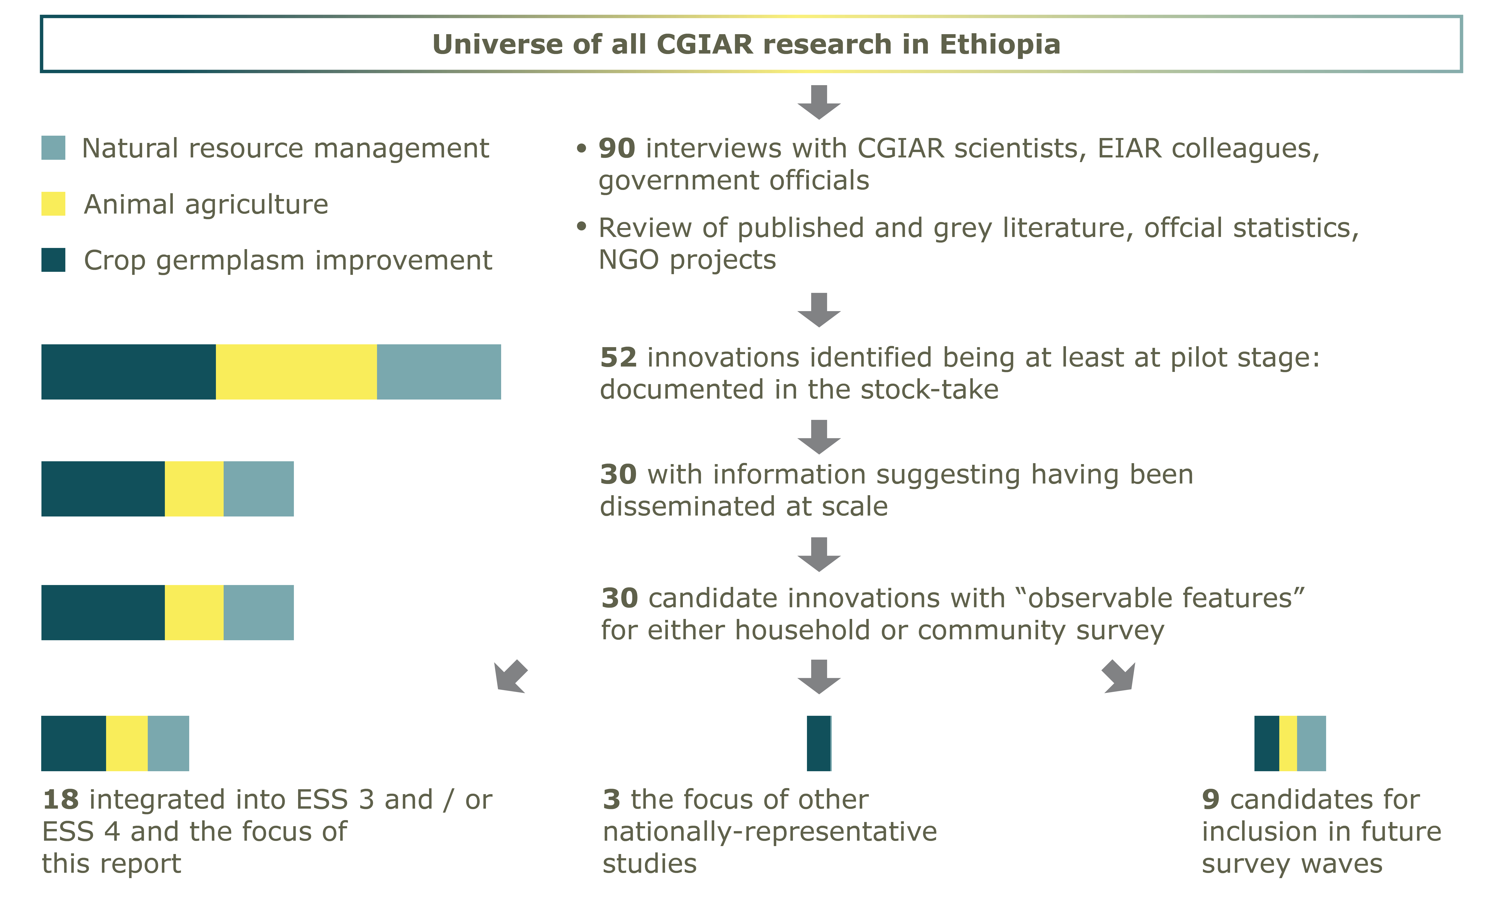
Methods: CGIAR stocktaking exercise

Slide 5
Survey collaboration with the Ethiopian Socioeconomic Survey (ESS)
SPIA working with World Bank and CSA in Ethiopia since 2015
Light-touch collaboration in ESS 3, much more complete integration possible in ESS 4
ESS 2
2013/14
ESS 3
2015/16
ESS 4
2018/19
ESS 5
2021/22
SPIA-CSA collaboration
Panel sample redrawn

Slide 6
Inclusions in the ESS
 | Already present | Questions added | Visual-aid added | Sample/DNA fingerprinting add.
Animal Agriculture
Small ruminant crossbred | X
Large ruminant crossbred | X
Poultry crossbred | X
Artificial insemination | X
Forages |  | X
Crop germplasm improvements
Barley varieties |  |  |  | X
Chickpea kabuli varieties* |  |  | X
Maize varieties |  |  |  | X
Sorghum varieties |  |  |  | X
Awassa-83 sweet potato variety |  |  | X
Orange-fleshed sweet potato varieties |  |  | X
Natural Resource Management
Soil & Water Conservation practices | X
River dispersion | X
Treadle pump |  | X
Motorized pumps |  | X
Conservation Agriculture |  |  | X
Papaya, mango, avocado trees | X
Broad Bed Maker* |  |  | X
* Inclusion in ESS 2015/16 only

Slide 7
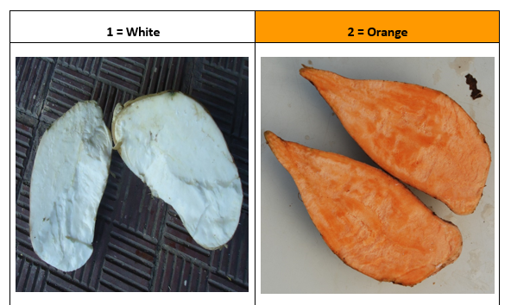
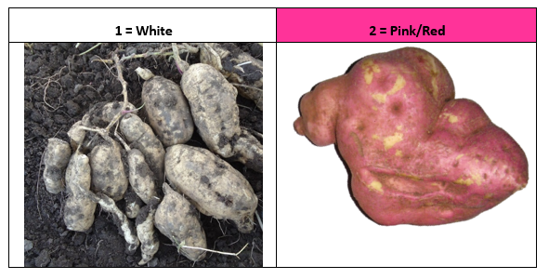


Visual aids for greater accuracy of measurement
a) Sweet Potatoes
(flesh and skin)
Kosmowski et al 2015
b) Chickpea desi & kabuli type

Slide 8
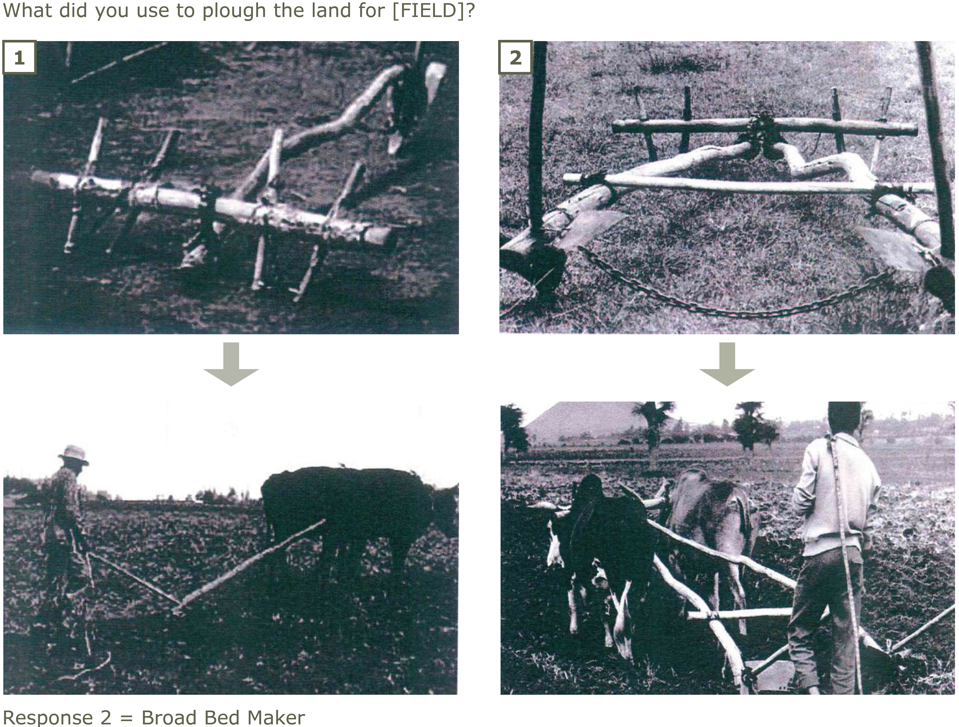
Visual aids for greater accuracy of measurement
c) Crop residue cover – images on L
(Kosmowski et al, 2016)
d) Broad bed maker – images on R

Slide 9
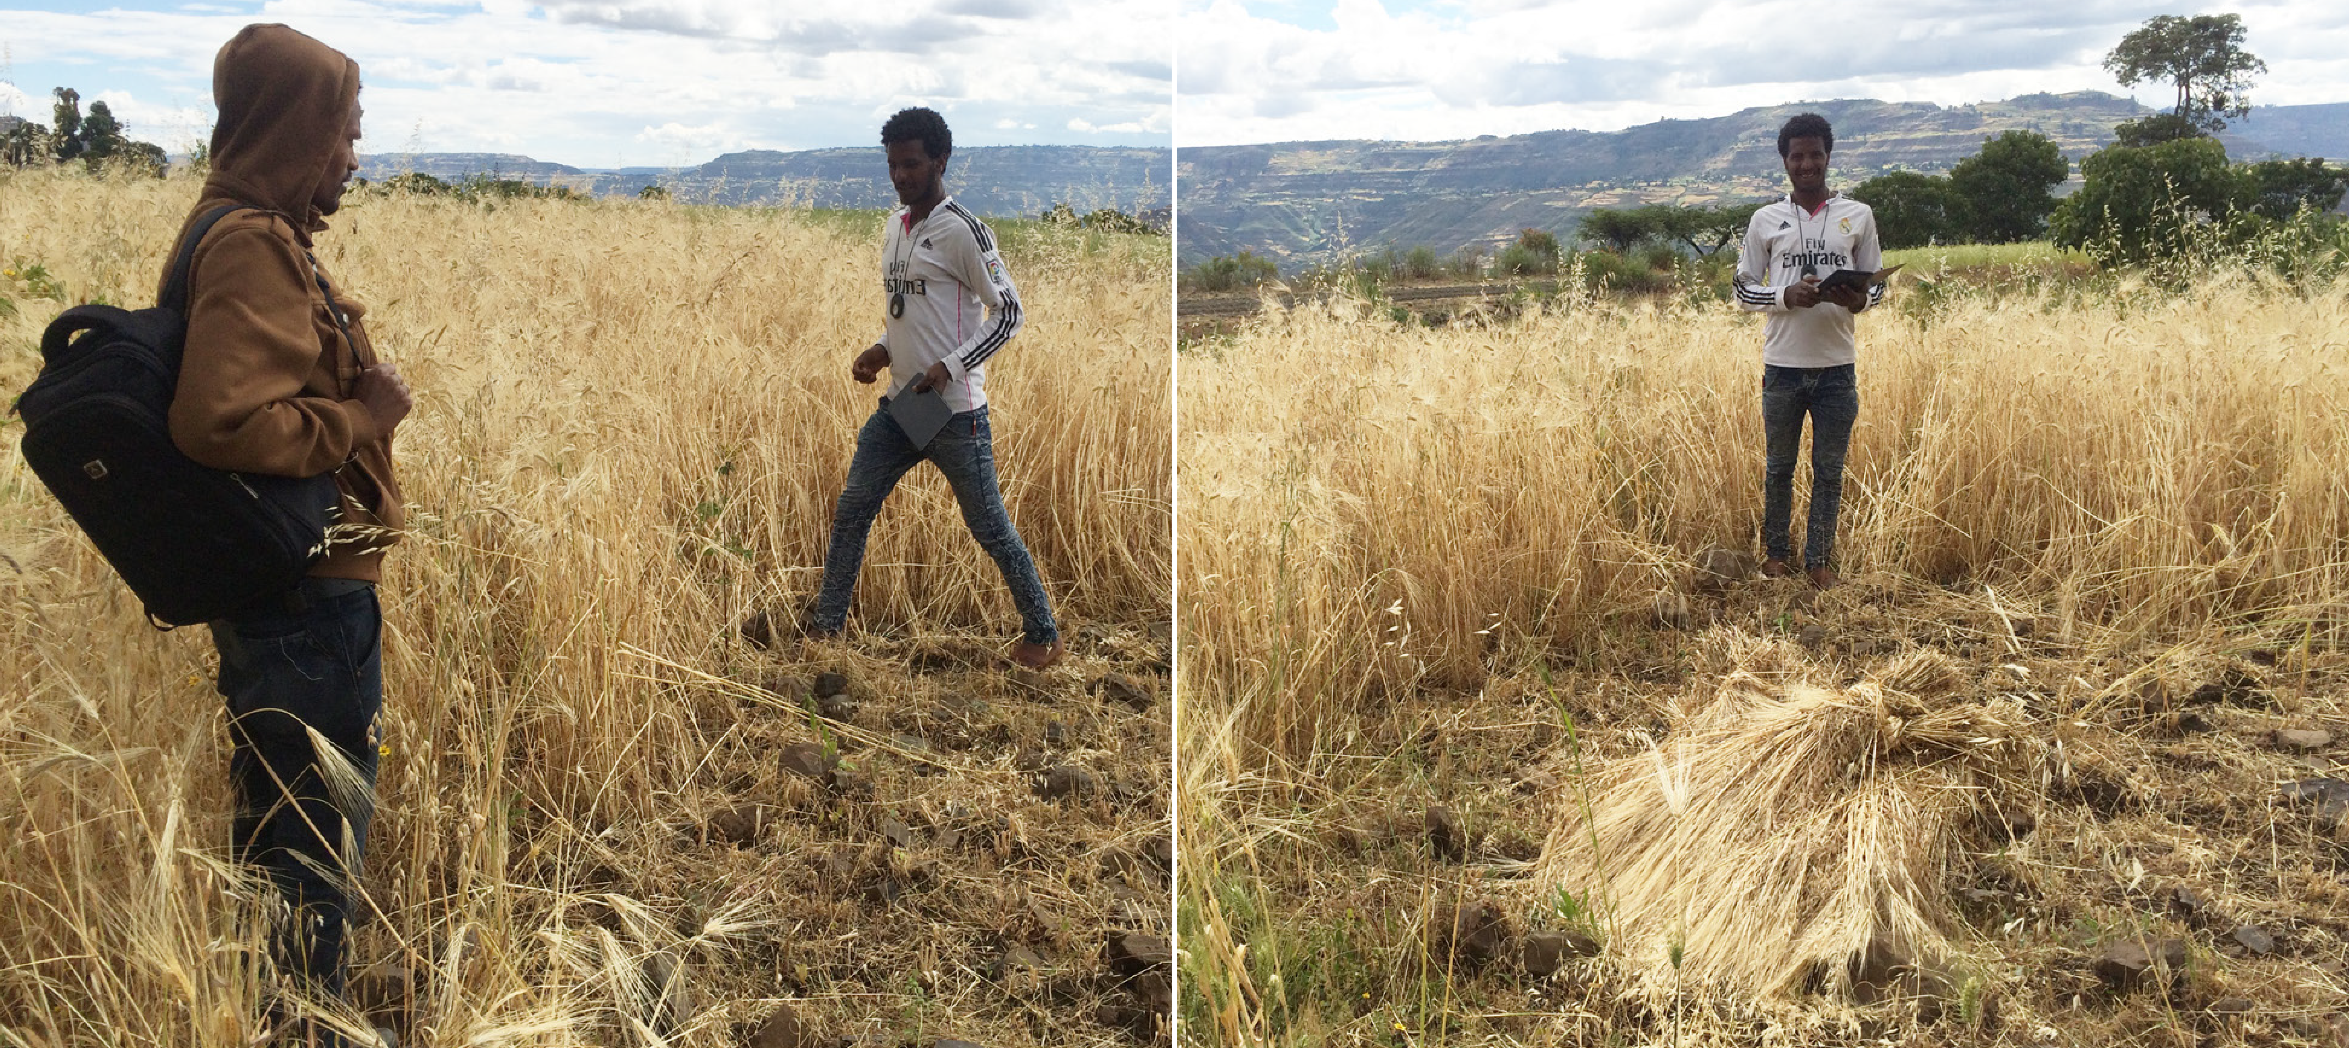
DNA fingerprinting for data on crop varieties
Leverages crop-cuts – grains sampled after yields have been calculated
A priority topic for LSMS team in 50 x 2030 initiative

Slide 10
Measurement: DNA vs self-report (1)
The average age of maize varieties identified was 20 years for open-pollinated varieties and 15 years for hybrid varieties
Misclassification in self-report is large
In line with other recent evidence (Wossen et al, 2019; Le et al, 2019; Wineman et al 2020)
  But misclassification smaller when consider recent varieties

Slide 11
Measurement: DNA vs self-report (2)
Self-report leads to wrong conclusions suggesting larger, richer and more male farmers use improved varieties

Slide 12
Innovations from each domain have scaled, but many have not
Number of rural HHs adopting each CGIAR-related innovation (millions)
Based on data we could collect in ESS 4 only (wheat and haricot beans notable absences)

Slide 13
Number of households reached
Attribution of CGIAR-related innovations
Number of households reached
  Lower-bound estimate – 4.1 m. households
  Upper-bound estimate – 11 m. households
Difference between these numbers reflects different level of confidence in contribution of CGIAR:
  Lower-bound estimate – CGIAR had clear role and there is an observable, embodied innovation to detect
  Upper-bound estimate – Difficult to differentiate CGIAR role but clear that CGIAR has worked on promoting / evaluating / helping others design their programs etc

Slide 14
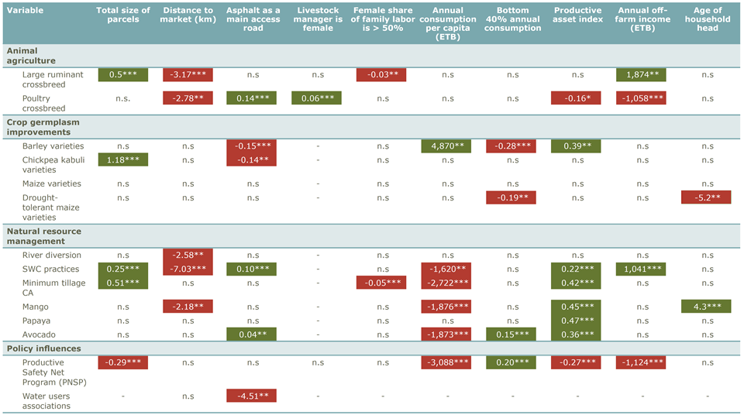
Different types of household are reached: summary of correlates
*** p < 0.01; ** p < 0.05; n.s = non-significant

Slide 15
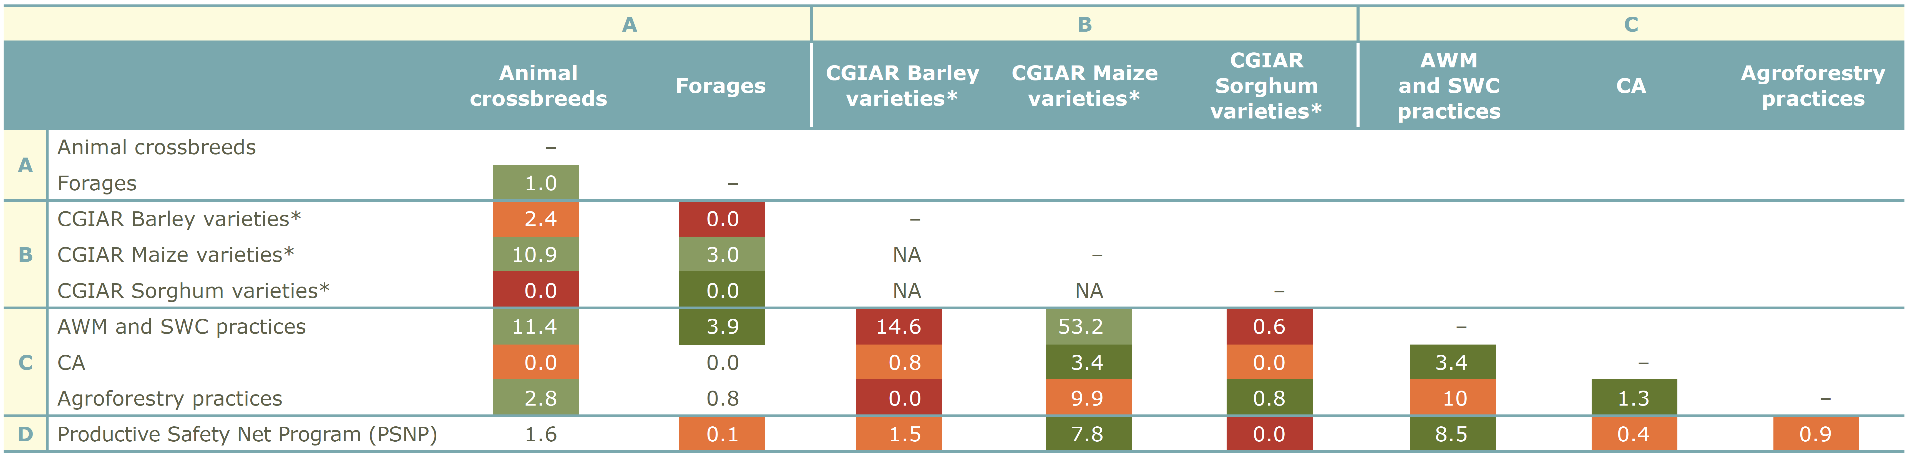
Synergies between innovations
Joint adoption rates matrix: unconditional incidences of joint adoption

Slide 16
Other findings
Narrative overview of innovations and policy influences, with related research efforts
Adoption rates, including review of earlier evidence
  Worth thinking of denominators…
Dynamics of adoption, with some notable stories
  By comparing waves
  Age of varieties on farmers’ fields
Where are different innovations diffused
  ESS representative at regional level
  Relation with location of research activities
Further analysis of misclassification with self-reported measures

Slide 17
Implications
Widespread adoption of agricultural innovations
Relatively few innovations reaching large numbers of households
  Arguably as expected: Inherent uncertainty of AR4D
  Considering innovations one-at-a-time gives incomplete picture
  Scaling works differently for different innovations
No clear evidence of synergies at farm level
  Reflects different innovations reaching different types of farmers
  Points to constraints limiting possible gains from synergies
Many innovations are not disproportionately more likely to be adopted by male, larger, richer, more educated or more connected farmers
  Good news for contributing to rural poverty reduction
  But certain innovations not reaching target households & regions
The most widely adopted innovations can all be linked to supportive government policies / programs (some WB supported)
  SLM, Livestock master plan, DSM

Slide 18
Our specific contribution
First open access evidence on which innovations are adopted, by who, and where, at the country-level
  https://doi.org/10.3886/E124681
  Of course this comes with caveats & limitations
  Other countries to follow – coordination with 50x2030
  Only possible because of WB data investments
Updated estimates of the “who, where and when” of diffusion can help in process of re-evaluating Theories of Change (ToC)
  => input into design of scaling policies
  => input into targeting of programs/interventions
  => contribute to understanding returns to broader ag/rural policies
From single innovations to a portfolio of innovations
    Smallholders as ”critical consumers” of innovations, who may not necessarily value yield, but other features: labor-saving, seasonal smoothing, nutritional values, risk reducing, soil restoration, …
    Policies/programs that offer a menu rather than individual innovations

