Slide 1
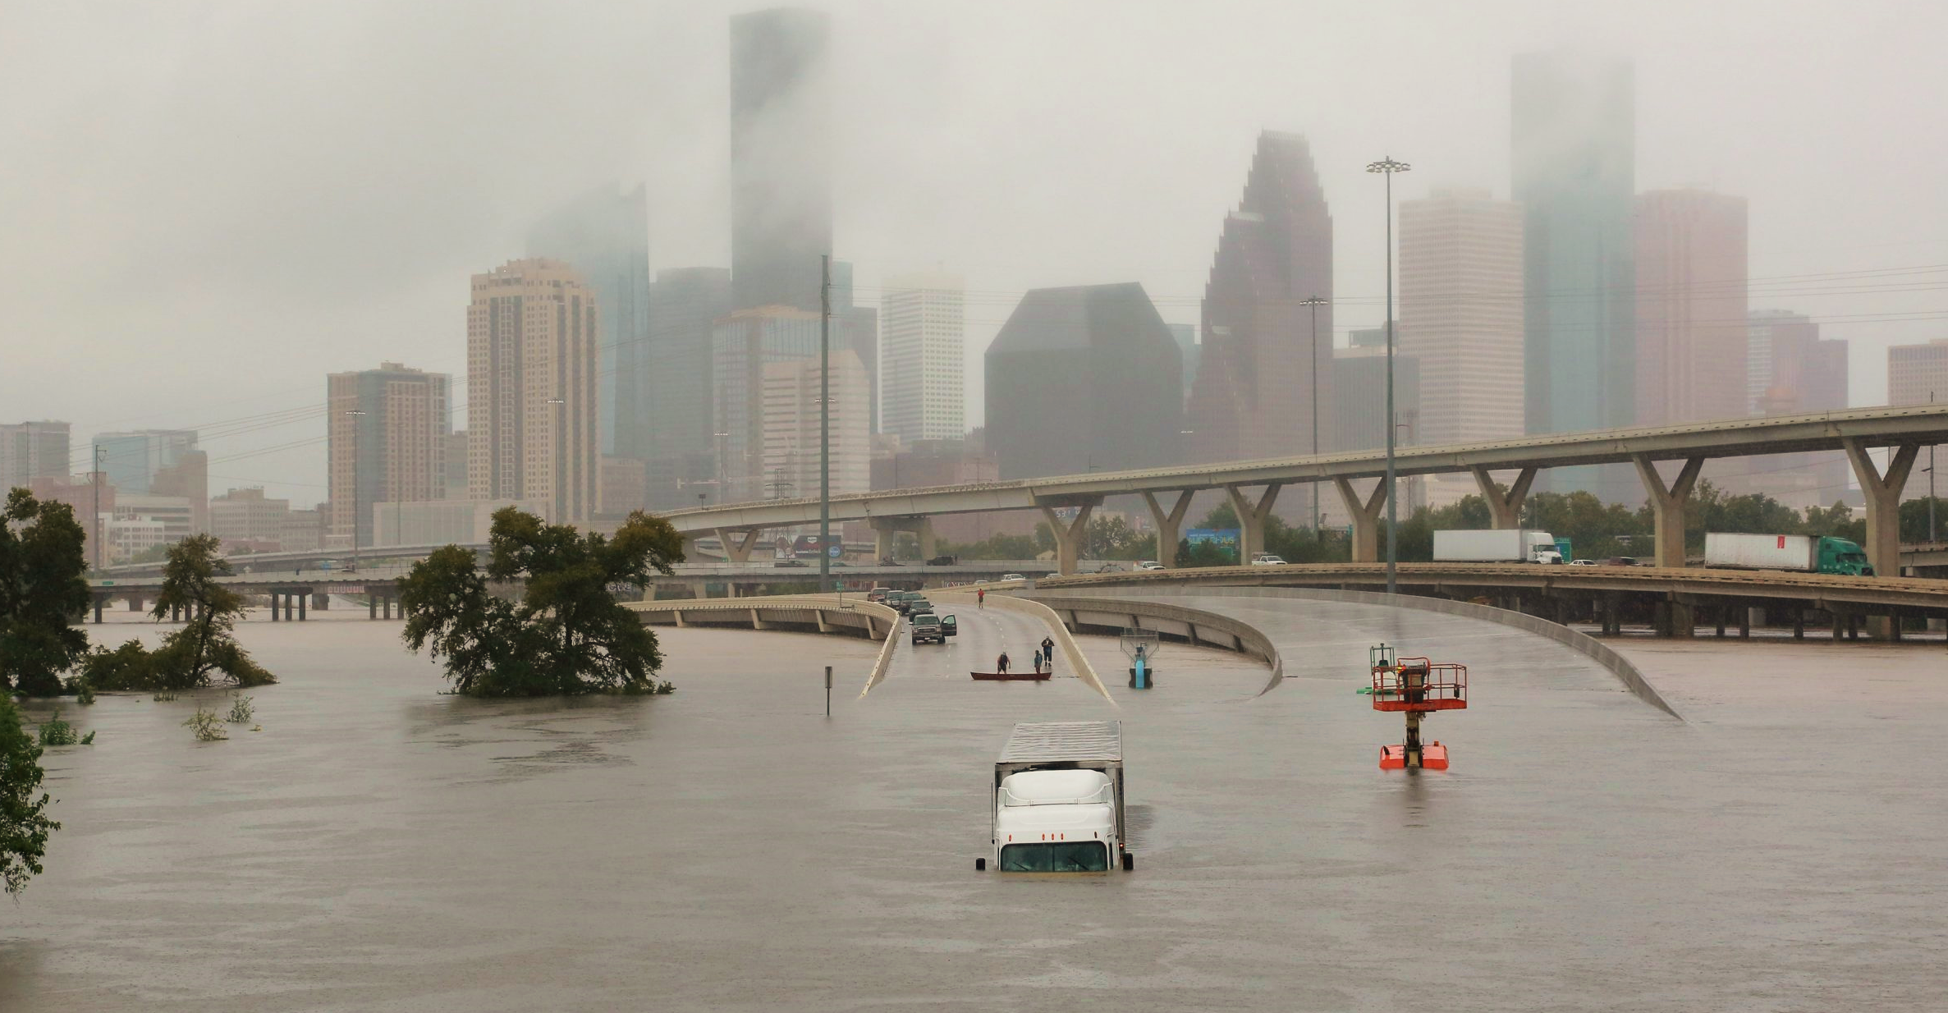

Incorporating Climate Risk into Performance-Based Contracting
Yana Waldman PE
Resilient Engineering Consultant
Infrastructure Advisory
Houston TX, 2017

Slide 2
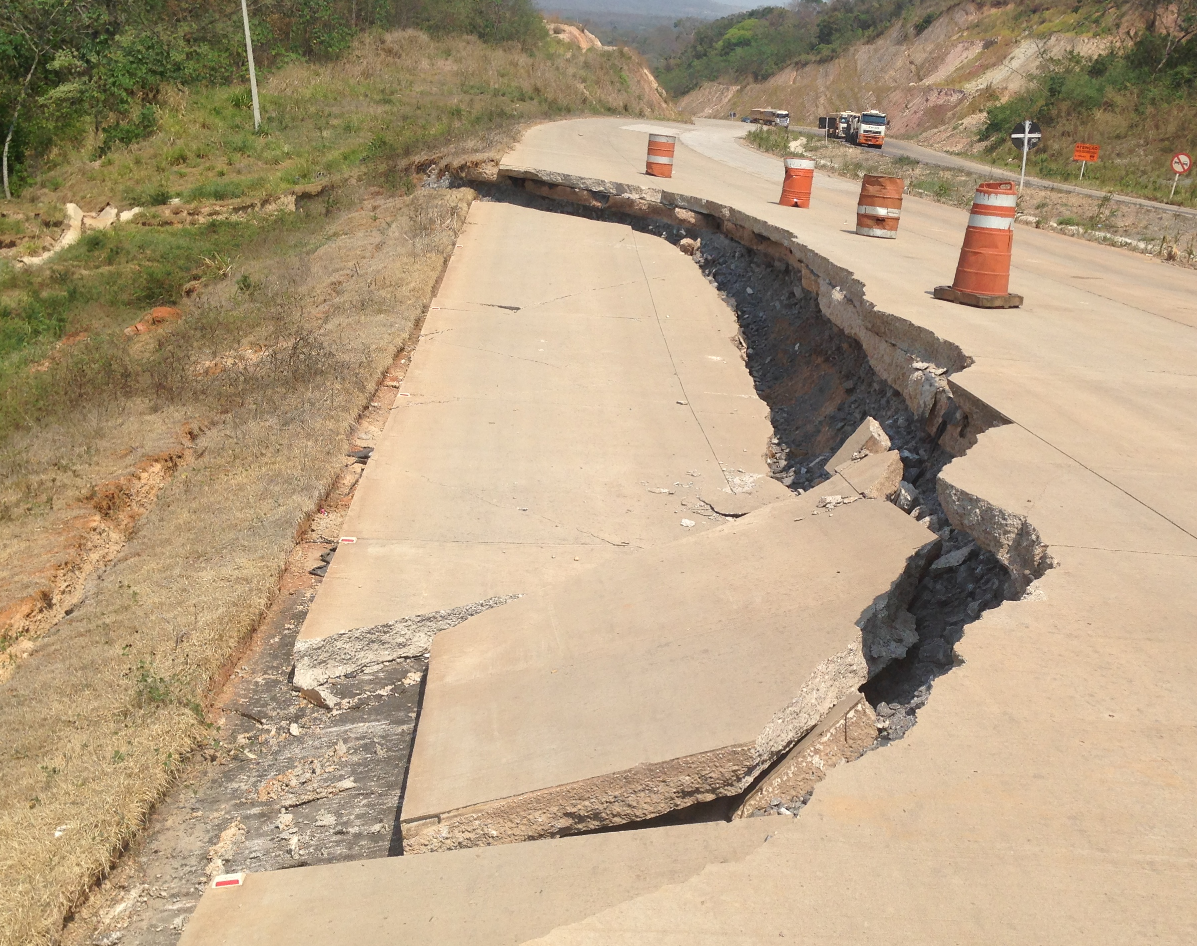
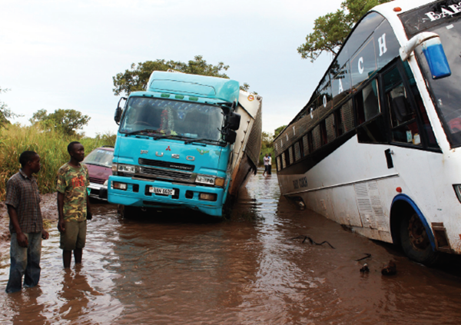
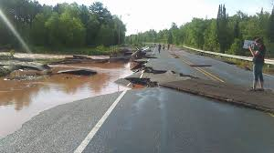
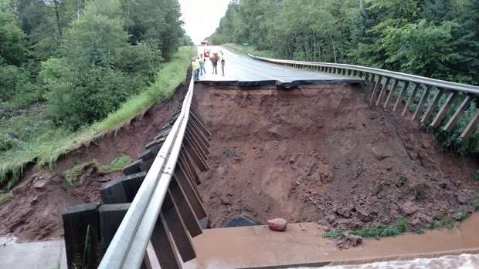
Project Overview
Industry Challenge
Issues
Climate change presents serious challenges to long-term viability of roadway assets due to increasing O&M costs
Climate risk is difficult to quantify and project based on historic data that does not reliably represent future climate
Economic and social benefits of projects will not be fully realized due to insufficient accounting for climate change
Proposed Solutions
Determine how climate risk can be integrated into PBCs to minimize consequence, taking into consideration the criticality of the facility and overall exposure
Determine who owns that risk during and after the execution of the contract and how transparent that risk is from a contractual perspective
Notes:
- Climate change is becoming an immediate problem in the transportation industry due to reduced reliability of routes (land, water and air), increased volume of repairs and diminished economic benefit for regions.
- Unfortunately, it is hard to calculate the economic impact of these changes due to the many unknowns associated with the future climate. The only thing that is certain is that climate is already increasing risk exposure today and this will intensify over time. The various possible scenarios will be discussed later in this presentation.
- Until these risks are mitigated, through adaptation or some other means, the benefit of investment in transportation assets will be dampened. In order to protect the global interest in driving economic development, we need to take cost action to safeguard our transportation assets.
- To address these issues within PBCs specifically, we have focused on leveraging risk ownership throughout the project lifecycle.

Slide 3
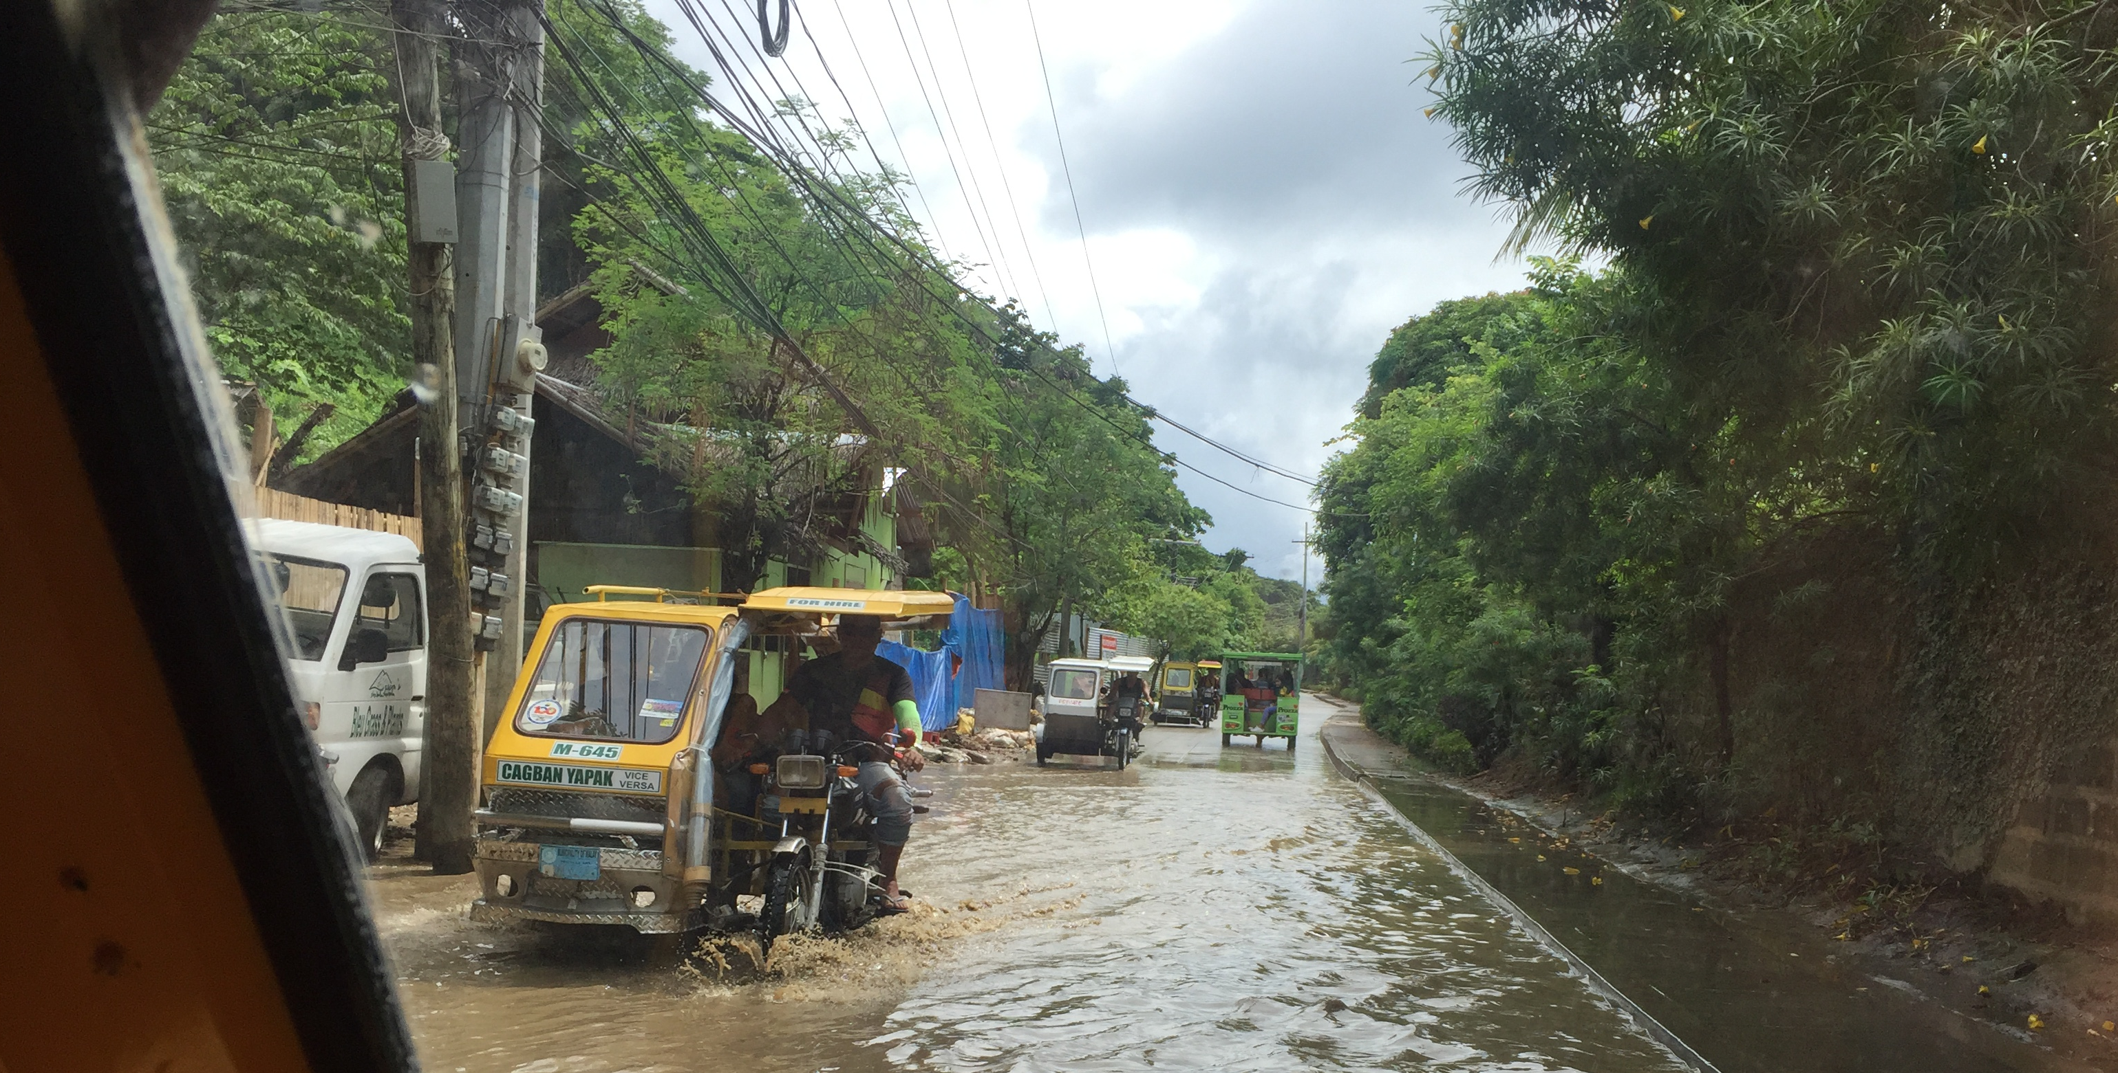
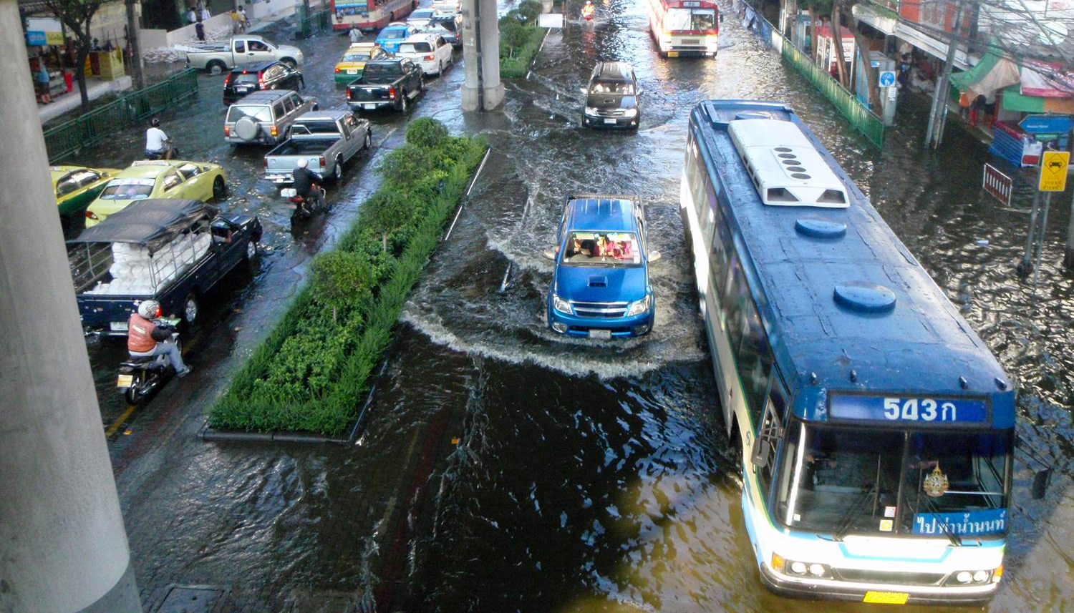
Project Overview
Project Objectives
Ultimate Goal
Protect investment in Transport Infrastructure globally and reduce money spent on disaster response and recovery
A - Scalable Assessment Tool
Outline of risk management tool to understand Roadway risk due to breadth of data, global applicability and design complexity
Future application to expand to other transportation asset types beyond roadways
B - Contracting Guidelines
Develop guidelines to assess, assign, and price the risk of climate change in PBCs for roadways
Develop performance standards for PBC projects that address climate change impacts
Understand global barriers to implementing climate adaptation methodologies in roadway projects
Notes:
Balance of risk between under and over allocation to contractor
Two main deliverables

Slide 4
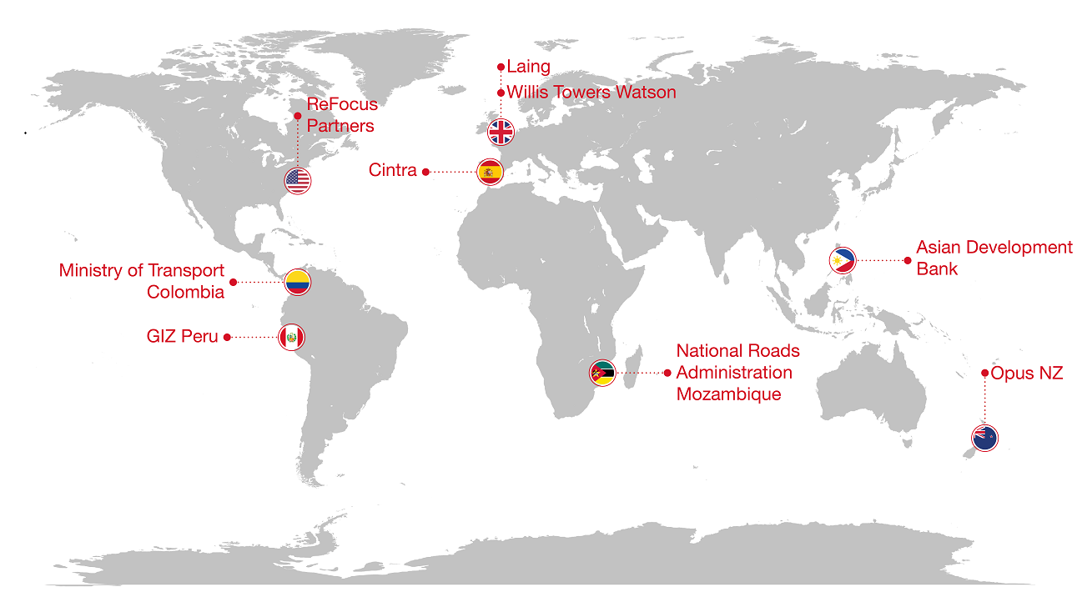
Background Research
Stakeholder Engagement
Notes:
Collection of perspectives from stakeholders around the globe.

Slide 5





Background Research
Stakeholder Input
Party | Takeaways
Contractors/ Developers | The costs associated with recovering from climate shocks and stressors will impact project profit
 | Uncertainty around climate risk could dissuade contractors and/or lead to increases in price to buffer the climate risk contingency
 | Responsibility for maintenance of the mitigation facilities provides one mechanism for control
 | The definition of force majeure will likely need to evolve with respect to climate change
Owners/ Client Countries | When the contingency budgets for storm repairs, increased drainage maintenance and unforeseen conditions have been exceeded, the regional government and asset owners are hit with additional service requests
 | Threats posed by offsite causes such as poor land use planning, agriculture and logging are hard to manage
Funders/ Investors | Duration of investment terms need to be extended
 | Contractual language should be augmented to incentivize resilience planning by developers
Communities | Local involvement in project development, execution and transition of ownership is vital to ensuring the ongoing feasibility of investments.
 | Project evaluation should consider economic impact of roadway on local community from both the positive perspective of increased commerce and the negative perspective of business continuity downtime associated with reduced availability.
Insurers | As providers increasingly experience claims as a result of intensifying climatic events, they will need to balance these with higher premiums.
 | Many countries without insurance markets lack coverage and are forced to self-insure with rainy day funds or turn to government bailout options.
Notes:
5 Main players in PBCs
Each is effected by different threats.
Procurement
It was recognized that the ADB procurement process does not easily provide a vehicle for climate change adaption requirements.
There is no link between procurement and the loan requirements through incentives or other means.
There is also currently no pre-qualification process for a loan which could be used as a gateway.
ADB staff felt that the opportunity for influencing the contracts was in the ‘bidding documents,’ primarily because the actual contract documents are commercially sensitive and between the national government and contractors.
Risk allocation within operations contracts is toggled from contractors to government parties solely through Force Majeure and Unforeseen Conditions terminology that defines these events using generic language unspecific to event scale.

Slide 6
Background Research
Key Challenges
Poor Risk Identification: Climate data is out of date and future projections are variable over investment periods.
Inaccurate Risk Valuation: Vulnerability assessment of projects does not typically consider the economic and social impact of asset availability.
Ineffective Risk Allocation: Risk ownership is not aligned with responsibility and unknown exposure discourages investment.
Implementation Phase | Challenges
Planning | Lack of clear understanding of risk exposure now and in the future
Design | Lack of appropriate standards to encourage adaptation measures
Investment | Lack of connection between Climate Risk and Credit Ratings
Construction | Cost of bidding additional products and materials used to mitigate risks
Operation | Inaccurate estimation of maintenance and adaptation costs
Notes:
Based on consideration of the entire project lifecycle, there are three main issues affecting proper climate risk mitigation in PBCs.

Slide 7
Project Overview
Program Goals
Risk Identification
Risk Valuation
Inputs for risk-based decision making
Value of adressing climate risk in PBC
How will logic and tool outputs be applied to real world projects
How to measure risk and structure KPIs effectivly
Risk Allocation
How to balance risk assignment and ownership
Strengths and weaknesses of this approach in relation to WB contracts
Distinguish the criticality drivers for roadway assets
Establish future climate scenarios and time horizons/ Over what time horizons should risk be assigned
Integration of climate risk in contracting
Characterize the sensitivity drivers leading to failure
How much risk should the contractor absorb
How to transfer risk through Contract Augmentation
Notes:
Our takeaway from the background research was that a functional tool should answer these questions.
In order to drill down and determine how to best answer these questions, we conducted a number of workshops in Asia, Europe and the USA.
From the feedback we received, we arrived at a five step process.

Slide 8
Risk Management Framework
Overview
Criticality
4-Minor
Vulnerability
3-Robust
Threat
Exposure of the roadway's critical assets to climate impacts
2-Possible
2-Major
3-Important
3-Potential
Measures to reduce costs of climate impact on roadway PBC
Consequences
Adaptation
Susceptibility of the roadway asset to climate related threats
2-Exposed
2-Event
3-Phase
Significance of the route to the country and economy
Impact of climate threat on cost of operation and maintenance
1-Vital
1-Sensitive
1-Likely
1-Repair Cost
2-O&M Costs
3-Deductions
1-Ownership
Notes:
The process has been designed to be feasible for replication globally and allow for quick prioritization of threats and associated cost implications.
The objective is to develop reasonable loss projections as a result of climate events and use these to inform region appropriate contractual adaptation measures (threshold definition, project phase specifics, risk ownership).

Slide 9
Risk Management Framework
Step 1 Step 2 Step 3 Step 4 Step 5 Criticality Vulnerability Threat Consequences Adaptations
Decision Tree Stress Test
Asset
Vital
Sensitive
Exposed
Minor
Exposed
Robust
Likely
Potential
Thresholds
Robust
Possible
High -
O&M Costs
Medium - O&M Costs
Ownership
Thresholds
Likely
Likely
High -Replace
Possible
Potential
Likely
Possible
Potential
Low - OK
Ownership
Terms
Standards
Thresholds
Terms
Standards
High - Deductions
High - Repair
Medium -Deductions
Medium - Replace
Medium - Deductions
Major
Important
Medium - Repair
Notes:
The 5 steps are part of a stress test process to identify and mitigate climate related risk as much as possible.
Next we’ll go through the theory behind each step to provide background to the framework questions.

Slide 10
Risk Identification
Project Specific Factors
1. Criticality
Determining the importance of the roadway based on usage and alternative pathways which may achieve the same desired result.
Example: roadway is Vital as it links the only port in the country to all major cities
2. Vulnerability
Determining the susceptibility of the roadway to climate change in the future based on physical qualities and condition assets.
Example: roadway is well constructed with proper drainage and set away from all water ways with significant buffer space.
Threat
Determine over what timespan the roadway will need to function and use an appropriate RCP based on this.
Example: RCP 6 requires reasonable ROI as roadway is “Significant” but will become a secondary route in 20 years
Extreme Heat
Extreme Cold
Sea Level Rise
Precipitation
Surface Flooding
Riverine flooding
Coastal Flooding
Storm Surging
Material Deformation
Snow
Ice
Fire
Notes:
Steps 1 through 3 each feed into risk identification.
The goal of the section in its entirety is to identify which threats are likely to impact the roadway during its expected lifecycle.
When we think of climate change impacting roadways, we often think of precipitation and SLR.
In many parts of the world extreme heat and extreme cold are also causing loss in functionality and reliability as well as asset failures

Slide 11
Risk Identification
Understanding Asset Criticality Factors
Economic - Does this road:
    Connect commercial hubs?
    Serve as a route for goods?
    Provide access to employment?
Social - Does this road provide direct access to:
Schools or daycares?
Hospitals, eldercare or related facilities?
Emergency response, police or fire stations?
Infrastructure - Does this road provide direct access to:
  energy utilities (e.g., substations)?
  telecomm utilities?
  water or wastewater utilities?
Redundancy
    Is there another road/alternative route nearby?
    Will any community or resource be isolated by road loss?
Volume
    Average Daily Trips
    Level Of Service
Notes:
Criticality is representation of how needed the route is for a functional society.
Detailed research in numerous countries around the world has indicated that criticality is heavily based on few key factors.
Economic function
Social needs
Infrastructure
Access
Usage

Slide 12
Risk Identification
Criticality Ranking
Criticality Scale | Description
Criticality 1 (Vital) | A vital route or section of road whose failure would have a nationally significant economic or social impact, or is a nationally significant lifeline, ensuring access or continuity of supply of essential services during an unforeseen event.
Criticality 2 (Major) | A major route or section of road whose failure would have a significant economic or social impact to more than one region, or is a regionally significant lifeline, ensuring access or continuity of supply of essential services during an unforeseen event.
Criticality 3 (Significant) | An important route or section of road whose failure would have a significant economic or social impact to a region, or is a significant lifeline, ensuring access or continuity of supply of essential services during an unforeseen event.
Criticality 4 (Local) | A local route or section of road whose failure would have a serious local economic or social impact, or is a locally important lifeline, ensuing access or continuity of supply of essential services during an unforeseen event.
Notes:
Most countries have some mechanism for classification of routes.

Slide 13
Risk Management Framework
Step 1: Asset Criticality
1 - Vital
2 - Major
3 - Important
4 - Minor
Example:
A 60km collector roadway in Tonga provides access to employment and local schools. There is another 80km alternative route that takes 30 minutes longer, but all of the water and communication lines that supply the community are in route A.
Route should be upgraded from important (collector routes) to Major based on utilities
Location
Country
Length
Classification
National
Regional
Redundancy
Isolation
Alternative Route
Economic
Social
Electrical
Collector
Rural
Time Loss
Travel Time
Average Daily Trips
Commercial Hubs
Ports
Imports
Exports
Employment
Hospitals
Evacuation
Infrastructure
Schools
Emergency Services
Tech
Water
Wastewater
Notes:
Step 1 of the framework assists in collecting data related to criticality.
The factors which shift the needle most are going to be factors relating to successful function of social systems and economies.

Slide 14
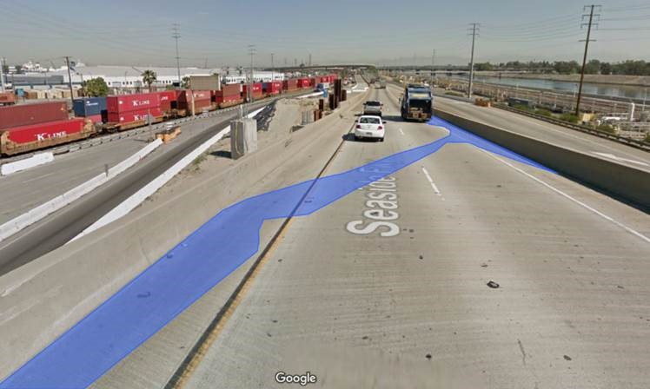
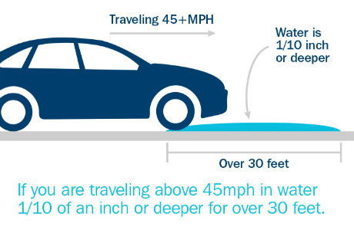
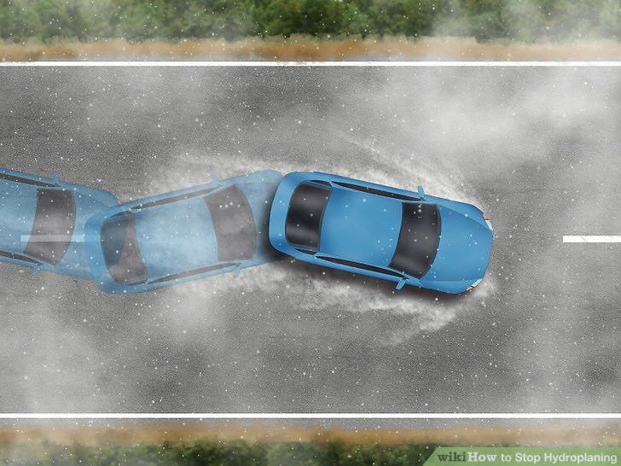
Risk Identification
Design Standard Failure
Design Standard
50 year storm code
Flow remains in shoulders
RCP 8.5 2081-2099
(50th Percentile)
0.33 cfs bypass
  (230% exceedance)
3.6-ft shoulder exceedance
  (30% of Lane 1)
RCP 8.5 2081-2099
(90th Percentile)
0.51 cfs bypass
  (410% exceedance)
6.1-ft shoulder exceedance
  (51% of Lane 1)
Performance Standard
Install new drain inlets or
Fail performance indicator
Bypass
Shoulder
New drain inlet
Notes:
Roadways are designed to be safe a ‘reasonable’ amount of time. This is typically up to the historic 100 or 50 year event threshold.

Slide 15
Risk Identification
Shifting Design Standards
Acceptability Thresholds
Downscaled GCMs can produce average values for climate parameters over set planning periods, for example 2020 to 2050.
Climate Response Map indicates the climate sensitivity of a roadway project
Climate response functions can be used to identify changes in performance with varying climate conditions
Example (right) shows a hypothetical performance threshold mapped to climatic parameters
Roadway Design Standards
RCP 4.5
Present
Climate Design
Envelope
Standard Design
Envelope
Less Robust → Poor Future Performance
Standard Practice
More Robust → Good Future Performance
Source: Ray, Patrick A., and Casey M. Brown. 2015. Confronting
Climate Uncertainty in Water Resources Planning and Project Design: The Decision Tree Framework.
Washington, DC: World Bank. doi:10.1596/978-1-4648-0477-9. License: Creative Commons
Attribution CC BY 3.0 IGO
Notes:
What is acceptable needs to shift as historic 100 year events are recently occurring each decade.
This concept of revised design thresholds is taken from work performed by the World Bank around water utilities but applies equally to roadway infrastructure standards.

Slide 16
Risk Management Framework
Step 2: Asset Vulnerability
1 - Sensitive
2 - Exposed
3 - Robust
Example:
The 2 lane roadway is paved with concrete and set in a rocky, rolling terrain. The design combines at grade and cut and fill sections with very few dirt ditches.
The roadway should be downgraded from robust (concrete), to Exposed based on poor drainage conditions.
Geometry
ROW width
2 Lanes, no shoulders
Terrain
Flat
Rolling
Components
At Grade
Viaduct
Geology
Surface
Drainage
Mountainous
2 Lanes, dirt shoulders
2 lanes paved shoulders
Rock
Concrete
Silt
Sand
Clay
Sealed
Asphalt
Gravel/Dirt
Culverts
Treated Ditches
No Ditches
Cut/Fill
Tunnel
Bridges
Dirt Ditches
Notes:
The key design and construction factors which effect the vulnerability of roadways are included in the framework tool.

Slide 17
Risk Identification – Understanding Project Threats
Geopolitical Risks
War
Trade disruption
Energy security
Market Risks
Prices
Exchange rates
Interest rates
Institutional Risks
Political
Financial
Regulatory
Industry Risks
Demand
Supply
Competition
Natural Risks
Geology
Climate
Weather
Indirect Influence
Direct Influence
Project Risks
Partners
Contractors
Execution
Notes:
Climate risk is one of the many risks that effect PBC contracts.
Traditional Project Risks are slightly more manageable using contracting mechanisms.
Some risks are outside the scope or control of most PBCs.

Slide 18
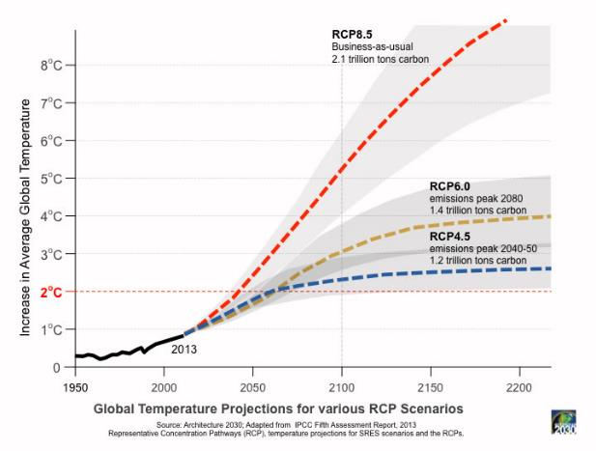
Risk Identification
Understanding Climate Threat
RCP8.5
Limited/No Global Emissions Reduction
Outcomes from different climate simulations vary
RCP4.5
Moderate Global Emissions Reduction
Notes:
Climate threat is a moving target but still more predictable using data than other risks.
Defining variables helps in identifying
Variables include not only what Representative Concentration Pathway to use but also to what point in time.

Slide 19
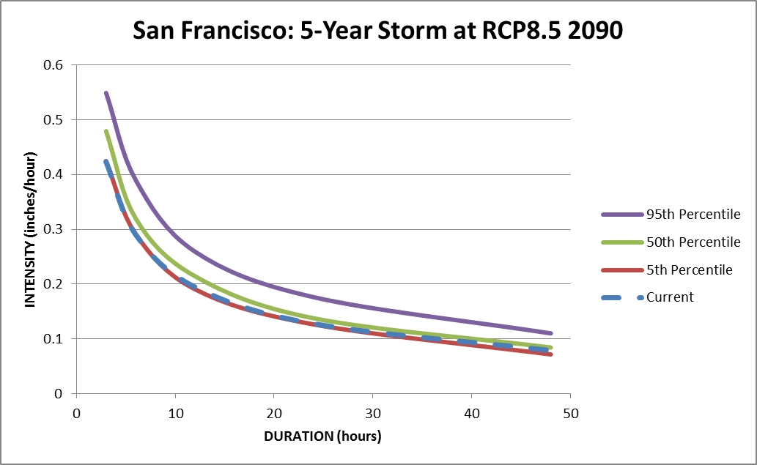

Risk Identification
Future Hydrology
Rainfall intensity offsets
Derived for a variety of combinations of duration and return period
Cumulative distribution functions (CDFs) are constructed from the offset values
Risk scenarios are represented by values extracted from the CDFs for 7 standard percentiles (5th, 10th, 25th, 50th, 75th, 90th, 95th)
Future IDF curves are generated by adding these offset values to historical IDF values
WeatherShift Rainfall hydraulic modeling analysis utilizes these Future IDF Curves for climate-ready risk management
Offset for a 5-year, 10-hour storm, at the 95th percentile
Offset for a 5-year, 20-hour storm, at the 50th percentile
Notes:
Increased precipitation associated with shifted RCPs can be projected on IDF curves similar to the traditional model. This means the data can easily be used in design in the same manner as it is today.
Future Intensity-Duration-Frequency (FIDF) Curves
WeatherShift uses 21 downscaled global climate change models (GCM)
Global climate change models from the Intergovernmental Panel on Climate Change (IPCC)’s Fifth Assessment Report (AR5)
Representative concentration pathways (RCPs): 8.5 & 4.5
Availability Criteria
Impassable days per year
Reduced Service days per year
Accidents per year
Cracking / Potholes per square meter
Climate Impacts
Inundated roadway – flood depth
Inundated roadway – flood duration
Inundated roadway – rainfall intensity
Visibility impaired – rainfall intensity
Ponding on roadway – rainfall intensity
Ice on roadway – freezing temperatures
Snow on roadway – winter storms
Identify Correlations with Design Specs
Intensity vs. Runoff Rate
Minimum temp vs. Freeze Index
Maximum temp vs. Heat Index

Slide 20
Risk Management Framework
Step 3: Climate Threat
1 – Likely
2 – Possible
3 – Potential
Example:
A paved roadway base along a river in Tonga will last 30 years, deeming a 2050 planning horizon when the precipitation and heat from the RCP 6 model will be most severe.
This Major roadway will use the 75th percentile to predict that floods and landslides are Likely
Source Proximity
Sea
Planning Horizon
2030
Concern
Flood
RCP
Confidence
RCP 8.5
95th %
2040
2050
2100
RCP 6
RCP 4.5
River
Canal
Glacier
50th %
25th %
Dam/Lake
Material Failure
Landslide
Snow/Ice
Hazard
Percipitation
Sea Level Rise
Heat
Cold
Wind
Storm Surge
75th %
Notes:
Climate threat is always based on a number of inputs and owner appetite
In the case of this tool, we’ve chosen to use vulnerability to influence the planning horizon.

Slide 21
Risk Valuation
Driving Resilience with numbers
1. Cost Increases
Determining which climatic events increase Operation and Maintenance costs over time due to more regular repairs and amplified ongoing wear and tear. Example: roadway repaving is required every 7 years instead of 10 due to base failure
Key Performance Indicators (KPIs)
Determining which indicators best measure the ability of an asset to perform with greater resilience to variable climate patterns through an extended contracting period.
Example: lane closures from flooding
3. Return on Investment
Determining which investments create the best O&M cost savings related to resilience to variable climate patterns through an extended contracting period.
Example: raised roadway costs less to clean
Maintenance
Payments
Usage
Operations
Snow Removal
Electrical Costs
Revenue
Funding
Pump Replacements
Failed KPIs
Availability Loss
Asphalt Wear

Slide 22
Risk Valuation
Increasing Lifecycle Costs
Cost Category | Original Budget ($/year) | ROC ($/year)
Materials (Ice Slicer, Sand, Liquid De-icer) | $914.00 | $1,096.80
Winter Equipment Maintenance, Inspection, Parts, etc. | $25.50 | $29.33
Seasonal Employees | $231.00 | $231.00
Fuel for Winter Trucks | $35.00 | $42.00
Total | $1,205.50 | $1,399.13
Cost Overruns | $193.63 | 16%
* Values in '000$s
Notes:
Credit Rating Agencies require borrowers to estimate risk over the term of a loan. This has traditionally included risk related to design, permitting, construction, schedule and revenue. They are now asking borrowers to consider climate risk over the life of the project as well.

Slide 23
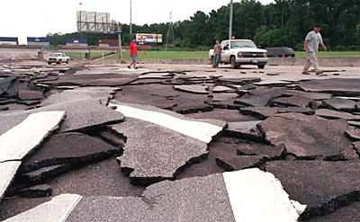
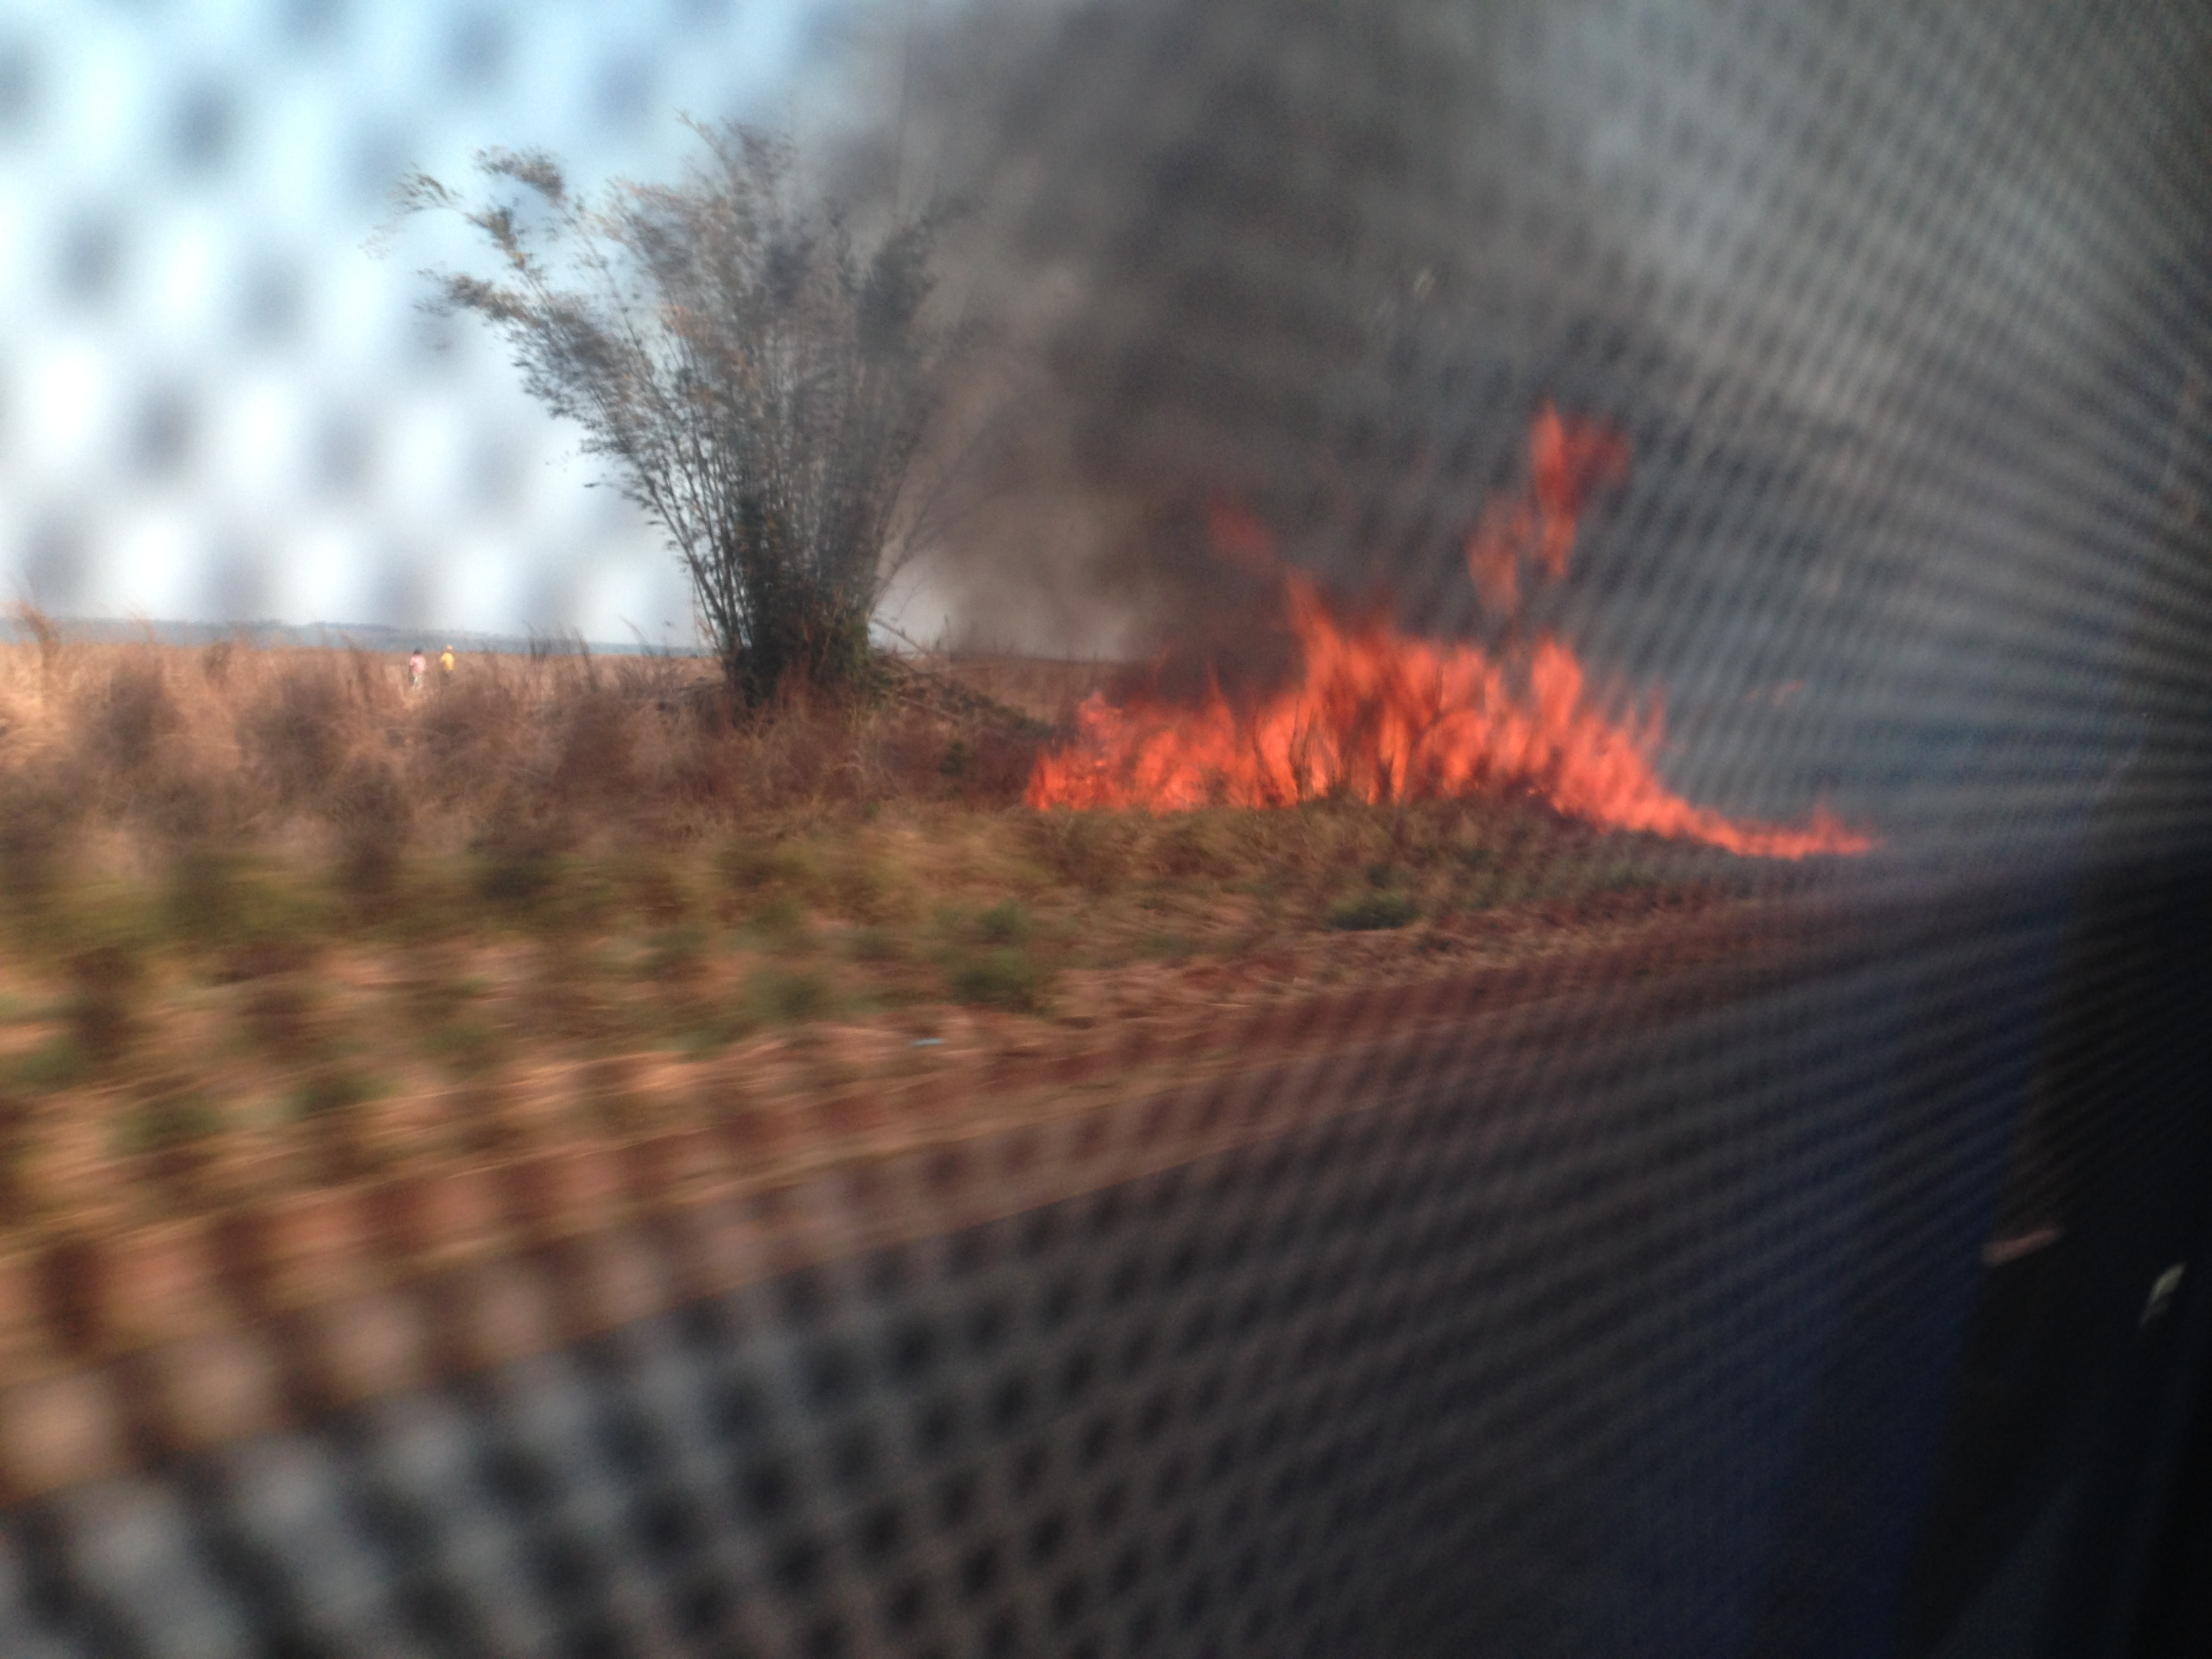
Risk Valuation
KPIs – Performance failures may result in Payment Deductions
Physical KPIs Unit of Measurement
Flooding | Depth | Debris Damage | Quantity
Erosion | Volume | Wall/tunnel damage (increased accidents) | Length
Scour | Area | Mechanical failure (increased pumping) | Quantity
Pavement cracking/potholes | Area | Salt damage (from snow treatment) | Area
Asphalt wear | Roughness | Snow plow damage | Area
Drainage network damage | Blockage | Electrical failure | Quantity
Metal corrosion | Area | Camera failures | Quantity
Landscape damage | Area | IT failures | Quantity
Embankment failure | Length | Street Light deterioration | Quantity
Fire damage | Area | Paint peeling | Area
Railing failure | Length | Paint melting | Area
Operational KPIs Unit of Measurement
Accidents | Quantity | Accessibility
Level of service | Rating | Sun exposure/ Heat exhaustion | People
Travel time | Minutes | Capacity (change due usage type) | Vehicles
Availability | Days | Demand (change due to lifestyle changes) | Vehicles
Delay Volume | Hours | Snow removal time | Minutes
Notes:
Damage level and functionality are both ways we measure performance.
The same indicators are used to rate performance under climate threat.

Slide 24

Risk Valuation
Availability Payments
General Fund
Availability Payments pay back initial investment and ongoing O&M needs
Sequence of payments prioritizes ensuring the asset is available for use and kept in good repair
Subject to deductions for shortfalls in performance
Costs associated O&M and major repairs directly impact reserves for debt repayment
Reduced Availability Payments will directly impact Financial Performance and long term viability of an Asset
Availability
Payments
Other Project Revenues
Facility O&M costs
Maintenance reserve
fund
Debt repayment
Equity
repayment
Upgrade
fund
Notes:
Deductions and cost overruns effect long term viability of projects.

Slide 25
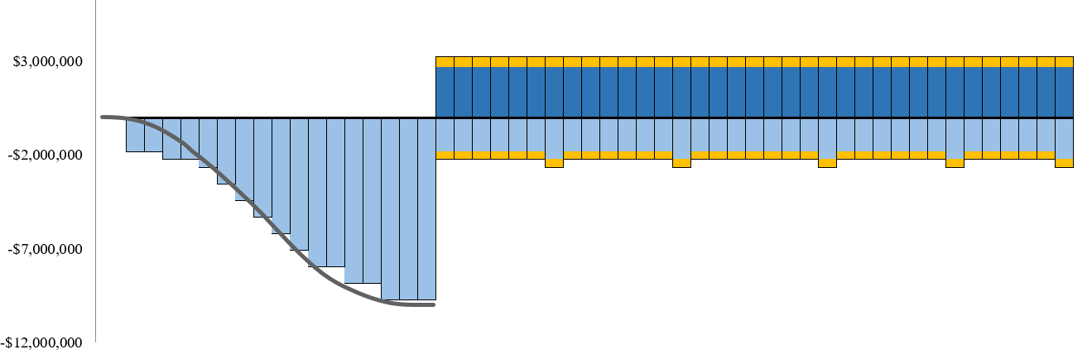
Risk Valuation
O&M Cost Increases
Construction
Operations and Hand-back
Payment Deductions from noncompliance with KPIs
CapEx
Operations and Maintenance
OpEx Cost Increases
Time
Notes:
Operating Budgets are hit from both sides with increased O&M costs and losses due to KPI failures.

Slide 26
Risk Management Framework
Risk Quantification
 |  | Route Criticality (Step 1)
 |  | Minor (use 25th) | Important (use 50th) | Major (use 75th) | Vital (use 95th)
Climate Change Threat Probability (Step 3) | Likely | Medium | Medium | High | High
 | Possible | Low | Medium | Medium | High
 | Potential | Low | Low | Medium | Medium
Notes:
Use criticality and vulnerability data to determine risk exposure

Slide 27
Risk Management Framework
Step 4: Consequences
1 – Repair Costs
2 – O&M Costs
3 – Deductions
Example:
There is a high risk the roadway will experience slope and surface failures as a result of over saturation and flooding, leading to closures, delays and failure to meet KPI s.
Deductions are possible and additional labor to repair damage will increase O&M costs.
Material Costs
Concrete
Labor Costs
Person
Losses
Crossings
Operations Performance
Maintainence Performance
Closures
Potholes
Vegitation
Truck
Heavy Equipment
Accidents
Delays
Gravel
Stone
Steal
Slides
Base Failures
Dirt/ Debris
Pipe
Drainage
Slopes
Surface
Risk
Low
High
Medium
Notes:
Consequences are a product of risk probability and O&M costs

Slide 28
Risk Allocation
Driving Resilience with language
Influence Risk Mitigation through Contracting
Credit Rating
Setting evaluation criteria to require climate risk consideration. “SBD Works Following Prequalification - to be used when the bidding is preceded by a prequalification exercise.”
Example: Require climate aware designs for loan prequalification.
Contracting Language
  Determining what measurable drivers can be introduced into the PBC structure. Are these thresholds enforceable as part of the contract and payment structure and reasonable in regards to success of the developer or contractor?
Example: Specify factors of safety in risk mitigation
Key Stakeholders
Funding Partners
    The World Bank
    The Asian Development Bank
    Private Banks
Asset Owners
    National Ministries
    Local Governments
  Developers
    Special Purpose Vehicles (SPVs)
    Construction Contractors
    Operations Contractors
  Insurers
    Private Insurers
    National Disaster Funds
Notes:
Understand reasonable “Transfer” of Risk Ownership
Design and Construction
Determining how much risk the contractor should carry and over what time horizon this risk should be assigned. Are Warranty Periods appropriate for the PBC structure?
Example: 10 year warranty of tunnel waterproofing system
Operations and Maintenance
Determining how to best incorporating climate risk ownership into the PBC structure. How to effectively measure climate performance through KPIs and how to best balance risk assignment and ownership.
Example: Tunnel systems is free of water at all times

Slide 29
Risk Allocation
Understanding Concerns
Owners
Concern is Social Impact
Driver is Increased functionality of the roadway network and associated assets
Contractors
Concern is Physical Impact
Development Banks
Concern is Economic Impact
Driver is Economic benefit of roadway asset on community or region
Driver is Reduced risk exposure per dollar spent on mitigation activities
Insurers
Concern is Financial Impact
Driver is Reduction in climate impact on roadway asset condition
Notes:
Risk mitigation is driven by stakeholder objectives

Slide 30
Risk Allocation
Understanding Drivers
Social Impact
Availability Performance
Physical Impact
Economic Impact
Business Generation
Loss Reduction
Service Performance
Physical Damage
Environmental Damage
Business Downtime
Repair Cost Estimates
Asset Functionality
Damage Reduction
Value for Money
Asset Values
Financial Impact
Notes:
This in turn drives KPIs

Slide 31
Risk Allocation
Mitigation Measures
Government Policy
Prescribe codes and specifications which require greater consideration of climate
  Avoid backwards looking Design Events (50 year, 100 year)
  Include changing Factors of Safety
  Encourage consideration of VfM thinking in design standards
Fiscal Incentives
Push for Insurance rebates for Resilience measures which can prove reduced exposure to insurance providers.
Floodplain reduction due to roadway project
Evacuation pathways protect lives
Access routes reduce repair time and related business downtime
Stakeholder | Traditional Risk Mitigation | Expanded Risk Mitigation | Value Capture Methodology
Asset Owner Executing Agency | Issue Design Standards | Offer Performance Incentives | Set stringent Availability based payments
Funding Partner ADB | Require Loan Repayment | Reduce Interest Rates | Offer Improved Credit Rating for Protected Assets
Developer Construction Contractor | Contractual Transfer | Require Business continuity management plan
PMU O&M Contractor | Purchase Insurance | Harden Assets | Increase Asset Robustness
Private Insurer | Set Liability Limitation | Offer Premium Discounts | Risk Reduction
Disaster Fund National Government | Accept | Offer Hazard Mitigation incentives | Expand Incentives for Regional Protection
Community Region | Locally Funded | Invest in Maintenance | Land Value

Slide 32
Risk Allocation
Contractual Language
Systems Planning
Tender
Detailed Design
Owners produce Climate Hazard Models
Construction
Operation
Designers under employ of the owner develope precise drawings which contractors must follow
Banks mandate project requiremnst in order to minimimze rosk to investmnet
Owners control possibility for alternative concepts
Owners establish risk appeities
Contractors make roadway improvments per the owner's design and specification
Contractors clean and maintain facililities per the specifications of the contract for 5-10 years prior

Slide 33
Risk Allocation
Contractual Language
Event of Force Majeure Means an event beyond the control of the Authority and the Operator, which prevents a Party from complying with any of its obligations under this Contract, including but not limited to: act of God (such as, but not limited to, fires, explosions, earthquakes, drought, tidal waves and floods). | Unforeseen Condition Unanticipated or unexpected circumstance or situation that affects the final price and/or completion time of a contract or project. | Storm Event The occurrence of storms and other significant weather phenomena having sufficient intensity to cause loss of life, injuries, significant property damage, and/or disruption to commerce; Rare, unusual, weather phenomena that generate media attention, such as snow flurries in a coastal area. | Reasonable Expectation Doctrine is a principle applied in insurance law which states whenever there is an ambiguity in an insurance-policy, it is resolved in favor of the insured's reasonable expectations. Usually an ambiguity arises when there are plausible, competing interpretations of a policy term.

Slide 34
Case Study: Almanzora Autovía - Spain
Adaptable Performance Metrics to Attract Investment
Objective
The Almanzora Autovía (A-334) project is part of the "Plan for the Improvement of Accessibility, Road Safety and Conservation in Andalusia's Road Network".
The contract includes requirements for continuous improvement mechanism or update of the proposal for environmental indicators.
By including this environmental criteria in the project, the concessionaire is able to more easily attract responsible financing and funding from Multilateral Agencies.
Inclusion of environmental indicators in the operations maintenance program reduces the risks arising from possible fines or penalties for non-compliance with legal environmental parameters.
The disadvantage is that future incorporation of environmental indicators/criteria into the Concession Agreement may result in the need for additional economic investment.
Scope
Failure to comply with certain environmental standards and criteria covered by the law and specified in the EIS (Environmental Impact Statement), entails contractual penalties and, if applicable, legal penalties.
The contract involves additional contractual commitments, with non-compliance that may result in potential sanctions, fines or other penalties.
In addition, deductions may be made in the availability payments for breach of the indicator modifications agreed to in the contract process and contract structuring section.
In addition to the costs of compliance with legal provisions, the concessionaire also assumed the cost of implementing ISO 9001, which was not mandatory by law but required by the innovative contract.
Overcharges caused by delays in obtaining permits and authorizations will also be borne by the concessionaire.
Notes:
Addressing unknown level of change by adjusting KPIs every ten years

Slide 35
Risk Management Framework
Step 5: Adaptations
1 – Risk Ownership
2 – Thresholds
3 – Project Phasing
Example:
To reduce O&M cost overruns the contract should include language around Stress Event and Shock event thresholds as well as transfer of design risk to the Contractor.
Standards
Scale
Affected Parties
Events
Shock Event
Terms
Phase
Force Majeaure
Planning
Other communities
Business
Investors
Unforseen Conditions
Reasonable
Effort
Reviewed
Tender
Design
Construction
Compounding Events
Operation
Stress Events
Quality
Ownership
Client Country
Contractor
Local Community
Insurance

Slide 36
Procurement Changes
Contractual Augmentation
1
5
Extend Investment Periods
2
Lack of awareness or understanding of how risk exposure threatens investments leads to a de-prioritization of risk mitigation.
3
Consider Return on Resilience Investment
Conservative global climate models with long range time horizons result in cost prohibitive design and construction estimates for risk adaptation measures.
Educate Governments and Asset Owners
Include Climate Risk in Credit Rating
Credit and insurance ratings undervalue climate risk exposure and consequently give little consideration to the effectiveness of adaptation efforts.
4
Prioritize High Risk Assets
Urgent concerns, such as immediate threats to investments from 5-year flooding, will continue to outweigh adaptation efforts to mitigate risks that are 30 years in the future.
Contracts with shorter terms of 7 years or less do not incentivize long term risk mitigation and adaptation.

Slide 37
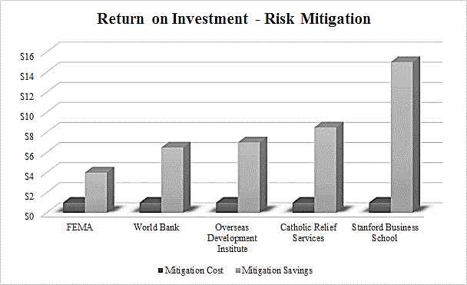
Barrier 2: Valuing Preparation for Extreme Weather
Return on Investment
“Its cheaper to build it right the first time around”
…is a familiar saying but is statistically proven to be highly applicable when it comes to preparing for disaster.
Many agencies working in disaster relief have shown that for every $1 spent on preparation, $4 to $15 is saved on emergency response and repair.
These numbers typically do not include loss of business or other economic impacts.
Notes:
$1 invested in building resilience and reducing exposure saves $4 in disaster response and recovery
$1 invested in resilience saves $4-7 in response and $5-10 in avoided economic losses
$1 on disaster risk reduction saves $7 in response activities
$1 on disaster preparedness saves $7-10 on response
$1 in preparedness is worth $15 in disaster relief efforts

Slide 38
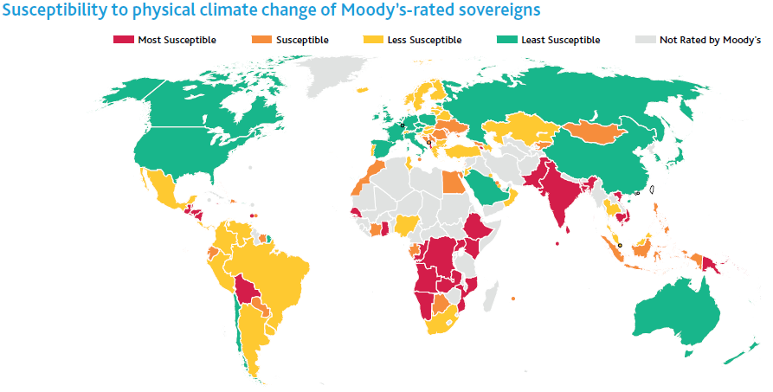
Barrier 3: Reduced Borrowing Limits
Consider Credit Rating
In 2017, the major Credit Rating Agencies began dropping the credit scores of countries and municipalities with high risk of climate impact damaging their assets.

Slide 39
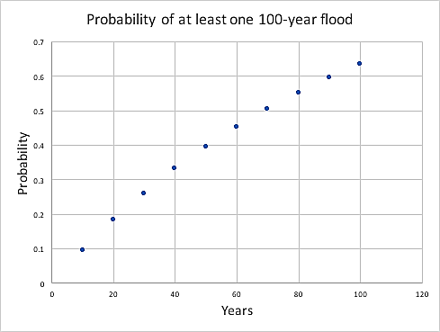
Barrier 5: Aligning Time Horizons and Risk Appetites
Threat Probability over Asset Lifecycle
Coverage gaps
Many contracts specify limits to coverage at what is considered an improbable event.
    The 100 year storm or 1% probability of flood sounds like a very low risk event.
Even without Climate Change this event would have an over 50% probability of occurring during an average asset’s lifetime.
    A 10% probability during a loan period.
Recent Climate statistics show this scale of event happening on the order of 1/10 years pushing the cumulative numbers even higher.

Slide 40
Incorporating Climate Risk into Performance-Based Contracting
Yana Waldman PE
Resilient Engineering Consultant
Infrastructure Advisory
Houston TX, 2017

