Slide 1
The PASET Regional Scholarship and Innovation Fund (RSIF)
Dr. Moses Osiru
Manager, RSIF, icipe

Slide 2
RSIF Value proposition (1)
Country contributions (Window 1- PhD Training): 80:20% for nationals, and other SSA students resp.
High quality doctoral training in SSA universities
Rigorous competitive selection
Partnerships with international universities/institutions
Partial study abroad
Lower cost of quality PhD training
Support for transition from studies to employment:
Ph.D graduates eligible for research and innovation grants (Windows 2 and 3).
Pooling of funds
Lower management costs through regional approach
Reduced inbreeding
Targeted priority areas
High retention

Slide 3
RSIF Value proposition (2)
Increase women participation in ASET fields
Building new departments in African universities
Spillover effects on national research funds
Participate in RSIF governance
Students come back with cutting edge research knowledge
Membership to Governance Council
Membership to PASET Executive Board
International networks within and outside Africa
Focus on women scientists women (Target of at least 40%)
Focus on bright young faculty
Targeting students from poor backgrounds
Demand driven research (e.g. private sector)
Faculty eligible for research and innovation grants.

Slide 4
PASET priority thematic areas Contributing countries can select areas to build capacity through RSIF
ICTs including big data and artificial intelligence
Food security and agribusiness
Minerals, mining and materials engineering
Energy including renewables
Climate change
Notes:
4.0 Priority ASET thematic areas
The priority thematic areas are selected based on critical needs on the continent,
4.1 ICTs including big data and artificial intelligence.
This involves use of information and communication technologies in a wide range of economic sectors, including big data analytics and artificial intelligence systems, computer programming, software development and their applications in manufacturing and service delivery.
4.2 Food Security and agribusiness
This includes sustainable food production systems, pest and disease control strategies, management of post-harvest losses of crops and new opportunities for agribusiness development. Other areas include new ways to improve soil fertility, conserve water for food and agricultural production, and enhancing nutrition for humans and livestock.
4.3 Minerals, Mining and Materials Engineering
This includes mineral processing and beneficiation, and mining and materials engineering. Other important areas include new materials for construction, transportation, consumer goods, health care delivery and production equipment. Work involving nanomaterials, and exploring novel biomaterials and related climate-smart materials would be of much interest.
4.4 Energy
This involves new forms of generating energy as well as more efficient ways of using energy. Developing renewable energy sources, e.g. biomass, wind, solar, and geothermal are highly encouraged.
4.5. Climate change
This involves developing strategies for mitigating or adapting to climate change, including, for example, early warning systems for natural disasters and strategies for disaster management, modelling for climate change, and building climate smart or resilient systems for urban and rural communities and disaster prone populations in Africa.

Slide 5
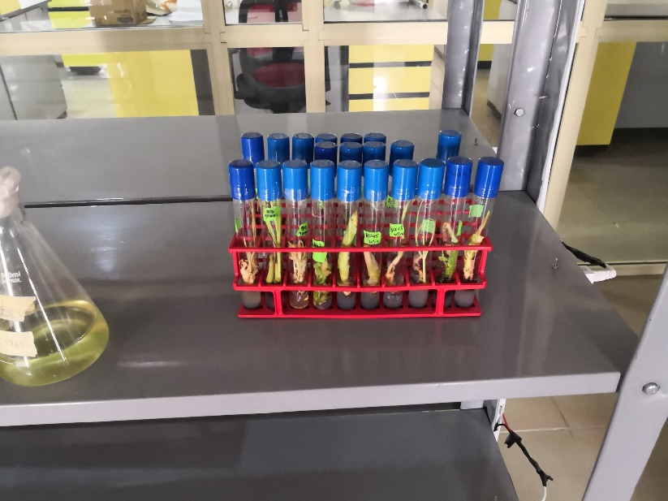
PASET Regional Scholarship Innovation Fund launched in 2015 to build sustainable doctoral training, research and innovation ecosystems to develop transformative technologies in Africa for economic growth and development
RSIF Objectives:
Create a stock of highly skilled scientists, professionals and innovators in ASET areas.
Identify and nurture young talented Africans who wish to further their studies in ASET fields where expertise needed most
Address imbalances in the number of women and disadvantaged groups in ASET fields in Africa
Build African university capacity to provide relevant ASET training and to ensure continued investment in scaling up ASET education and workforce
The launch was led by HE President Macky Sall of Senegal along with representatives of the heads of states in Ethiopia and Rwanda

Slide 6
RSIF Design
Permanent (Endowment) Fund
(US$15million by 2024)
General Fund
(US$50 million by 2024)
Window 1:
Scholarships, institutional capacity building, partnerships & networks
Window 2:
Research Grants
Window 3:
Innovation Grants and creation of innovation environments

Slide 7
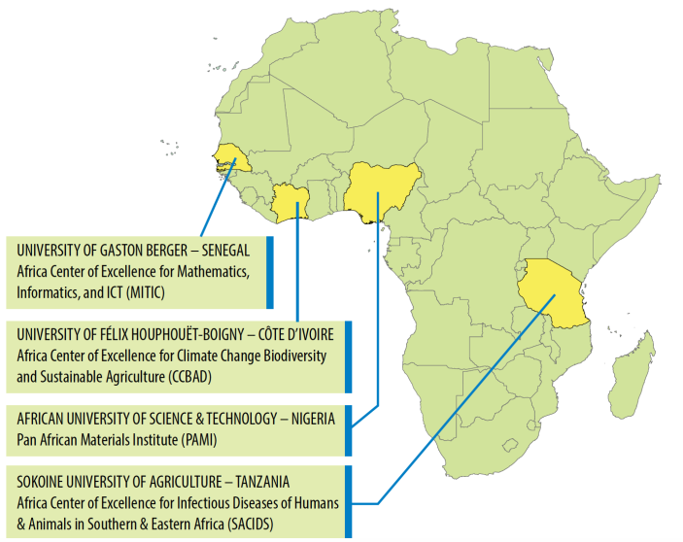
RSIF African Host Universities
The first 4 RSIF Host Universities were competitively selected in 2017 from existing Africa Centers of Excellence.
Competitively selected to offer a PhD program in one of the RSIF Priority Thematic Areas
implement international-quality PhD training, research and innovation
Host RSIF PhD Scholars
Can apply for RSIF Research and Innovation grants
Receive institutional capacity building
Develop international partnerships with world-class institutions/universities and private sector globally and in Africa

Slide 8
Rigorous, competitive selection of host universities
Call for proposals published
Compliance check undertaken by the RCU
Remote desk review by a panel of independent reviewers
A physical meeting of the Independent Evaluation Committee (IEC) to select proposals for onsite review
The onsite evaluation: physical validation of proposal and resources
a Virtual meeting of the IEC to provide recommendations to the EB of PASET
Final selection by the PASET EB.

Slide 9
RSIF PhD Sandwich Program
Year 1
Years 2 & 3
Year 4
African Host University (AHU)
International Partner Institution (IPI)
African Host University (AHU)
Up to 1 year
Admitted to an AHU PhD program
Matching with suitable IPI supervisor completed early in program
Student, with support from both supervisors, develops research proposal and plan for activities at AHU and IPI
Student begins research as required
Completes coursework as required by AHU
Takes TOEFL exam if required by IPI
2 years as a visiting scholar/ researcher
Conducts major part of doctoral research
Coursework as required by IPI
Writes scientific papers
1+ year
Finalise research as necessary
Writes scientific papers
Complete thesis
Thesis defense is heard by both parties from AHU and IPI
Degree awarded by AHU
Graduation
Joint supervision by African Host University and International Partner Institution supervisors
Notes:
The student will have two supervisors – 1 at each institution – for joint supervision throughout the PhD program
The African Host University and International Partner will develop a strong partnership for joint supervision of the PhD scholar, with regular contact between both supervisors and scholar.
The partnership will begin at an early stage of the student program, so that both supervisors are involved with the student as they develop their research proposal and plan for activities at both the AHU and IPI.
A strong supervisory Partnership is important for the success of the student and strengthening of the PhD program at the African Host University
The RSIF PhD scholar will conduct a major part of their doctoral research at the IPI: therefore the Partner Institution must have the relevant research capacity as well as an interest in research with relevance to Africa

Slide 10
RSIF International Partner Institutions
IPIs are universities, research institutes or companies (public or private)
Institutions with strong PhD training, research & innovation in the Priority Thematic Areas
Private sector partners will help strengthen industry linkages and promote more demand-driven training, research and innovation
Experience or willingness to work with RSIF African Host Universities (AHU) and ASET fields relevant to sub-Saharan Africa
Offer 1-2 year sandwich opportunities for RSIF PhD Scholars -relevance to African problems
Support AHUs to improve quality of relevant PhD programs
Notes:
Improving the quality of the PhD programs may include curriculum review and improvement; joint development of new courses; faculty exchange; accreditation

Slide 11
Window 2: Research Grants- Applied research to resolve local development challenges
Type 1 -Research Awards
Grant size: US$ 90,000
Type 2 -Junior Investigator Res. Award
Grant size: US$ 80,000
No. to be awarded: 10
Eligible: AHU Faculty involved in RSIF PhD Program.
No. to be awarded: 16
Eligible: RSIF PhD graduates who get postdoc or permanent position at university or research centre in SSA.
Source of funds: Govt of Korea & World Bank (piloting)
Source of funds: Govt of Korea
Duration: 3 yrs
Duration: 3 yrs

Slide 12
Window 3: Innovation Grants- Supporting innovation and commercialization
Type 1 -Innovation Capacity Building
Grant size: US$ 50,000
Type 2 -Cooperability Grant
Grant size: US$ 50,000
No. to be awarded: 6
Duration: 2 yrs
No. to be awarded: 5
Eligible: Faculty of RSIF AHU involved in PhD training.
Source of funds: World Bank (Piloting)
Source of funds: World Bank (piloting)
Eligible: AHU
Duration: 2 yrs

Slide 13
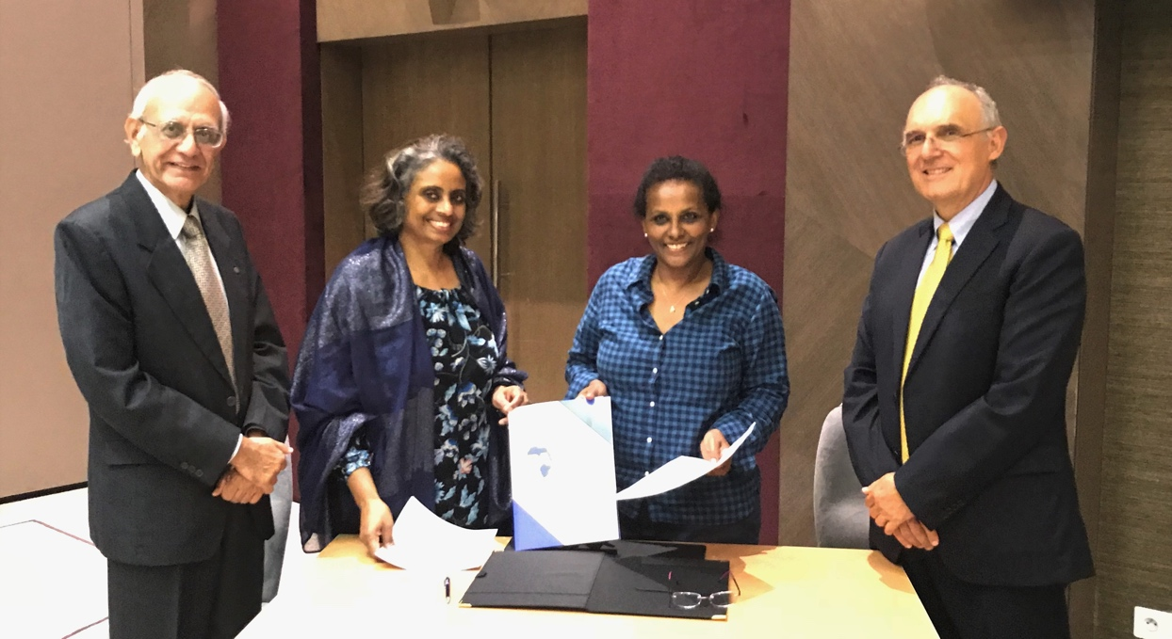
RSIF’s Regional Coordination Unit
RSIF RCU is the International Centre of Insect Physiology and Ecology (icipe) based in Nairobi, Kenya (since 1st Aug 2018)
Primary implementation body for planning, coordination, M&E of RSIF activities
Manage PhD training, research and innovation, institutional capacity building activities, help develop partnerships and networks
Establish, manage and grow the Permanent and General Funds
Building on icipe’s core capacity for innovation and capacity building– two administrative units
Prof. Goolam Mohamedbhai (Chair, PASET CAG), Dr. Sajitha Bashir (WB), Dr. Segenet Kelemu (DG, icipe), and Dr. Javier Botero Alvarez (WB) at signing of the Financing Agreement for the World Bank grant to icipe for the RSIF at PASET Executive Board and Consultative Advisory Group Meeting, 1st Aug 2018, Abidjan, Cote d'Ivoire

Slide 14
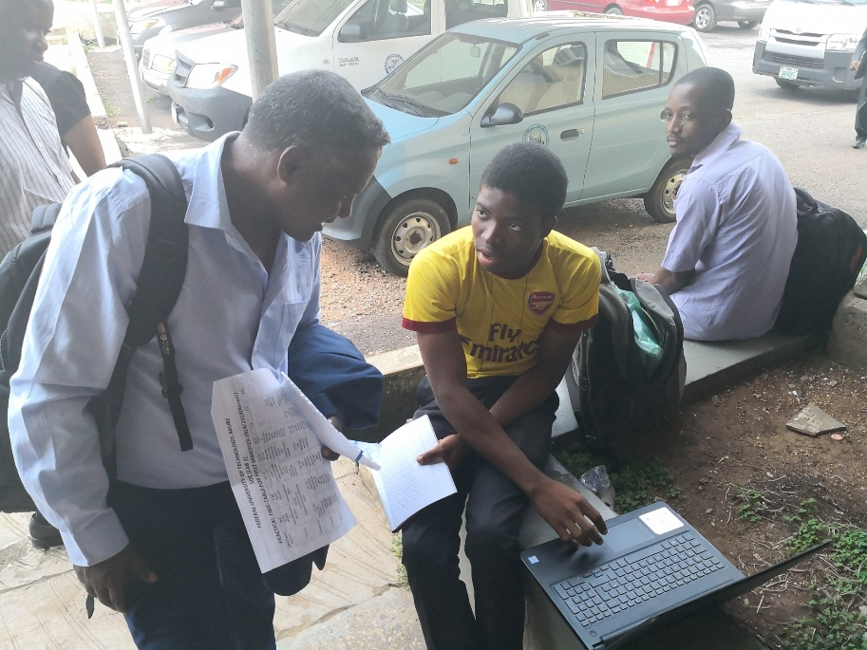
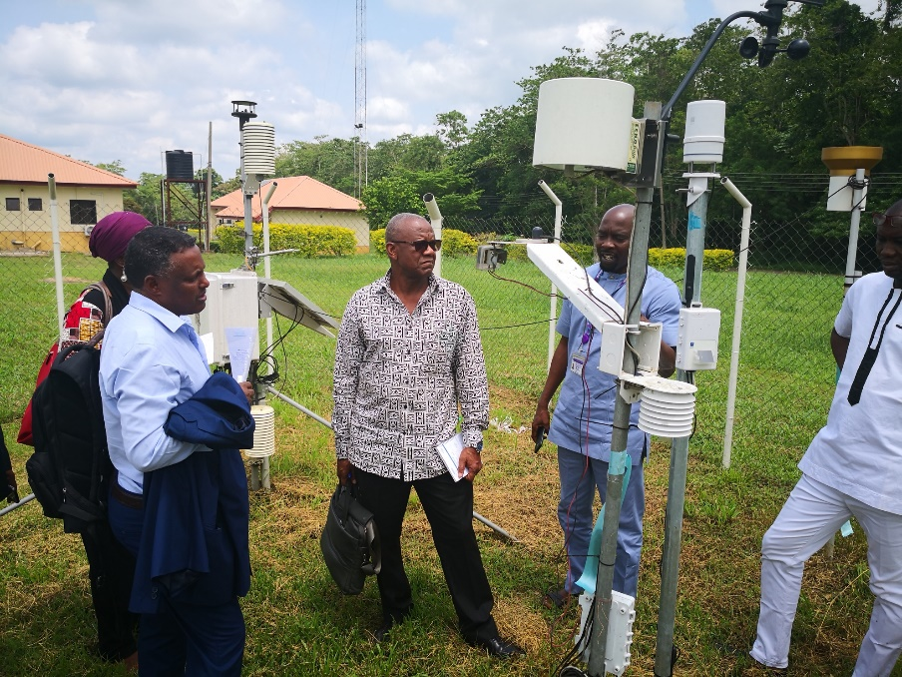
RSIF “Modus operandi”
RSIF Partner Universities
Consultative Advisory Group
Governing Council
PASET Secretariat
RSIF Host Universities
Executive Board
Student
World Bank project team
Student
Student
RSIF RCU (icipe)

Slide 15
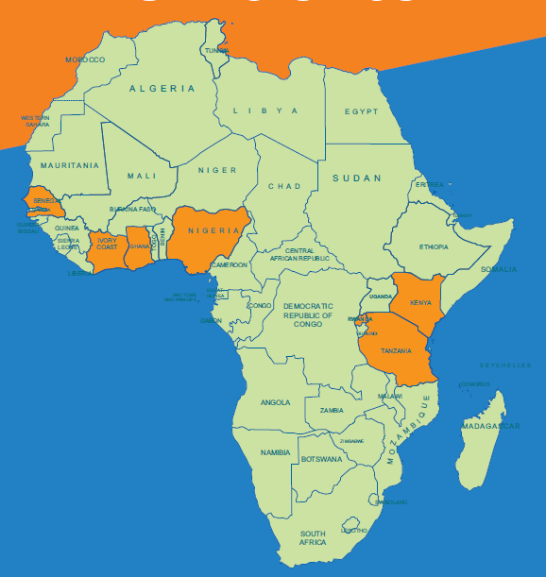
RSIF Host Universities
No. | UNIVERSITY | COUNTRY | THEME
1 | Nelson Mandela African Institution of Science and Technology | Tanzania | Mines, Minerals and Materials Engineering
2 | Kenyatta University | Kenya
3 | African University of Science and Technology* | Nigeria
4 | University of Ghana | Ghana | Food Security
5 | Sokoine University of Agriculture* | Tanzania
6 | University of Port Harcourt | Nigeria | Energy
7 | University of Nairobi | Kenya
8 | University of Rwanda | Rwanda | ICT
9 | University of Gaston Berger* | Senegal
10 | Bayero University | Nigeria | Climate Change
11 | Université Félix Houphouët-Boigny* | Côte d'Ivoire
*RSIF Host Universities selected in 2017

Slide 16
Implementation status (2)
Scholars (Window 1)
16 PhD students selected in first cohort
40 PhD students to be selected by July, 2019, 44 July, 2020.
Provide tuition, living costs, partial research funds
Criteria for students:
Citizens of SSA
Scholars selected on a competitive basis
Priority
Promising young African faculty without PhDs
Females
Includes ‘Sandwich’ of 1-2 years at an International Partner Organization
MoUs signed with four further partners at this Forum
Finalising Design Innovation Grants (Window 2&3)
Creating research technologies:
Grants to be awarded of up to 3 years for faculty involved in RSIF PhD scholars program
Grants to RSIF post-docs in AHUs of up to $80,000
Stimulating innovation:
Competitive grants to support the development of Innovation-enabling environments in RSIF Host Universities
Competitive grants to faculty of RSIF Host Universities in partnership with private sector who will co-finance the project.

Slide 17
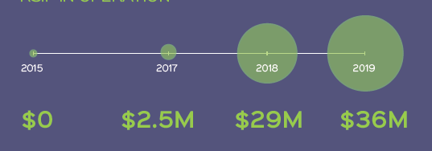
Funding goal: Raise US $65 million in seed funds and ultimately make the fund sustainable
Funding from African Governments:
Initial contribution of US$ 2 million per country
Can use World Bank instruments
Other funding
World Bank -US$15 million to administer and grow the fund
Senegal, Guinea, Ghana, Burkina Faso, Ethiopia, Mozambique & Nigeria expected to contribute in 2019
Establish icipe as regional capacity builder for ASET
Government of Korea: US$10 million for Windows 1 & 2
Additional funds to be mobilized by the RCU
Kenya (US$2m), Ivory Coast (US$1m) and Rwanda (US$2m)
Other African governments, Private sector, Donors
Co-funding from partner institutions (e.g. UM6P)
Growth in financial contribution

Slide 18
How to join
Contributions from SSA countries set at minimum of US$2 million
Contribution can be linked to specific deliverables
Find out more about how to join
E-mail: rsif@icipe.org; or pasetafrica@worldbank.org

Slide 19
Thank you
International Centre of Insect Physiology and Ecology
P.O. Box 30772-00100, Nairobi, Kenya
Tel: +254 (20) 8632000
E-mail: icipe@icipe.org
Website: www.icipe.org
facebook.com/icipe.insects/icipe
twitter.com/icipe
linkedin.com/company/icipe
Support icipe: www.icipe.org/support-icipe

