Slide 1
MALTA WATER SECURITY EXPERIENCE
Beirut, 10th July 2017
Manuel Sapiano
Energy and Water Agency
Malta

Slide 2
Introduction
Context:
Starting Point: Unavailability of sufficient water resources
Objective:
Ensuring an adequate supply of water to the population and their economic activities whilst respecting the needs of the environment
security of supply
supply and demand
environmental protection

Slide 3
Introduction
POPULATION
CLIMATE
ECONOMY
PRACTICES
WATER DEMAND
NATURAL RESOURCE DEGRADATION
UNAVAILABILITY OF WATER SUPPLY
ILLEGAL WATER WITHDRAWALS
LONG TERM ECONOMIC IMPACTS

Slide 4
Introduction
CAUSE
WATER DEMAND
EFFECT

Slide 5
Introduction
Main focus:
Addressing Water Demand by all water using sectors
Objective:
Ensuring that water use is kept at the highest efficiency levels possible
Tools:
Education and Awareness
Legislation and Regulation
Economic Tools
Technology
Infrastructure and Works

Slide 6
Introduction
BUT
In a context of water scarcity, meeting water demand will still be challenging, even if the demand is kept at high efficiency levels.
AS
The natural water resources required to meet water demand are simply not available.
THEREFORE
Water demand management needs to be implemented in parallel with water supply augmentation.

Slide 7
Introduction
SUPPLY AUGMENTATION
DEMAND MANAGEMENT
WATER DEMAND
“Two pronged strategy”

Slide 8
Introduction
UNDERLINE
The importance of a comprehensive approach which leads to the identification of the best suites set of tools (measures) which take full consideration of (specific) environmental, social and financial aspects to identify the best implimenteable solutions.
SOCIAL
FINANCIAL
ENVIRONMENTAL

Slide 9
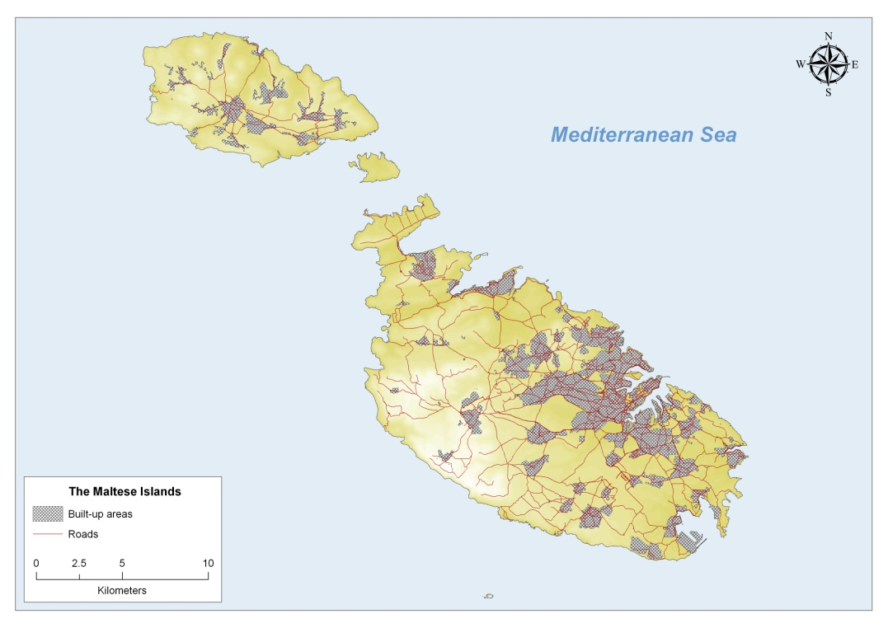
Context - Malta
Total surface area: 316km².
Population density: 1400inh/km²
Urban land-cover: 25%
Climate: Semi arid Mediterranean with high inter- and intra- annual variability
Mean Annual Rainfall: 550mm, effective rainfall <150mm
Natural water availability: 70m³/cap/day

Slide 10
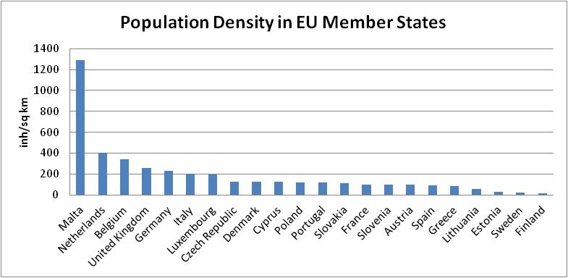
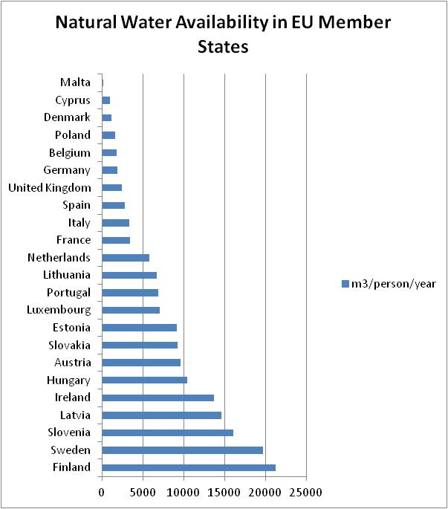
Context
Mean Annual per Capita availability of Naturally Renewable Freshwater Resources | Classification
>1600m³ | Sufficient Availability
1000 - 1600m³ | Water Stress
500 – 1000m³ | Chronic Water Scarcity
<500m³ | Below the manageable capability

Slide 11
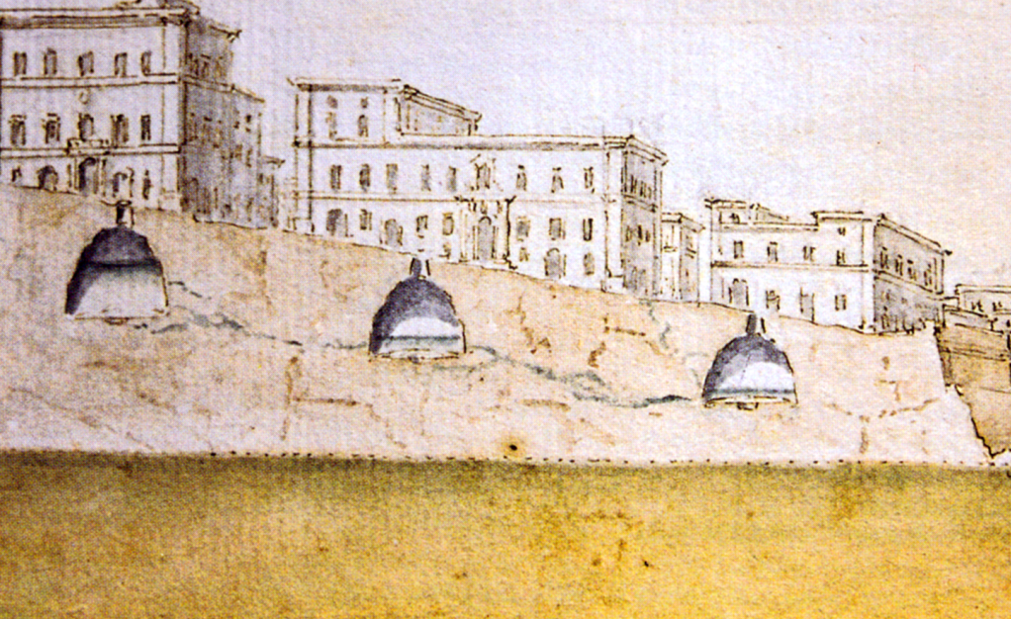
Context
Ensuring water supply in a context of water scarcity is a concept which is engrained in Malta’s water culture.
The Maltese language contains a number of water related terms of Arabic origin, and most of these describe natural water features such as springs ‘ghajn’ and valleys ‘wied’ and also water use activities such as rainwater harvesting ‘bir’ and irrigation ‘saqqaj’.
In 1565, during the building of the city of Valletta, the first law requiring the development of rainwater harvesting facilities was enacted: “every house should have an underground tank for the collection of rainwater, under penalty of fifty scudi for failure to comply”.

Slide 12
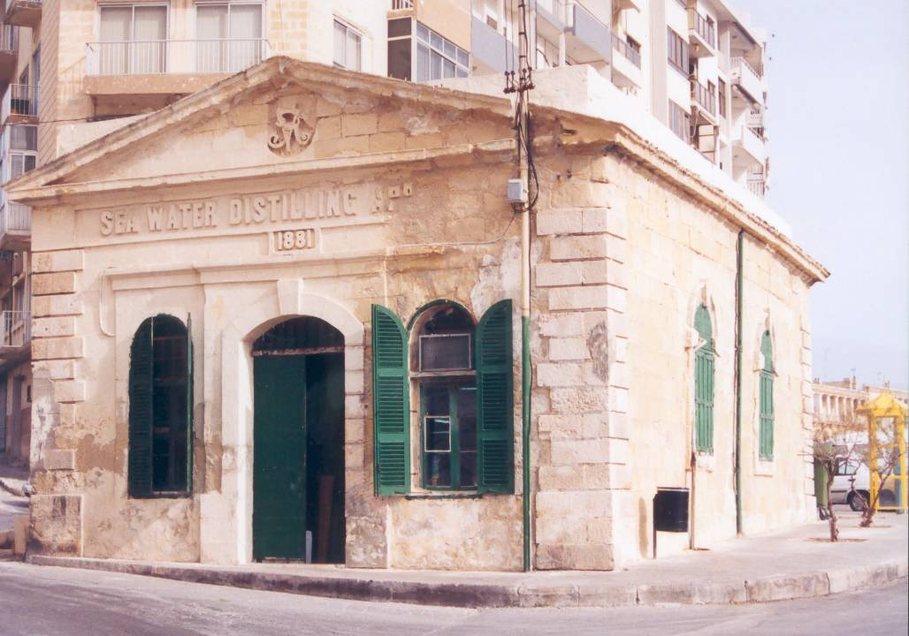
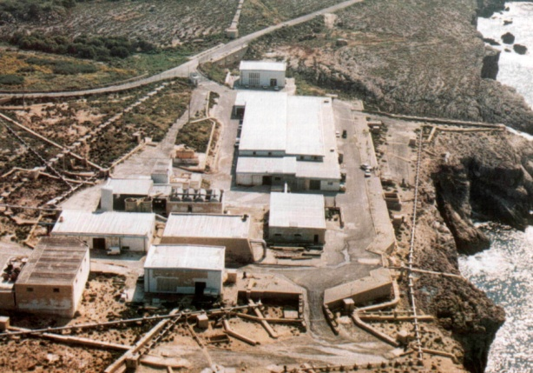
Context
Alternative Resources
Desalination of sea-water was first introduced in Malta in the early 1880’s, through two distillation plants.
Multi-stage flash distillation of sea-water was introduced in the 1960’s.
The 1980’s saw the introduction of reverse osmosis technology on a commercial scale – at that time Ghar Lapsi Plant was the largest in the Mediterranean.

Slide 13
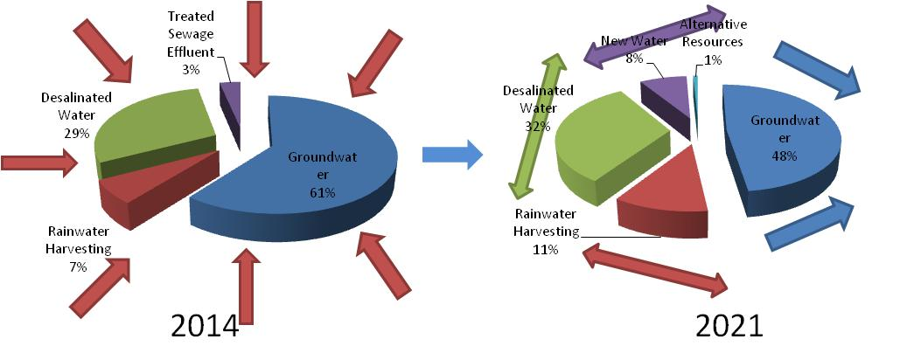
Policy Approach
Malta’s strategy in the water sector has thus been developed on two main principles:
- Optimising the efficient use of water resources, and
Widening the national water resource base to sustainably address water demand.

Slide 14
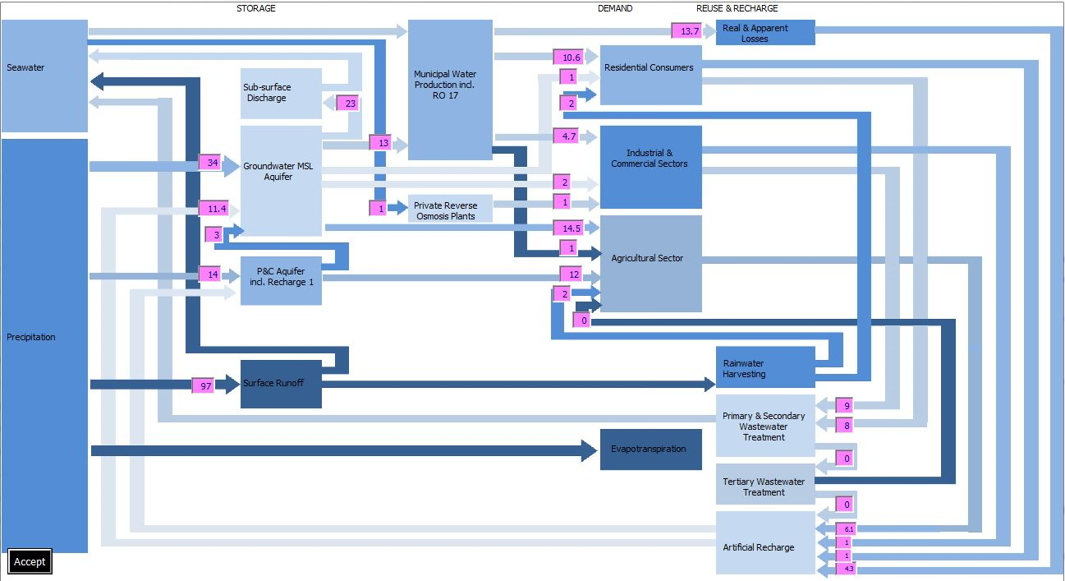
Policy Approach
which are applied to the comprehensive water-use cycle:

Slide 15
Demand Management
National Scale – Leakage Management
Network leakage was reduced from 3,900m³/hr (ILI of 20) in 1995 to 395m³/hr (ILI of 1.91) in 2015. As a result urban water demand today is <60% of what it was in 1994.

Slide 16
Demand Management
National Scale – Economic Tools
Rising block tariff mechanism which incentivises the efficient use of water.
1st block based on a consumption of 90l/cap/day at Eur1.39/m3
2nd block for all consumption exceeding 90l/cap/day at Eur5.14/m3
(over a billing period of three months)
Tariff mechanism ensures also a high level of cost recovery for the public utility.
Residential water demand stands at around 110l/cap/day.

Slide 17
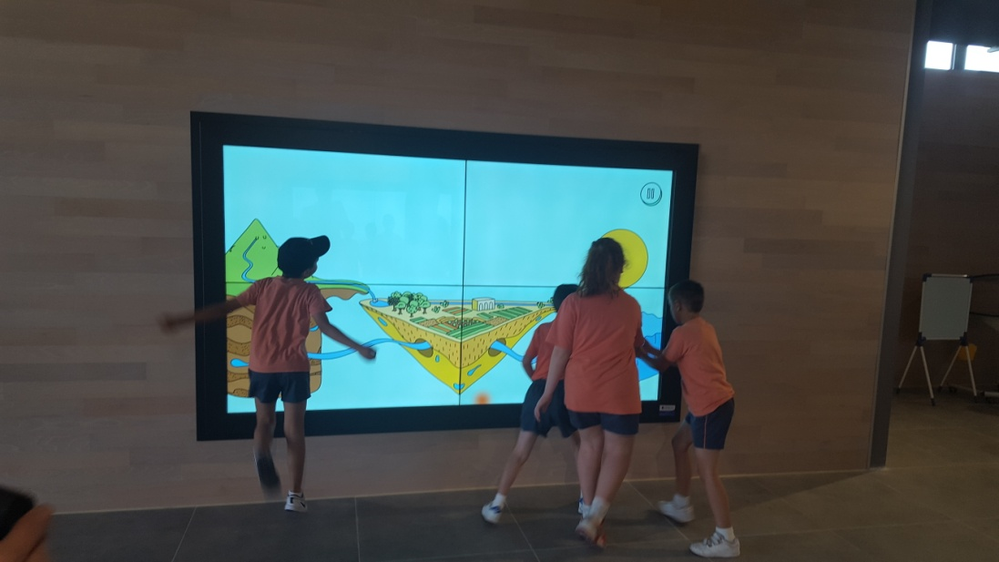
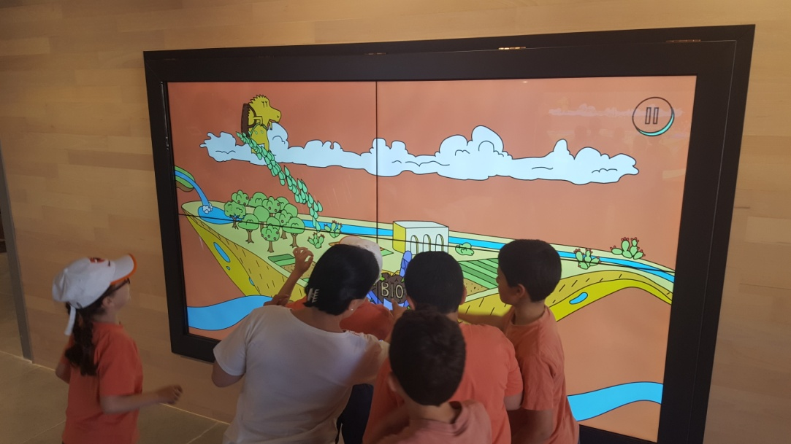
Demand Management
National Scale – Awareness on Water Conservation
Educational Centre for children focused on Water Conservation. A recently opened project financed under the EEA-Norway Grants.

Slide 18
Demand Management
National Water Conservation Campaign
A 3-year National Campaign on Water Conservation addressing all water using sectors is currently being planned. Campaign will be based on a through “consumer analysis” and will have the following components:
- Traditional and Social Media
- Public Engagement Activities
- Stakeholder Engagement Activities
- Demonstration Sites
- Technical Workshops
- Promotional and Printed Materials

Slide 19
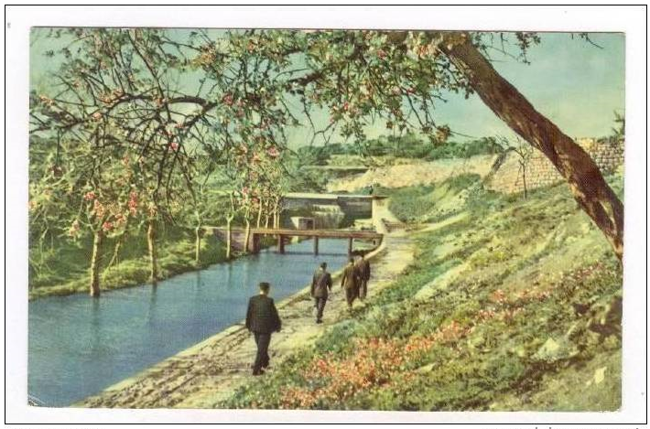
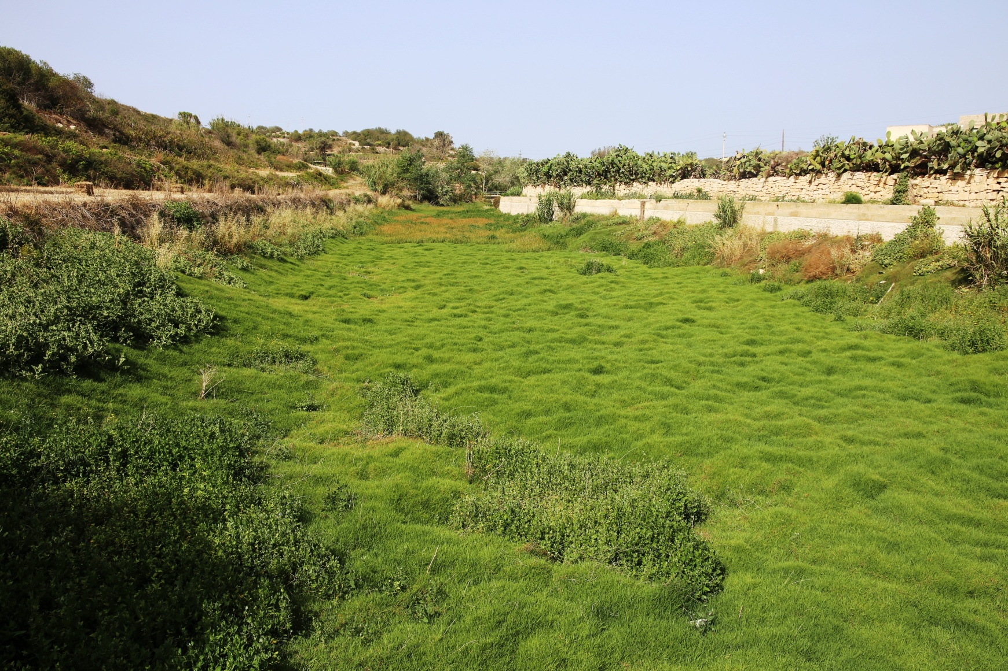
Supply Augmentation
National Scale – Increase the capacity of rainwater harvesting infrastructure
Projects aimed at the rehabilitation of the storage capacity of valley dams.
Focus on the generation of additional benefits: Ecosystems, Tourism, Recreation, ……

Slide 20
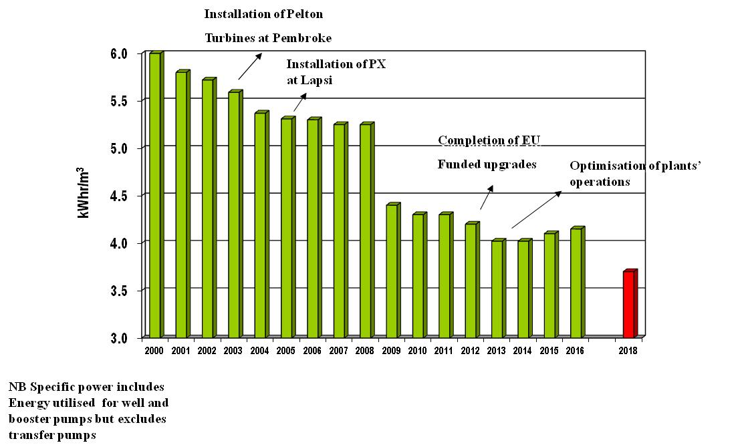
Supply Augmentation
National Scale – Optimisation of Reverse Osmosis Desalination Plants
Reduction in the specific power of desalination plants through installation of energy efficient technology..

Slide 21
Supply Augmentation
Water Reuse – New Water Project
Three polishing plants will be commissioned during the current year with a production capacity of 7 million m³ of high quality water for re-use in irrigation, landscaping, industry and aquifer recharge.
New Water use in replacement of groundwater use will be supported.

Slide 22
Outlook
Solutions need to be adapted to the local conditions
Investments alone will not solve the ‘water issue’ – the context in which investments are made is equally important.
A solution applicable for one country could fail in another country. Local issues are important:
seasonal and spatial variability of demand,
density of supply, and
economic aspects

Slide 23
Outlook
New Frontiers:
Desalination
continued reduction of the specific power/cost of desalination – can we arrive at a point where desalination will be competitive to the abstraction of deep groundwater?
Water Re-Use
alignment with circular economy principles – moving towards the concept of resource recovery plants instead of urban wastewater treatment plants.

Slide 24
Outlook
New Frontiers:
Affordable grey-water reuse
local solutions to reduce domestic water demand.
Low cost shower to toilet water applications have the potential to reduce demand by around 25%.

Slide 25
Conclusion
Need for increased collaboration between regional actors (or facing similar challenges) to :
Current regional initiatives under the Union for the Mediterranean and the 5+5 process for the development (and implementation) of regional strategies on water management can support the development of regional solutions and foster collaboration in the development of region specific solutions.

Slide 26
Thank-you for your attention

