Slide 1
2016 Procurement Framework Selection Methods and Approaches Goods, Works, Non-consulting and Consulting Services
April 2018

Slide 2
Goods, Works and Non-consulting Services

Slide 3
Selection Methods, Arrangements and Approaches (GWNcS)
Selection of Suppliers / Contractors for Goods, Works and Non-consulting Services (GWNcS) is based on:
Selection Methods
e.g.: Request for Bids (RFB) / Request for Proposals (RFP)
Selection Arrangements
e.g.: Public Private Partnership (PPP) Agencies /
Commercial Practices
Market Approach Options
e.g.: Open / Limited / Direct / National / International etc.

Slide 4
Overview – Selection Methods, Market approach and Arrangements
Goods, Works, and Non-consulting Services | Market approach options
Approved selection methods and arrangements | Open | Limited | Direct | Inter-national | National | PQ | IS | Single-stage | Multi- stage | BAFO | Negotiation | Rated criteria
Selection methods
Request for Proposals |  |  | x |  |  | x | normally |  |  |  | * | normally
Request for Bids |  |  | x |  |  | optional | x |  | x |  | * | not normally
Request for Quotations |  |  | x |  |  | x | x |  | x | x | x | x
Direct Selection | x | x |  | x | x | x | x |  | x | x |  | x
Selection arrangements
Competitive Dialogue |  |  | x |  |  | x | required | x |  | x | x | 
Public-Private Partnerships |  |  |  |  |  |  | x |  |  |  |  | 
Commercial Practices
UN Agencies
E-Auctions |  |  | x |  |  |  | x |  | x | x | x | x
Imports |  |  | x |  | x | x | x |  | x |  | x | x
Commodities |  |  | x |  |  |  | x |  | x | x | x | x
Community-driven Development |  |  |  | x |  | x | x |  | x | x | x | x
Force Accounts | x | x |  | x |  | x | x | x | x | x | x | x

Slide 5
Selection Methods (GWNcS)
1
Direct Selection: Approach and negotiate with only one firm. Price must be reasonable and consistent with market.
Direct
2
Request for Quotation: Competitive method of seeking quotations for readily available, off-the-shelf GWNcS. There is no Standard Procurement Document for RFQ.
RFQ
3
Request for Bids: Competitive method used when Borrower specifies requirements and wishes to maintain a higher degree of control in delivery.
RFB
4
Request for Proposals: Competitive method used when Borrower specifies functional/performance needs and market proposes solutions. Rated criteria are normally used.
RFP

Slide 6
Selection Arrangements
1
Contracts under ongoing PPP activities may be financed by the Bank,
If:
the justification, feasibility, PPP structure and contractual arrangements are acceptable
the selection process for the private partner is consistent with the Bank’s Core Procurement Principles
there is no Conflict of Interest
the private partner is eligible for Bank financing
Bank’s sanction requirement is agreed to apply
Bank’s Governance requirements such as Bank’s inspection and review rights are accepted.
Public-Private Partnership
Ongoing
Commercial
Practices

Slide 7
Selection Arrangements
.
Contracts under new PPP activities may be financed by the Bank, under the following main conditions:
consistent with the Bank’s Core Procurement Principles;
using selection methods in the procurement regulations
no longer restricted to open competitive bidding
Bank’s eligibility requirements and Anti-corruption guidelines apply
the private sector partners can then procure from eligible sources using own procedures
unsolicited proposals may be considered if fit for purpose and results in achieving value for money (vfm).
If the unsolicited proposal will be subject to a competitive process:
no advantage is granted to the proposer in a competitive process; or
if reasonable advantage is granted (such as a point bonus), the advantage shall be disclosed to bidders/proposers.
1
Public-Private Partnership
NEW

Slide 8
Selection Arrangements
2
use of well established procurement arrangements used by private sector
should be consistent with Bank’s Core Procurement Principles
may be used for programs of Imports
Commercial
Practices
3
Borrower may select UN Agency directly:
when Agency’s expertise or rapid mobilization is critical or
where there is urgent need of assistance or capacity constraints
use UN Standard Agreement
use Bank-UN Framework Agreement (where available)
UN Agencies

Slide 9
Selection Arrangements (cont’d)
E-reverse auction is a particular application of a RFQ
It is a scheduled on-line auction where PQ/registered firms compete
may be used when Borrower’s requirements are unambiguously specified and there is adequate competition
4
E-reverse auctions
5
Covers program of imports handled by the Borrower’s public sector entities
use RFB selection method with simplified advertisement and currency provisions
Period for submission of bid may be reduced to 20 days
General Procurement Notice not required
Payment may be limited to one international currency
If private sector entity handles the procurement, Commercial Practices may be used.
Program of Imports

Slide 10
Selection Arrangements (Cont’d)
6
Can use:
Framework Agreement
Request For Quotation (RFQ)
E-reverse auction where there are PQ/registered firms
Commodities
Call for participation of local communities/NGOs with local know-how, Goods, or employ local labor
usually a large number of small-value contracts often in remote areas
use RFQ: local competitive bidding for Goods or Works
use direct contracting: small-value GWNcS
7
Community Driven Development
8
works and non-consultant services carried out by government department using own personnel and equipment – Force Account unit
use department’s own procedures
apply rigorous quality checks and inspections
Force Accounts

Slide 11
Particular Types of Contractual Arrangements
Framework Agreements (FA)
An agreement with one or more firms to supply GWNcS, on an as-needed basis, over an agreed period of time
Key changes
for new FA = restrictions on use have been removed
for pre-existing FA = consistent with Core Procurement Principles
more detailed procedures provided for the operation of FAs
use of FAs now expanded beyond GWNcS to include Consulting Services
Examples
desktops + laptops
stationery + consumables
pharmaceuticals
vehicles
panel of experts
emergency response
small works

Slide 12
Market Approach Options
1
DIRECT APPROACH
Approach and negotiate with only one firm.
2
OPEN COMPETITION
Opportunity is openly advertised. All eligible firms have equal opportunity to participate. This is the Bank’s preferred option.
3
LIMITED COMPETITION
Competition is limited to those firms that are invited to participate. No open advertisement.
NOTE: All of these options may be used when approaching national or international markets.

Slide 13
Market Approach Options (cont’d)
4
POST-QUALIFICATION
Verification of qualifications and capability of bidder recommended for contract award
5
PRE-QUALIFICATION
Shortlisting process normally used with RFBs. PQ is optional depending upon the category of procurement, size, risk and complexity.
6
INITIAL SELECTION
Shortlisting process normally used with RFPs. It must be used when Competitive Dialogue (CD) s adopted.
7
SINGLE STAGE
Appropriate when the Borrower can describe the requirements in detailed specifications
MULTI STAGE
Appropriate when the Borrower describes the requirements in terms of business/functional needs. Examples: complex Plant, Design and Build Works, turnkey ICT contracts.
8

Slide 14
Market Approach Options (cont’d)
9
BAFO
An option where the Borrower requests Best and Final Offers. Bidders/Proposers are not required to submit a BAFO.
10
NEGOTIATION
An option that allows the Borrower to conduct a negotiation with the Bidder/Proposer with the most advantageous Bid/Proposal.
11
RATED CRITERIA
Rated-type evaluation criteria normally used with RFPs to evaluate non-price / quality attributes using point system.

Slide 15
Direct Selection
May be appropriate for:
extension of existing contracts where competition is not justified, and terms and conditions including prices are reasonable.
re-engagement of firm that has completed contract within last 12 months where competition is not justified, prices are reasonable and firm performed satisfactorily.
low value, low risk procurement
exceptional circumstances e.g. emergency situation
standardization of goods
proprietary equipment
achievement of essential performance or functional guarantee
services or goods provided by SOE, university, research center of a unique and exceptional nature
selection of a UN Agency

Slide 16
BAFO or Negotiation
Best and Final Offer (BAFO) or Negotiation may be used following bid/proposal evaluation if disclosed in the RFB/RFP documents
give substantially responsive bidders/proposers an opportunity to improve their bids/proposals
BAFO and Negotiation are mutually exclusive i.e. you cannot use both in the same procurement
to apply competitive pressure, financial proposals are not opened in public
to maintain integrity, the financial proposals are opened in front of a Probity Assurance Provider.

Slide 17
National Competition
National competition (approaching national market) may be appropriate when procurement is unlikely to attract foreign competition because of:
size and condition of market
value of contract
scattered geographical distribution
spread over time or are labor intensive or
goods, works or non-consultant services are available locally at price below the international market
foreign firms allowed to participate under same conditions as national firms
national procurement procedures may be used if acceptable

Slide 18
International Competition
General
Applying international competition (approaching international market) may be appropriate when the participation of foreign firms:
will increase competition, and
may lead to best VfM and fit-for-purpose results.
Open international competition is the preferred approach for contracts that are:
complex
high-risk and/or
when the applicable national competitive procurement thresholds are exceeded.
Procurement Documents
For international competitive procurement, the borrower shall use the Bank’s applicable Standard Procurement Documents (SPDs).

Slide 19
OPEN vs LIMITED Competition
When to use LIMITED (by invitation only without advertisement)
where there are only a limited number of firms in the market, and they can be identified or
there are other exceptional reasons that justify departure from open competition.
When to use OPEN
this is the Bank’s preferred approach as the default choice for competition

Slide 20
Request For Quotation (RFQ) key characteristics
This is the simplest form of competitive procurement
competitive method of seeking quotations for readily available, off-the-shelf GWNcS, standard specification commodities or simple civil works
there is no SPD for RFQ
quotations normally from not fewer than three firms
E-reverse auction may be used

Slide 21
Request For Bids (RFB) key characteristics
Competitive method that seeks Bids that comply with the Borrower’s detailed specifications.
appropriate SPD is used based on the category of GWNcS, risk, size and complexity of procurement
BAFO or Negotiations may be used with Bank’s prior concurrence
Typical characteristics:
The borrower has the design to enable it to specify its requirements
requiring compliance is fit for purpose as opposed to seeking solutions
the Borrower retains control over design and delivery
the Borrower accepts the design risks
Rated criteria are normally not needed
procurement decision is normally based on the lowest evaluated and responsive Bid
Examples
road construction designed by the employer
vehicles
pharmaceuticals

Slide 22
Request for Bids
Cons
Pros
Can take longer to get to market as Borrower develops the specifications
Simple identification of MAB based on qualifying criteria and lowest evaluated cost
1
1
Borrower carries risk if design and specifications are wrong
2
2
Borrower retains control over design and delivery
Limited scope for innovation and alternative solutions
3

Slide 23
Request For Proposal (RFP) key characteristics
Competitive method that seeks Proposals that offer solutions in response to performance/functional requirements.
appropriate SPD is used based on the category of GWNcS, risk, size and complexity of procurement
Typical characteristics:
the borrower does not have the design to specify its requirements
procurement is for non standard/customized solution
borrower seeks solutions that fit the purpose rather than compliance
borrower has less control over the design, contractor takes the design risk
rated criteria are normally used
procurement decision is normally based on the best value for money by weighting quality and cost
normally uses a multistage approach to optimize solutions
BAFO or Negotiations may be used with probity auditor and closed opening of financial proposal
Notes:
Examples
integrated financial management information systems
Complex plant
Design and build

Slide 24
RFP key characteristics (cont’d)
3 model RFPs:
RFP

Two-Stage following Initial Selection
MODEL 1
RFP
Streamlined
MODEL 2
RFP
Competitive Dialogue
MODEL 3

Slide 25
Request for Proposals
Cons
Pros
Transaction costs and time could be higher than RFB
1
1
Delivers a customized, fit-for-purpose solution
Requires higher Borrower capacity and may demand additional specialist support to: (1) define the functionality and performance criteria, (2) design and apply appropriate rated-type criteria and (3) manage the deliverables
2
2
The Borrower shifts the design risk to contractor

Slide 26
Fit-for-purpose Procurement Process Summary
HIGH
Fit-for-purpose by design
Getting the best fit-for-purpose procurement process can sometimes be a combination of the:
right selection method e.g. RFB or RFP and
right market approach options e.g. single-stage or two envelope, or negotiation
RFP
CD
closed opening
BAFO or Negotiation
COMPLEXITY AND RISK
RFP
2 envelope
prequalification
RFB
LOW
1 envelope
EASY
DIFFICULT
EASE IN DEFINING OUTCOME/S + COMMERCIAL DEAL

Slide 27
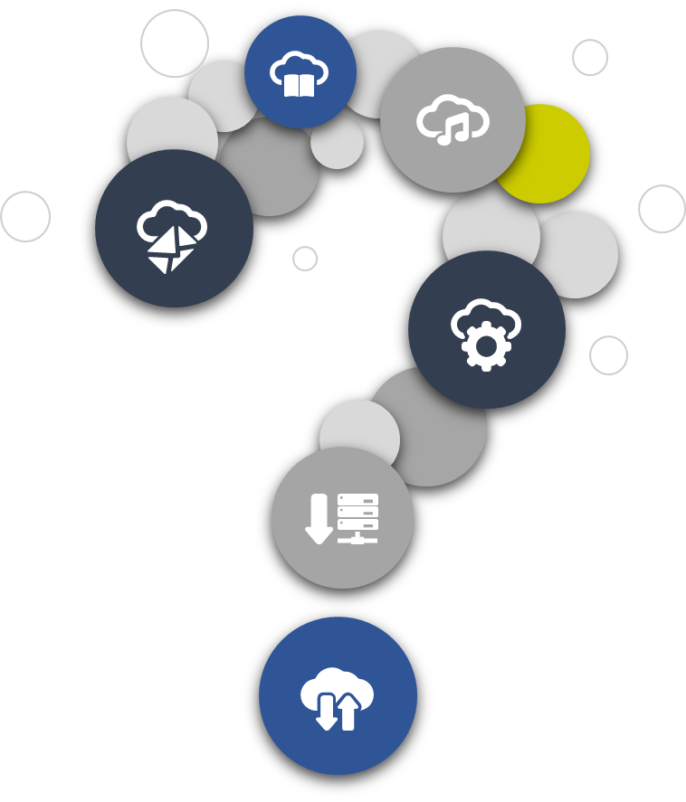
Questions?

Slide 28
CONSULTING SERVICES

Slide 29
Updated RFP Consulting Services
No significant changes
Quality attributes continue to be the main selection factor for consultants: QBS -100% quality, QCBS – normally 80 to 90% quality, Least Cost Selection – for standard or routine assignments
maintained existing shortlisting process and selection methods, arrangements and market approach
Changes
removed the restriction of no more than 2 firms from one country and at least one firm from a developing country
changed maximum number of short list of 6 to a range = between 5 and 8
explicitly requires that the terms of reference should be attached to the expression of interest.
Framework agreement allowed

Slide 30
Selection Methods, Arrangements and Approaches (Consulting Services)
Selection of Consultants is based on:
Selection Methods
e.g.: Quality and Cost Based Selection (QCBS), Quality Based Selection (QBS)
Selection Arrangements
e.g.: Commercial Practices, UN agencies
Market Approach Options
e.g.: Open / Limited / Direct / National / International etc.

Slide 31
Overview – Selection Methods, Market approach and Arrangements
Consulting Services | Market approach options
Approved selection methods and arrangements | Open | Limited | Direct | Inter-national | National | Shortlist
Selection methods
Quality Cost Based Selection |  | x | x |  |  | 
Fixed Budget Based Selection |  | x | x |  |  | 
Least Cost Based Selection |  | x | x |  |  | 
Quality Based Selection |  | x | x |  |  | 
Consultant’s Qualification Based Selection |  |  | x |  |  | x
Direct Selection | x | x |  | x | x | x
Selection Arrangements
Commercial Practices
UN Agencies
Non Profit Organizations (such as NGOs) |  |  |  |  |  | 
Banks |  |  |  |  |  | 
Procurement Agents |  |  |  |  |  | 
Selection Methods for Individual Consultants
Selection of Individual Consultants |  |  |  | x | x | x

Slide 32
Useful links
World Bank’s Procurement Regulations for IPF Borrowers | https://policies.worldbank.org/sites/ppf3/PPFDocuments/Forms/DispPage.aspx?docid=4005&ver=current
World Bank’s Procurement Policy | https://policies.worldbank.org/sites/ppf3/PPFDocuments/Forms/DispPage.aspx?docid=4002&ver=current
Standard Procurement Documents templates | http://www.worldbank.org/en/projects-operations/products-and-services/brief/procurement-new-framework#SPD
Guidance on SPDs | http://www.worldbank.org/en/projects-operations/products-and-services/brief/procurement-new-framework
Guidance on how to complain | http://pubdocs.worldbank.org/en/975671478891365829/Complaints-Guidance-FINAL-Revised.pdf
Guidance on PPSD | http://pubdocs.worldbank.org/en/123601488224013672/PPSD-Short-Form-Final.pdf http://pubdocs.worldbank.org/en/847531467334322069/PPSD-Long-Form.pdf
Procurement App for IPad: Data on contracts | https://itunes.apple.com/us/app/world-bank-project-procurement/id911312962?mt=8
Procurement App for IPad: Data on projects, finances and procurement data | https://itunes.apple.com/us/app/world-bank-group-finances/id465555488?mt=8
UNDB Online | https://www.devbusiness.com/Search/Search.aspx?PreLoadProjects=1

Slide 33
Questions?

Slide 34
For more information
http://www.worldbank.org/procurement
Operations, Policy and Country Services
Standards, Procurement and Financial Management Department
The World Bank
1818 H Street, NW
Washington, D.C. 20433 U.S.A.

