Slide 1
Key constraints on the supply of and demand for
ECD services in Armenia
March 2019
Financial support for this work was provided by the Government of Japan through the Japan Trust Fund for Scaling Up Nutrition

Slide 2
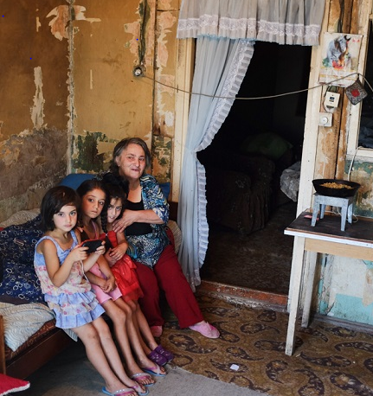
As in many countries, Armenian Young children are more likely to live in poverty than other age groups
Households with youngest child of 5 or younger- 34% poverty; vs. 26% national poverty rate
Also multidimensional poverty- 17% of poor children live without shower or bath, 36 lack hot running water
Social assistance mitigates child poverty … though not necessarily the one targeted to families with children:
Child (18 or younger) poverty rates | Base rate (with benefits ) | Without pension | Without social assistance (family benefit)
Poverty rate | 30.8 | 42.7 | 35.2
Extreme poverty rate | 2.1 | 11.3 | 7.2
Source: Statistical Committee of the Republic of Armenia, 2018

Slide 3
…and there are a Number of risks and protective factors around the early years (pregnancy to 5 yrs)
Child & mother health and nutrition
97% women receive ANC & skilled assistance for delivery and PNC
9% children under 5 are stunted, 14% are overweighed or obese, specially in bottom 3 wealth quintiles, in rural areas with mothers with secondary education or less
Access to education/ stimulation
51.97% of children between 3 and 5 enrolled in pre-school (UNESCO 2018)
Child protection
99% of children under 5 have birth certificate (DHS 2015/16), though regional differences, 3.5% children in Ararat lack certificate→ necessary to access key services
Almost all children are breastfed at some point but only 45% exclusively breastfed for 6 months, 25% between 6 and 23 months are fed with acceptable dietary standards.
84% receive all WHO recommended vaccinations
Source: DHS 2015/16
Notes:
ANC= Antenatal care, PNC= post-natal care

Slide 4
This report assesses supply and access to key ECD services – with focus in 4 marzes
Combines information from:
WB’s survey on ECD services carried out between March and August 2018 in 4 prioritized areas: Yerevan, Lori, Ararat and Gegharkunik.
Household surveys: Integrated Living Conditions Survey (ILCS 2017), DHS (2015/16)
ECD-related studies in Armenia: World Bank (2012, 2017), Save the Children (2017), UNICEF (2018), Van Ravens (2008).
Notes:
Prioritization index: dimension 1: Nutrition status of children under 5 years (stunting, overweight and anemia), dimension 2: Percentage of multidimensionally poor , dimension 3: Availability of services (kindergartens that operate whole year, share of FBP beneficiaries, # of social workers), represent urban and rural areas
WB 2012: Armenia: Assessment of the Early Childhood Development Policies and Programs, Summary of Policy Recommendations. Systems Approach for Better Education Results (SABER)
World Bank, 2017: Why Should We Care About Care? The Role of Childcare and Eldercare in Armenia. Poverty and Equity Global Practice, Europe and Central Asia Region.
Save the Children, 2017, Assessment on Access of Children to Pre-school Education Services in Armenia
UNICEF, 2018, Cost-benefit analysis of alternative pre-school education services in consolidated multi-settlement communities of Armenia
Van Ravens, 2008, Scenarios for Early Childhood Development in Armenia: Financial and Legal Analysis of National Preschool Education Programs, Policies and Strategies in the Republic of Armenia, UNICEF.

Slide 5
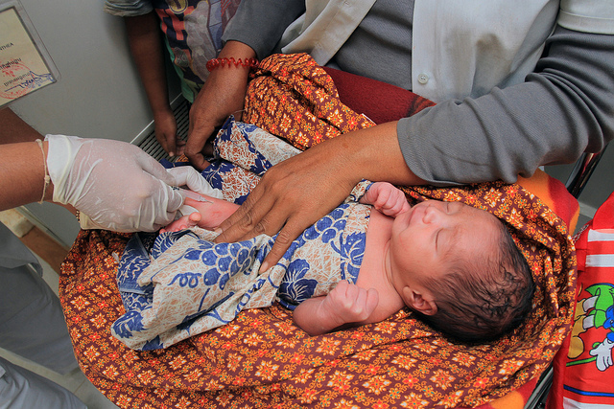
The ECD Survey Covered THE UNIVERSE OF NON-PRIVATE SERVICES FOR FAMILIES WITH CHILDREN UNDER 5
Data collection included review of secondary information & direct interviews with key informants and services providers
Services that meet all these criteria:
For children <5 or pregnant women
Children members of a family
Universal or targeted to vulnerable population
Provided by public, NGOs and/or International Donor organizations (doesn’t include private)
Services on health, nutrition, early stimulation/education and protection from stress
797 ECD services were identified and characterized
Notes:
\

Slide 6
MOST of the services identified ARE public, facility-based & intended to be universal (E.G. NOT TARGETED TO POOR)
Type of service | Health centers | Education (of which kindergartens) | Parenting education center/maternity school | Child protection | Total
Number of services identified | 353 | 391(of which 344 kindergartens) | 49 | 4 | 797
Percentage of services of each type | 44% | 49% (43%) | 6% | 1% | -
Average number of services of this type received per child aged under five years | 1.5 | 0.3 | n/a | 0 | -
Main sources of financing: percentage of services that receive financing from each source | Central government (100%) International organization (56%) | Local government (88%) Central government (12%) | Central government (92%) International organization (10%) | International private sector (100%) International organization (75%) | Central government (55%) International organization (45%)
Notes:
Less than 1% pf service providers report that their service is targeted to particular vulnerable groups, such as poor families, children with disabilities or minorities.

Slide 7
Their objectives normally span more than one sector
2 main clusters:
Health facilities tend to encompass maternal and child health, nutrition and parenting objectives, and quite often also child rights.
Early years education facilities (mainly kindergartens) almost always seek to provide early learning and education and child care, and to promote child rights and quite often also positive parenting;

Slide 8
activities tend to focus on materials’ Dissemination & one-to-one advice → participatory modalities are less common
Outreach services (such as group-based or peer-to-peer learning) and practical support (food demonstrations) are rare; home visits are even less common

Slide 9
Kindergartens have the most complete data on budgets and staffing, allowing to estimate budget per child and child/teacher ratio
Heavily subsidized by local government: average fee in marzes (Ararat, Gegharkunik and Lori) is 53,000 AMD per year; subsidization is substantially higher in Yerevan (no fees)
Majority of staff has college degree (59%) but only 18% is trained in ECD, child/staff ratios is 1:4 but teacher are only 34% of staff → child/teacher ratio is 1:12
 | Ararat | Geghar qunik | Lori | Yerevan | Total
Total staff | 1317 | 711 | 864 | 4,533 | 7,425
Percentage with a college degree | 63% | 72% | 60% | 56% | 59%
Percentage trained in ECD | 19% | 28% | 29% | 14% | 18%
Child to staff ratio | 3.9 | 3.4 | 3.6 | 4.3 | 4.1
Child to teacher ratio | 11.8 | 10.0 | 12.9 | 12.3 | 12.1

Slide 10
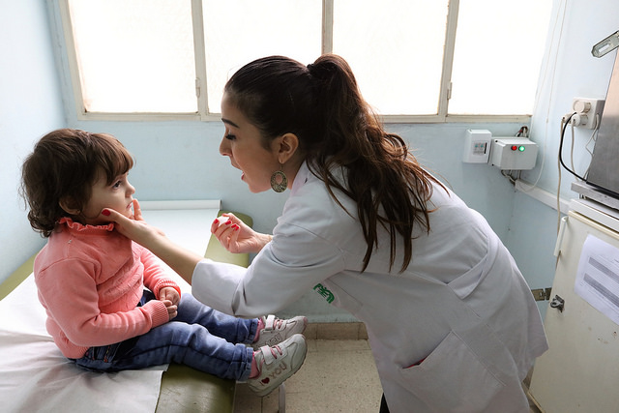
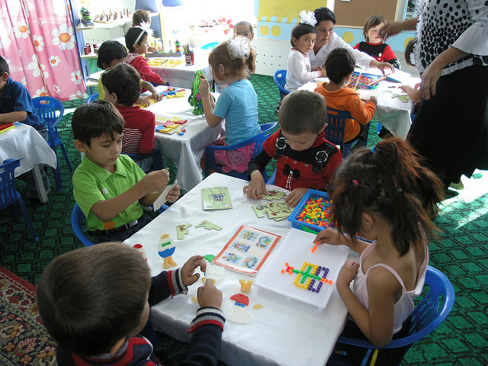
Access to health and education services in the early years face different challenges
Health
Education
Access: High coverage of key health services (DHS 2015/16), gaps in caregivers knowledge. ECD services’ survey: average of 1.5 service per child
Inclusion: Small differences in access by variables such wealth, area residence, mother’s education-- though Save the Children (2017) identifies barriers for children with disabilities (stigma & discrimination)
Access: Varies by area (ILCS 2017): Gerghaqunik 8%, Lori 19%, Ararat 20%, Yerevan 31%. And age group (ILCS 2017, kindergartens): nationally 49% 4yrsold, 37% 3yrsold,13% 2yrsold s and almost no children under 2
Inclusion: Access affected by poverty and other related variables. Fees can aggravate. Also only 16% of kindergartens monitor number of children with disabilities

Slide 11
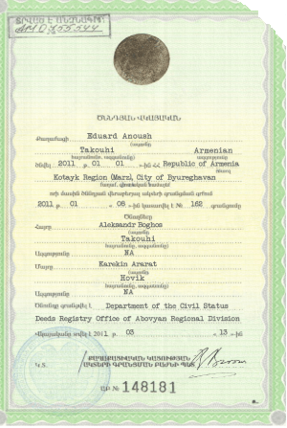
Requirements and fees for access are higher in education services
Fees
Core health ECD services are free nationally. Some health facilities (specially Yerevan) fee for additional services (e.g. laboratory tests)
Kindergartens:
Free in Yerevan, except to children with parents lack city registration → monthly fee of 8,000 AMD
Average monthly fee in Ararat, Gegharkunik and Lori of 4,400 AMD → equivalent to 20% per child consumption in poor households (ILCS 2017)
Kindergartens require the greatest number of documents in addition to child birth certificate
Save the Children (2017) parents do report substantial bureaucratic hurdles to entry services

Slide 12
In general lower access to education services seem to be associated to poverty and perception that kindergartens are for children with working mothers
It is not the case that parents fail to value kindergartens, Save the Children (2017)
Strongly held view (79% of parents) women should be primary caregivers and that working outside the home is bad for children (World Bank 2017)-- more flexible part-time learning opportunities for children for not working mothers

Slide 13
conclusions
Health services & birth certification: Coverage is close to complete. Home visits could focus on those missing, target using administrative information
Education Services:
Supply is limited, currently demand is higher that supply and no incentives to enroll poor or children with special needs
Additional targeted subsidies for families that cannot afford monthly fees (Ararat, Lori, Gegharkunik)
Re-think current low teachers per child ratio in kindergartens (reduce high proportion of ‘support staff’)
For some families (with non-working mothers) part time childcare might work better
Parental Education Services: Supply is very limited (except in Gegharkunik); when available, referral to these services will be key to improve health/nutrition practices and promote child stimulation at home.
CROSSCUTING: To promote inclusion ask services to monitor vulnerable groups among beneficiaries

Slide 14
Recommendations for social workers
Tailor the social work referral system to the type of ECD service and location
Launch a simple referral system in regard to ECD services widely and freely available (e.g. child and maternal health services, parental education in Gegharkunik). For other services, complement a referral system with systematic attention to the supply side
Ensure that social workers have detailed information on ECD services available locally and requisites --this information needs to be incorporated in their training.
Charge social workers with following up with service providers on behalf of vulnerable clients, checking that correct procedures are being followed and, for example, tracking where they are on kindergarten waiting lists.

Slide 15
Recommendations for social workers
Promote strengthening the supply
Support facilities providing ECD services to develop simple monitoring systems that disaggregate beneficiaries by age, poverty status, disability status and other relevant indicators of vulnerability
Expansion/ development of: (i) Parental education services, use best-practice interactive approaches (practical demonstrations, group and community training, peer-to-peer learning etc.); (ii) Alternative site-based early learning opportunities for children, such as part-time ECD centers, parent and toddler-groups, especially for children younger than 3 and pre-school children living in remote rural areas.

Slide 16
Thank you!

