Slide 1
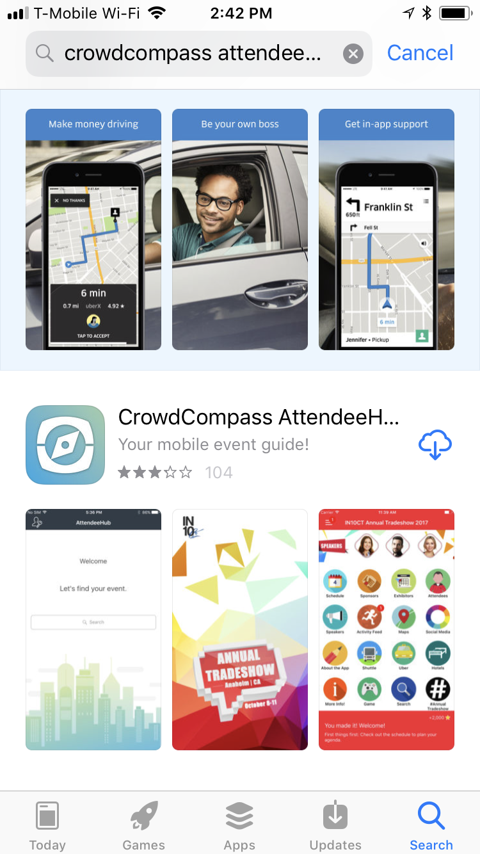
CrowdCompass
AttendeeHub
Notes:
Open up your Google Play or Apple App Store and look for the CrowdCompass AttendeeHub and install it on your phone.
The following screenshots are representative of views that you will see on your mobile device.

Slide 2
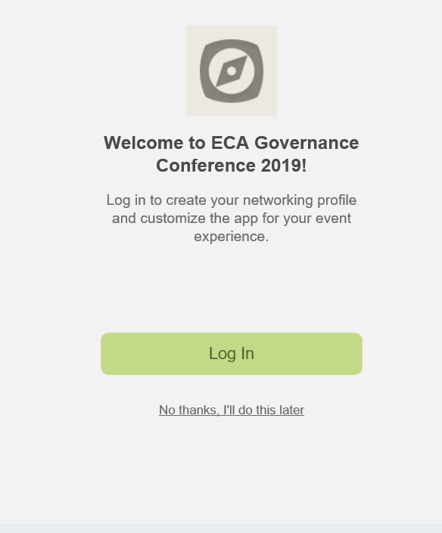
Notes:
Once you have installed AtendeeHub, as invited participants, you enter ECA Governance Conference 2019, download and Log-on to access the app.

Slide 3
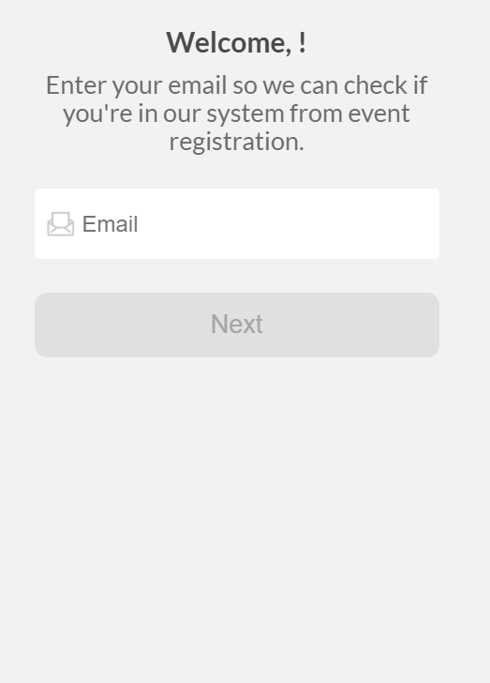
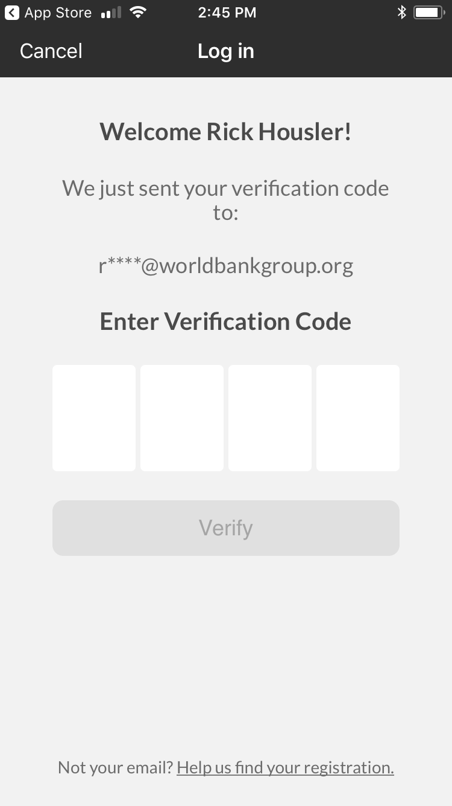

Slide 4
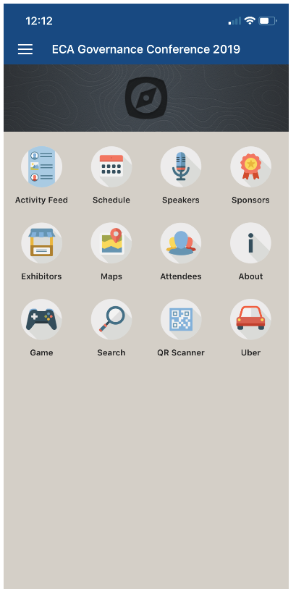
Notes:
Again, from the mobile screen, you can log on by clicking on the top left ‘sandwich’ button, the 3 parallel lines.
In order to navigate, just click on the icon, such as ‘schedule’

