Slide 1
The Business of Water Utilities
Aldo Baietti
The World Bank
June 2018

Slide 2
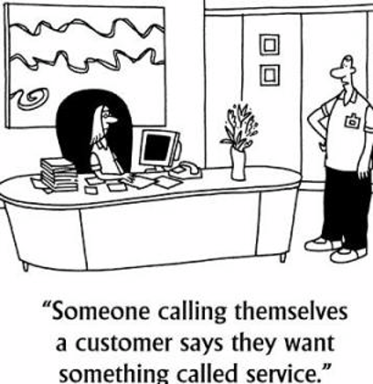
Monopoly Water Utility, Inc.
“Someone called Customer is wanting
something called Service!!”
Source: http://www.fastcompany.com/files/imagecache/multimedia_image/files/cs.jpg

Slide 3
What Does “Service” Mean
for a Water Utility?

Slide 4
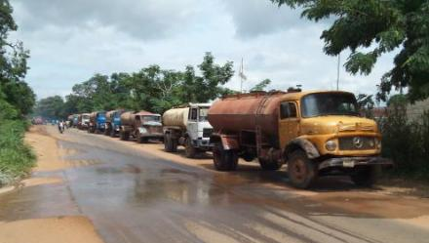
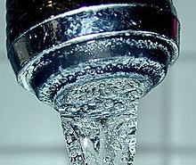
Some False Assumptions
Consumers only want piped service
Willingness to pay for piped service exists
Consumers don’t have other choices
The utility is a monopoly. Price and quality are non issues
Notes:
Our assumptions about customer preferences may not be correct.
Additional water sources include:
private wells,
neighbors,
public or private tankers,
bottled sources, and a variety of public
“free” sources include:
public wells and taps
rainwater,
rivers, or streams
Illegal connections
Small African towns tend to use piped water for a few hours during the day or during dry season and use free rainwater harvested from roofs during rainy season (25)
Jakarta, Indonesia middle income use piped water as an emergency supply if individual supply fails (25)
F/U WITH ABU TALIB MAJER RE SUBSITTUES IN EGYPT, MOROCOO OR YEMEN.

Slide 5
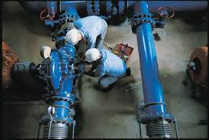
Instead…
Consumers have options besides piped water
They look at the cost of all their options
They consider all substitutes that best meet their interests
The poor especially that have low monetary income prioritize alternatives that don’t require direct payment
Utilities often do compete for their piped service

Slide 6
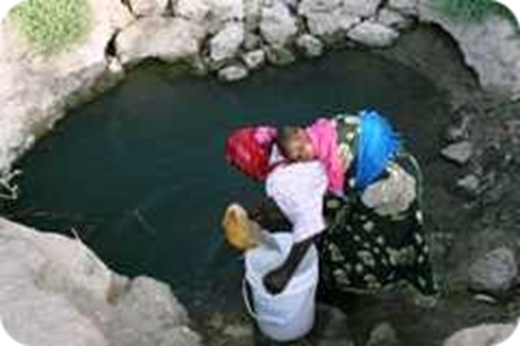
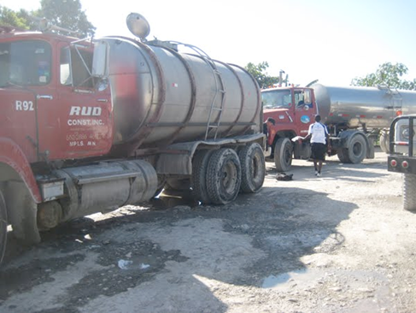
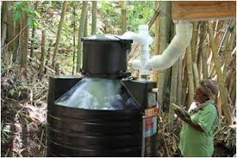
In most developing countries there are many substitutes for piped water
Groundwater/bore holes
Streams and Ponds
Rain Water Tanks
Vendors
Water Kiosks
Bottled Water

Slide 7
What is the Willingness to Pay?
Washing | + | Bathing | + | Sanitation | + | Drinking | = | 100% Daily Need
30L/Day |  | 15L/day |  | 20L/Day |  | 4.5 L/Day |  | 69.5L/day
Streams
Ponds
Rainwater Tanks
Water Kiosks
Bottled Water
Private Vendors
If the consumer pays $10 m3 for drinking water from a vendor and opportunity cost only for the other sources, the daily monetary expense for drinking water is only 4.5 cents. To compete, the utility would need to charge less than 66 cents per m3.

Slide 8
But How Much Less?
Served by Vendor
Served by the Utility
M3 price = $10
Price/liter = US 1 cent
Liters/person/day = 4.5
Liters/month = 135
Monthly Expense = $1.35/person
M3 price = US 66 cents
Price/liter = US .066 cents
Liters/person/day = 66
Liters/month = 2045
Monthly Expense = $1.35/person
=
But…..Given that the substitutes are still available, will the consumer continue to use them at the expense of piped water. The consumer can substantially reduce its monetary expense by adding the piped-in alternative. But does this help the utility? Can it serve customers at such little revenue per household (e.g. Less than or equal to $6.75). OBA subsidies can pay for the connection but what about O&M?

Slide 9
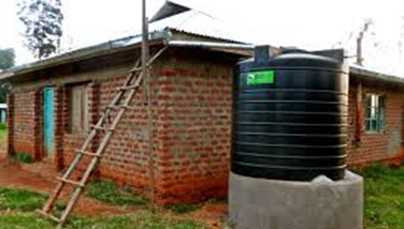
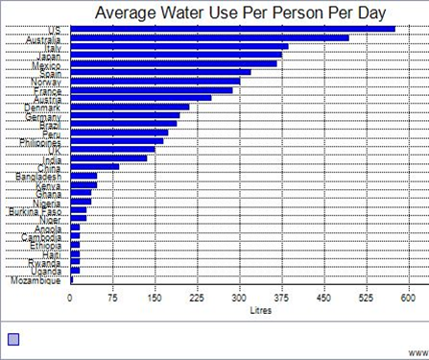
The Utility will fail financially unless it knows its customers well
Understands their consumption behavior and
Aligns its services to meet their needs!

Slide 10
How Do We Find Out What Consumers Want and Their Willingness to Pay?

Slide 11
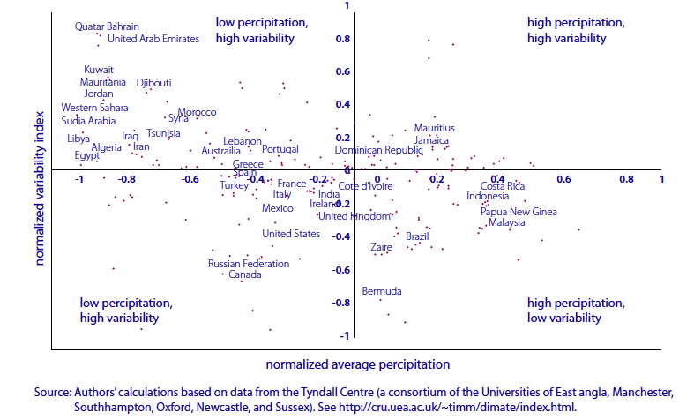
Consumer Characteristics Vary
Notes:
Source, making the most of scarcity, page 38.
Figure 1.2 Unusal combinations of Low Precipitation and High variability in Mena Countries
MENA in top left quadrant. Based on your quadrant, your water source used is determined.
MENA countries have to manage an unusual combination of high variability and low rainfall. Figure 1.2 takes comparable precipitation
and variability data for almost 300 countries and territories across the world, covering a period of 30 years, and plots mean rainfall and mean variability. All MENA countries fall in the quadrant defined by high variability and low rainfall. The numbers require some interpretation. The highest variability is found in the most arid countries, where average rainfall is so low that even modest rainfall can represent a huge variation on the mean, even though it might not pose a significant management challenge. Countries with this level of aridity concentrate on infrastructure that channels runoff when rainfall does occur and dams that store water or encourage aquifer recharge. Countries that depend on water flowing in from other nations (Egypt, Iraq, Syria) may not have high levels of variability on their own territory but do experience the effects of variability in other territories. Variability is a particular challenge in those MENA countries that have just enough rainfall on average but where the patterns are irregular over time or space. While the region has low water availability on average, the quantity of water available varies considerably among countries in the region (figure 1.3). This affects the water management challenge. The source of the water—rainfall, rivers, springs, and groundwater—is also important, as is whether it originates within national boundaries. These factors bring additional management challenges, because each source carries different costs for storage, extraction, and protection. Countries that do not have enough water to grow their own food make up the shortfall through trade.
Net importers of food essentially import the water embedded in those products, a concept known as “virtual water,” which is discussed below. The source of water and the amounts of virtual water (embedded in net
food imports) also vary considerably from country to country (figure 1.4.).
From deleted slide:
Limited piped connections due to affordability, lack of coverage, regulation, land tenure issues
Middle income: Ex. Jakarta
Public piped water as emergency supply if individual supply fails (Jakarta)
Low income
Avoid piped due to high connection fee and monthly bill
Combination: piped few hours during day or during dry season + free water harvesting from roofs during rainy season (small African towns)
Rural
Limited access to safe water
Use alternatives rivers
Streams
Tanks water wells
Vendors
Public health concerns
LOOK AT IBNET FOR % CONNETED AND HOW THEY GET TO THAT NUMBER. LOOK AT INDUSTRY VS HOUSEHOLDS (BATHING, SANITATION, ETC), RURAL VS URBAN.

Slide 12
What Service Do Consumers Want and What They Are Willing to Pay For?
In Ghana, the WTP survey concluded:
Willingness to pay for improved sanitation services is high enough to cover the costs of ventilated pit latrines but not to cover the cost of sewer connections
Your solution should reflect survey results!

Slide 13
Aligning Services to Meet Your Customer Needs
Evaluate survey data
Develop consumer classes
Differentiate services based on consumer class and coverage area
Understand user preferences
Address the needs of the poor
Use results in your planning and operations process
Design appropriate tariff structures
Notes:
The objective of this Module is to train participants in the use of Political Economy Analysis (PEA). The rationale for promoting this type of analysis is because there is no possible reform if key stakeholders are not identified, analyzed and involved into the reform. Obviously, not all stakeholders will be allies for the reform. There are always winners and losers with a reform. Some time, one stakeholder can loose something but can win other thing as consequence of the reform as well. PEA provides with the tools that will allow reformers to understand the context of the reform and then be able to build a coalition for a reform within the water sector.
This module goes through some tools that are used in a PEA:
PEA to understand different perspectives within the water reform.
PEA to recognize different interests from stakeholders: obvious and vested interests.
PEA to do a Stakeholders mapping, where every channel of exertion of power (decision making, cash flow; supervision; capacity to appoint, etc ) is identified.
PEA is presented as a tool to identify and evaluate allies and opponents of the reform.
PEA as an approach to identify essential characteristics from actors that will support the reform: willingness to influence, ability to influence; and energy to support the reform.
PEA as a tool to analyze level of information and channels used by stakeholders.
PEA to analyze Resources managed by stakeholders, specially allies and opponents.
This module will finish with the presentation of the PEA developed in the water sector in Yemen, where the findings of the PEA were used to improved a water operation.

Slide 15
What about Un-Served Communities
Some Characteristics
Can’t pay up-front connection costs
Struggle to pay monthly bills
Increasing block tariffs penalize sharing households
So they tend to be overlooked by utilities

Slide 16
Incorporate Subsidies that are:
Targeted at the poor
Limited
Temporary
Ideal for investments and/or connections
Careful with O&M costs
Notes:
Look for subsidy program in MENA

Slide 17
Empower Community Based Organizations
Government to support capital costs
Donors and NGOs to provide technical and organizational assistance
Community to design, manage and pay for O&M
Link them to formal utilities
Provide small investment finance
Introduce regulation
Eliminate illegal activities
Notes:
Community-driven development - A review of urban water utilities in Latin America and Africa concludes that giving consumers little information about the process of reform and tariff setting—and limiting their opportunity for comment before taking regulatory decisions— weaken the regulatory process and the credibility of reform, and make tariff changes—however justified—difficult to Implement.

Slide 18
In Summary
Give consumers a voice
Neutralize vested interests
Eliminate administrative and legal barriers
Strengthen capacity, autonomy and accountability of providers
Adopt service policies that best balance consumer interests with financial sustainability of the WSP
Overcome physical and technical barriers
Include un-served communities

