Slide 1
2016 Procurement Framework Mandatory Direct Payment & Beneficial Ownership
Private Sector seminar
April 2018

Slide 2
Regulatory Framework
Articles of Agreement IBRD & IDA
Policy: Core Procurement Principles
Procurement Regulations
Standard Procurement Documents

Slide 3
Mandatory Direct Payment

Slide 4
Background
Increased concern that payment risks are affecting competition
Bank’s commitment to continue supporting effective procurement by improving the participation of contractors, suppliers, consultants (regardless their nationalities)
The Bank launched a mandatory Direct Payment Pilot as part of a broader effort to foster competition in particularly difficult environments and will be monitored and evaluated for its effectiveness

Slide 5
Scope of the Pilot
Pilot applies to IPF projects under preparation, which meet the following criteria:
financed under IDA18, and
triggers paragraph 12 of Section III of the IPF Policy (fragile and conflict-affected states/situations and small states - FCS) and
the Decision Review is held on or after November 1, 2017
Borrowers will not have a choice of disbursement method. Unless the Special Commitment disbursement method is used, borrowers are required to use the Direct Payment method for disbursement under contracts for goods, works, or non-consulting services and consulting services procured/ or selected through international (open or limited) competition or Direct Selection

Slide 6
Which selection methods are subject to this Pilot?
All approaching the international market (with open or limited competition) and direct selection
In addition, considering that the objective of the pilot is to improve the participation of contractors, suppliers, consultants (regardless their nationalities), it is expected that the decision on whether this Pilot also covers Direct Selection awards to national firms and individuals should be made taking into account specific risks for payment associated with low-capacity environment, governance issues, etc. The procurement plan shall reflect these decisions

Slide 7
Pilot Coverage
Approach facilitates monitoring and management of unexpected consequences
Hands on Expanded Implementation Support (HEIS) is available to borrowers in fragile and conflict-affected states/situations and small states
Through HEIS, the Bank may help borrowers to advance procurement

Slide 8
Operationalization and M&E
Changes/updates to:
Disbursement and Financial Information Letter (DFIL)
IPF Instructions for the preparation of FCS projects and Additional Financing Processing Instructions for IPF
Guidance on preparing Minutes of Negotiation
Standard Procurement Documents (SPDs)
An M&E framework has been designed to monitor progress of the pilot
Around the same principles of (and will be integrated with) the overall M&E framework of the Procurement Framework
Quantitative and qualitative data will be collected to monitor performance and to identify factors that may have a positive or negative impact on success

Slide 9
Beneficial Ownership

Slide 10
Background
Increased demand for transparency in World Bank-IPF procurement
Bank SPDs requires bidders to identify general B/O related information:
identity (name, legal form and proof of existence), organization chart, board of directors
Tracking B/O is new to public procurement and there is no international consensus yet
Extensive consultations with other MDBs and stakeholders, among others: Financial Action Task Force (FATF), DFID, Open Contracting Partnership, Open Corporates, Transparency International
Jurisdictions reviewed include the US, UK, EU, etc.
The Bank is at the forefront of developing this approach

Slide 11
B/O Pilot
A three-year pilot including all projects with decision to appraise held on or after November 1, 2017
The winning bidder -over the OPRC thresholds- is required to identify the Beneficial Owner before contract signing using a B/O Disclosure Form
Beneficial Owner is any natural person who ultimately owns or controls the bidder by meeting one or more of the following conditions:
directly or indirectly holding 25% or more of the shares;
directly or indirectly holding 25% or more of the voting rights;
directly or indirectly having the right to appoint a majority of the board of directors or equivalent governing body of the bidder

Slide 12
B/O Pilot
Winning bidders have three options (see the B/O Disclosure Form):
Provide the beneficial ownership information meeting the above conditions; or
Declare that there is no Beneficial Owner meeting one or more of the above conditions; or
Declare that we are unable to identify any Beneficial Owner meeting one or more of the above conditions. If this option is selected, the Bidder shall provide explanation why it is unable to identify Beneficial Owners
In the event that the Bidder is a joint venture, each reference to “Bidder” in the Beneficial Ownership Disclosure Form (including this Introduction thereto) shall be read to refer to the joint venture member

Slide 13
B/O Pilot
Decision on responsiveness made on case-by-case basis
B/O information will not be routinely verified, but will be available for verification when warranted (e.g. integrity red flags) and
Misrepresentation may trigger sanctions (i.e. fraud)
Borrowers will publish the completed template with its contract award information on its own website and the Bank’s website/system

Slide 14
Operationalization
Revisions to the Procurement Regulations for IPF Borrowers
Revisions to the Standard Procurement Documents (SPDs):
Adding a specific clause requiring the winning bidder to provide more detailed B/O information
Beneficial Ownership disclosure form (template)
Update STEP (ongoing process)
Integration of B/O concept into internal/external training
Cooperation with other MDBs and stakeholders

Slide 15
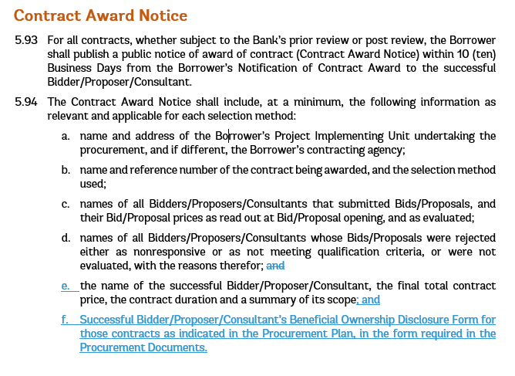
Operationalization: Revision of the Regulations (July 2016, Revised in November 2017)
Beneficial Ownership
Others
Editorial enhancements

Slide 16
Operationalization: Revision of the SPDs
Beneficial Ownership
For contracts identified in the Procurement Plan
SPN requires the Borrower to disclose successful bidder’s B/O information with the Contract Award Notice
ITB clause requires the winning bidder to provide more detailed B/O information
Bidder Information Form: revised to include the need for additional information on B/O using the Beneficial Ownership Disclosure Form
Letter of Acceptance; requires additional information on B/O to be submitted by successful bidder within 8 Business days
Beneficial Ownership Disclosure Form (template) included in SPDs
Contract Award Notice publication includes the Beneficial Ownership Disclosure Form within 10 business days after issuance of Letter of Acceptance

Slide 17
Operationalization: B/O Disclosure Form

Slide 18
Monitoring & Evaluation Framework
M&E framework to identify factors that have a positive and negative impact on the objectives of the pilot:
Data will be directly collected by OPCS
Management will learn through the process (i.e. cases of no responsiveness), and experience applying the pilot may be useful in re-defining the future scope of the B/O program

Slide 19
B/O Pilot… WHAT IS NOT/ does not cover
The Pilot is not an Anti-corruption but a pro-governance instrument but… if B/O information is misrepresented, this could be considered as a non-compliance, and reported to Integrity VP
The Pilot is not an Eligibility test or post qualification requirement
The Pilot is not an administrative process prior contract award (mandatory verification)
The Pilot does not cover/target Politically Exposed Persons (PEPs)

Slide 20
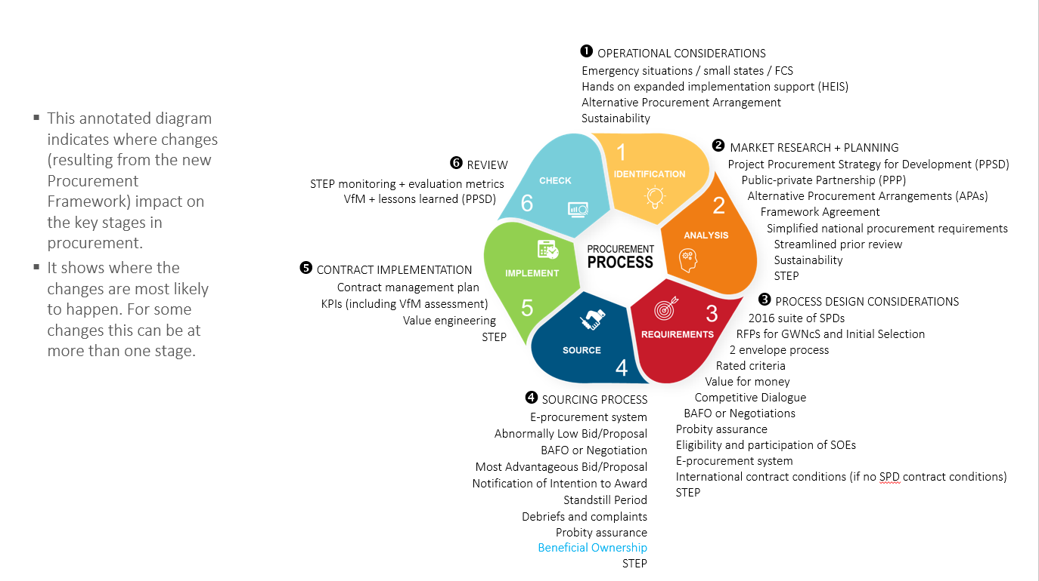
Key stages in Procurement and B/O

Slide 21
Questions

Slide 22
Contact for World Bank Procurement Framework:
Enzo de Laurentiis Diomedes Berroa
Chief Procurement Officer Lead Procurement Specialist
Elaurentiis@worldbank.org dberroa@worldbank.org
Tel: +1-202-473-0538 Tel: +1-202 458-9432
World Bank Group
1818 H Street NW
Mail Stop MC 10-1018
Washington DC 20433
USA
Procurement Website

