Slide 1
Public Procurement in The Maldives
Ahmed Mujuthaba
National Tender- Ministry of Finance
6th South Asia Region Public Procurement Conference:

Slide 2
Key parts of the presentation
Introduction and quick facts –Maldives
Legislative and institutional framework
Current practices on procurement
e-GP readiness and implementation status
Recent developments in Public Procurements
Contract Management
Public Procurement Professionalization and capacity development
One-year action plan

Slide 3
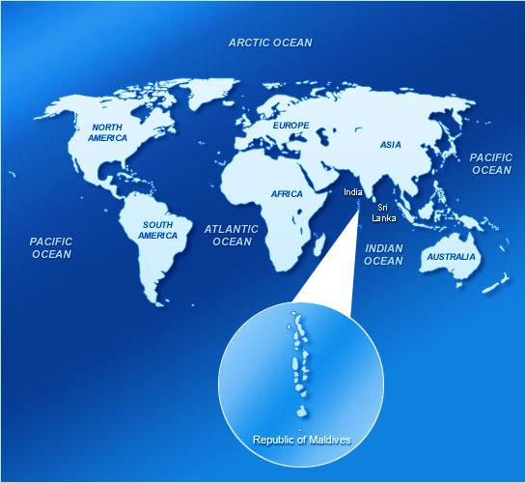
MALDIVES – Quick Facts
Land Area – approximately 300 km² (1190 Islands- 185 are inhabited)
Population – approximately 0.4 million
Main Industries – Tourism, Fishing, Construction
Currency – Maldivian Rufiyaa (MVR)
Per Capita GDP (nominal GDP)
– USD 10,449 (2018)

Slide 4
Legal Framework
Public Finance Law- Law No. 3/2006
Passed by the parliament
Public Finance Regulation
(Chapter 10)
Issued by Ministry of Finance
SBD, Guidelines, Manuals
Issued by NT
Covers public expenditure

Slide 5
What Do the regulations apply to?
All procurement by government agencies using public money
Public enterprises are not covered
Exceptions for;
Defense or national security
Grants/credits where donor rules apply
Private financing and concessions

Slide 6
Institutional Framework- Who does what
Ministry of Finance and Treasury
NATIONAL TENDER
Other Government Agencies
Over MVR 2.5 million
Less than MVR 2.5 million
Procurement policy
Regulations
Oversights

Slide 7
e-GP readiness & implementation status
Regulation has been changed to accommodate e-GP in the public sector
Readiness assessment has been done
Public procurement portal has been launched

Slide 8
Recent Developments in Procurement
Bandeyri Portal
Beelan Portal
Contract Management Portal
SAP- all procurements are capture on timely manner in SAP

Slide 9
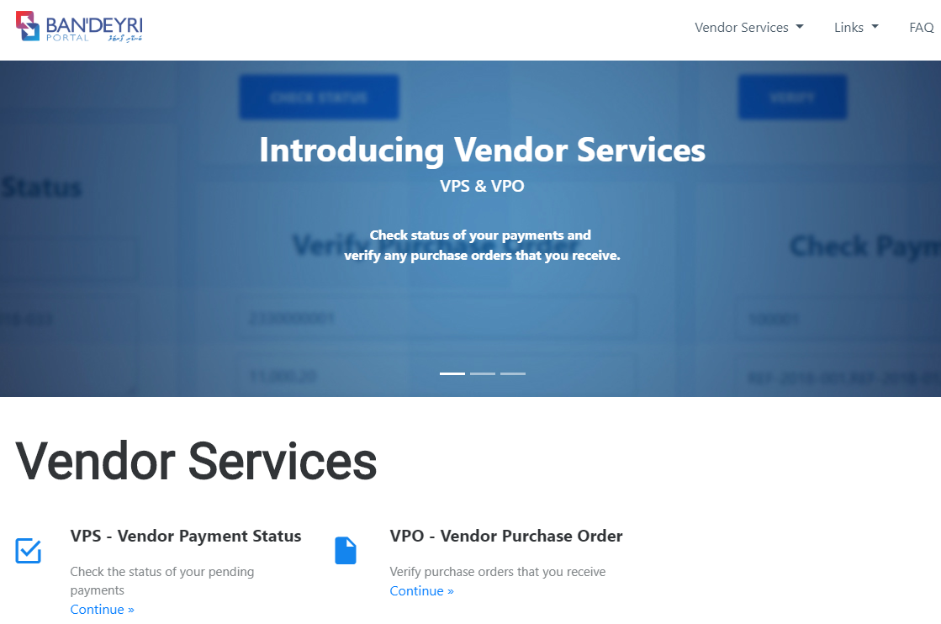
Recent Developments in Procurement (cont..)
Ban’deyri Portal
Government Agencies
Tender request
Variations
Budget requests
Travel requests
Internal travel arrangements
Contractors/Suppliers
Purchase Order Status
Payment status

Slide 10
Recent Developments in Procurement (cont..)
Beelan Portal
Provides publication of tender notices of all govt. agencies, up to date information on contract awards, up to date and relevant information of procurement regulation and guidelines.
Moreover, contractors/suppliers shall be;
able to register to participate in tenders
able get notifications and alerts on New Tenders
able get notification and alerts on documentation updates on registered tenders.
able to keep track of upcoming deadlines through alerts

Slide 11
Contract Management
All gov. PSIP ( including foreign funded projects) contracts
Variation
Scope changes
Disbursements
Contract progress ( component vice)

Slide 12
PROFESSIONALIZATION OF PUBLIC PROCUMENT FOR BETER PERFORMANCE
South Asia Region Public Procument Conference
Thimpu, Bhutan
22- 24 April 2019

Slide 13
Civil Service Training Institute
CIVIL SERVICE COMMISSION
The Civil Service Commission with its inception in 2007 through an act of parliament, took over the challenging task of establishing a modern professional Civil Service in the Maldives. Today the Maldives Civil Service is firmly in place and is working as the most important driving force of the government policy and democratic governance in the Maldives.
CIVIL SERVICE TRAINING INSTITUTE
Established in 2009, Civil Service Training Institute is the sole training provider catering for civil servants of Maldives. Envision to be a training and development institute of international standards, leading to the development of a modern, world-class civil service for the Maldives.

Slide 14
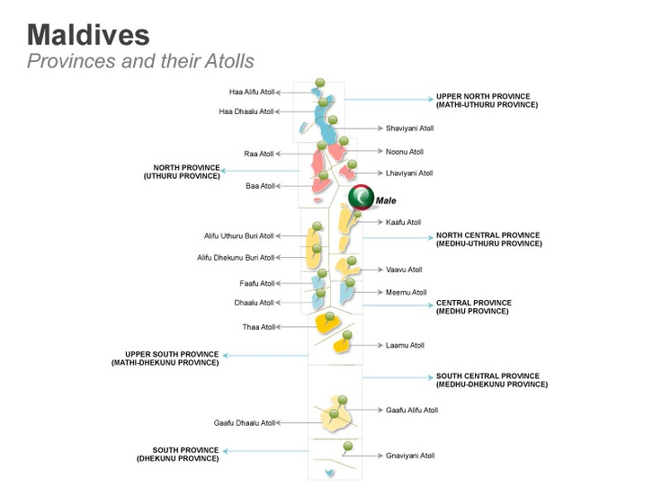
Maldives Civil Service
24516

Slide 15
Capacity Building Needs of Civil Servants in Maldives
All training initiatives are compiled based on an annual Training Needs Analysis conducted by CSTI.
Good Governance Department
Human Resource Management and Development Department
Economic Analysis and Financial Management Department
In average CSTI train
3000- 5000 employees per year
ICT & Innovation Department
Language and Communication Department
Personal Development Department
SHORT-TERM TRAINING PROGRAMS

Slide 16
MAJOR TRAINING PROGRAMS
Certificate Level
Pre-Diploma
Diploma Level
Certificate III in Office Administration
Certificate III in Project Management
Certificate III in Accounting and Financial Administration
Certificate III in ICT Management
NEW * Certificate III in Public Procurement
University Preparation Program
English Language Proficiency for Executives
Diploma in Public Administration and Management

Slide 17
2016 – 2017 started online public procurement programs 247 enrolled
STATISTICS OF PROCUMENT RELATED TRAINING PROGRAMS CONDUCTED AT CSTI (2017 – 2019)
2019
Program name | No. of Participants
Public Procurement | 63
Financial Management | 11
Public Procurement (Online) | 239
Bid evaluation and procurement | 25
Total | 338
2018
In addition to online programs, there were few programs on public procurements.
139 trained

Slide 18
Action Plan on Procurement Professionalization and Capacity building
Q1 | Q2 | Q3 | Q4
Short term training programs on Public procurement based on TNA (training completion certificate)
Virtual session on Public procurement for Atoll staff
Module development - customised training program for Atolls | Delivering customised training program to all the procurement and financial executives in atolls
Developing C111 in Public procurement program (professionalization ) |  | MQA process to accredit the program | Start the program in collaboration with Finance Institute

Slide 19
Thank You

